Slide 1
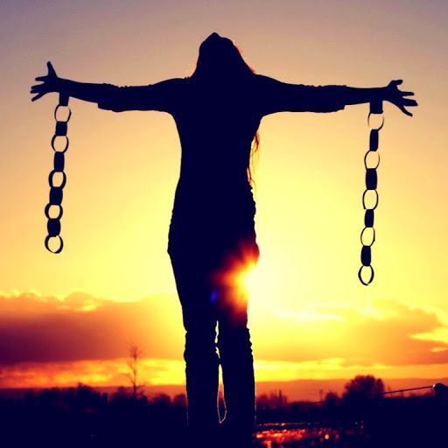
January 28, 2024
WELCOME!
Trinity Lutheran Church
Notes:
Image: Five Loaves by Caroline Coolidge Brown. Copyright © Caroline Coolidge Brown. All rights reserved. Used by permission of the artist.

Slide 2
= Please stand if able
= Please be seated
Prelude - By Roxanne Groff
Office of the Acolyte
Ringing of the Bell
Welcome

Slide 3
THANKSGIVING FOR BAPTISM
All may make the sign of the cross, the sign marked at baptism, as the presiding minister begins.
P: Blessed be the holy Trinity, ☩ one God, the fountain of living water, the rock who gave us birth, our light and our salvation.
C: Amen.
Notes:
Image: Preparing yeast dough. Copyright © tomasworks/iStock/Thinkstock. Used by permission.

Slide 4
P: Joined to Christ in the waters of baptism, we are clothed with God's mercy and forgiveness. Let us give thanks for the gift of baptism. Water may be poured into the font as the presiding minister gives thanks.
THANKSGIVING FOR BAPTISM
Notes:
Image: Preparing yeast dough. Copyright © tomasworks/iStock/Thinkstock. Used by permission.

Slide 5
P: We give you thanks, O God, for in the beginning your Spirit moved over the waters and by your Word you created the world, calling forth life in which you took delight. Through the waters of the flood you delivered Noah and his family. Through the sea you led your people Israel from slavery into freedom.
THANKSGIVING FOR BAPTISM
Notes:
Image: Preparing yeast dough. Copyright © tomasworks/iStock/Thinkstock. Used by permission.

Slide 6
P: At the river your Son was baptized by John and anointed with the Holy Spirit. By water and your Word you claim us as daughters and sons, making us heirs of your promise and servants of all. We praise you for the gift of water that sustains life, and above all we praise you for the gift of new life in Jesus Christ.
THANKSGIVING FOR BAPTISM
Notes:
Image: Preparing yeast dough. Copyright © tomasworks/iStock/Thinkstock. Used by permission.

Slide 7
P: Shower us with your Spirit, and renew our lives with your forgiveness, grace, and love. To you be given honor and praise through Jesus Christ our Lord in the unity of the Holy Spirit, now and forever.
THANKSGIVING FOR BAPTISM
C: Amen.
Notes:
Image: Preparing yeast dough. Copyright © tomasworks/iStock/Thinkstock. Used by permission.

Slide 8
CONFESSION AND FORGIVENESS
All may make the sign of the cross, the sign marked at baptism…
L: We confess our sins before God and one another.
Pause for silence and reflection.
L: Guiding God,
Notes:
Image: Five Loaves by Caroline Coolidge Brown. Copyright © Caroline Coolidge Brown. All rights reserved. Used by permission of the artist.

Slide 9
CONFESSION AND FORGIVENESS
C: We have failed to follow you as we ought. We have not reached out to our neighbors with the selfless and sacrificial love you modeled for us. We have caused harm to others and your creation by our actions and by our unwillingness to act.
Notes:
Image: Five Loaves by Caroline Coolidge Brown. Copyright © Caroline Coolidge Brown. All rights reserved. Used by permission of the artist.

Slide 10
CONFESSION AND FORGIVENESS
C: Forgive us our sins and lead us back onto the path you have trod for the sake of others.
Notes:
Image: Five Loaves by Caroline Coolidge Brown. Copyright © Caroline Coolidge Brown. All rights reserved. Used by permission of the artist.

Slide 11
CONFESSION AND FORGIVENESS
L: In Christ, God meets us where we are and as we are and for his sake, God makes us whole and holy. ☩ Go forth to follow Jesus in the knowledge that your sins are forgiven.
C: Amen.
Notes:
Image: Five Loaves by Caroline Coolidge Brown. Copyright © Caroline Coolidge Brown. All rights reserved. Used by permission of the artist.

Slide 12
Gathering Song/Hymn of Praise
“Take My Life, That I May Be”
LBW 406

Slide 13
“Take My Life, That I May Be” LBW 406
1 Take my life, that I may be
consecrated, Lord, to thee;
take my moments and my days;
let them flow in ceaseless praise.
2 Take my hands and let them move
at the impulse of thy love;
take my feet and let them be
swift and beautiful for thee.
Notes:
Image: Five Loaves by Caroline Coolidge Brown. Copyright © Caroline Coolidge Brown. All rights reserved. Used by permission of the artist.

Slide 14
“Take My Life, That I May Be” LBW 406
3 Take my voice and let me sing
always, only, for my King;
take my lips and let them be
filled with messages from thee.
4 Take my silver and my gold,
not a mite would I withhold;
take my intellect and use
ev'ry pow'r as thou shall choose.
Notes:
Image: Five Loaves by Caroline Coolidge Brown. Copyright © Caroline Coolidge Brown. All rights reserved. Used by permission of the artist.

Slide 15
“Take My Life, That I May Be” LBW 406
5 Take my will and make it thine,
it shall be no longer mine.
Take my heart, it is thine own,
it shall be thy royal throne.
6 Take my love; my Lord, I pour
at thy feet its treasure store;
take myself, and I will be
ever, only, all for thee.
Notes:
Image: Five Loaves by Caroline Coolidge Brown. Copyright © Caroline Coolidge Brown. All rights reserved. Used by permission of the artist.

Slide 16
APOSTOLIC GREETING
P: The grace of our Lord Jesus Christ, the love of God, and the communion of the Holy Spirit be with you all.
C: And also with you.
Notes:
Image: Five Loaves by Caroline Coolidge Brown. Copyright © Caroline Coolidge Brown. All rights reserved. Used by permission of the artist.

Slide 17
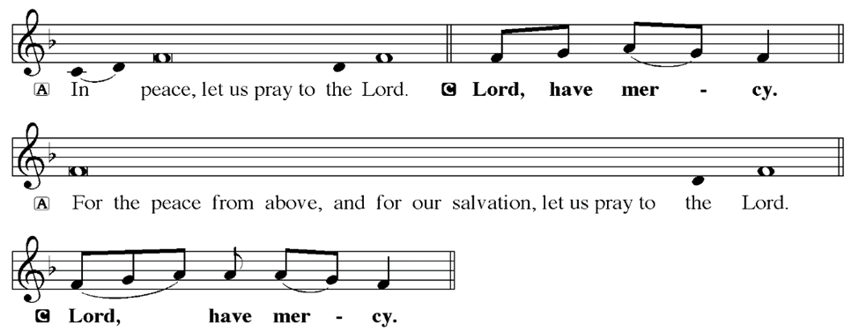
KYRIE
Notes:
Image: Five Loaves by Caroline Coolidge Brown. Copyright © Caroline Coolidge Brown. All rights reserved. Used by permission of the artist.

Slide 18
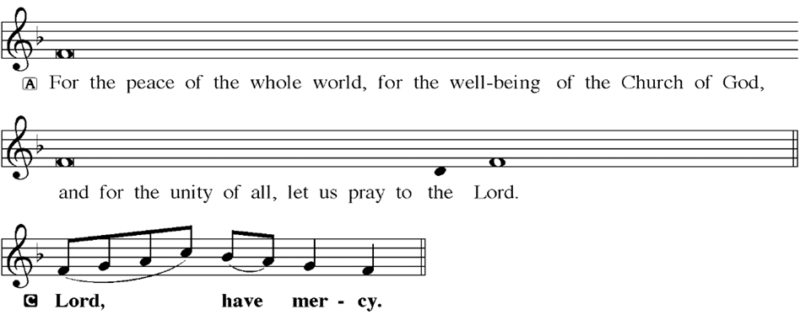
KYRIE
Notes:
Image: Five Loaves by Caroline Coolidge Brown. Copyright © Caroline Coolidge Brown. All rights reserved. Used by permission of the artist.

Slide 19
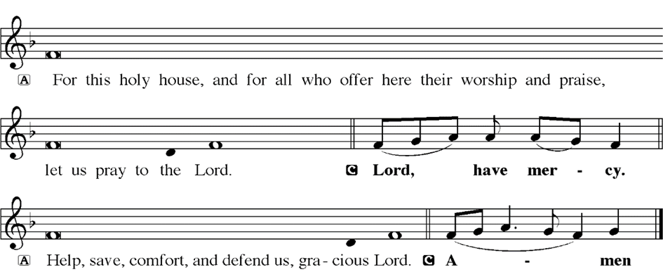
KYRIE
Notes:
Image: Five Loaves by Caroline Coolidge Brown. Copyright © Caroline Coolidge Brown. All rights reserved. Used by permission of the artist.

Slide 20
HYMN OF PRAISE
Glory be to God in heaven;
peace, goodwill to all the earth.
Mighty God of all creation,
Father of surpassing worth:
we exalt you, we adore you,
we lift high our thanks and praise.
Saints and angels bow before you; here on earth our songs we raise.
Notes:
Image: Five Loaves by Caroline Coolidge Brown. Copyright © Caroline Coolidge Brown. All rights reserved. Used by permission of the artist.

Slide 21
HYMN OF PRAISE
Glory be to Christ forever,
Lamb of God and Lord of love.
Son of God and gracious Savior, you have come from heav’n above;
on the cross you died to save us; now you reign at God’s right hand.
Hear our prayer; restore, forgive us; in your promise firm we stand.
Notes:
Image: Five Loaves by Caroline Coolidge Brown. Copyright © Caroline Coolidge Brown. All rights reserved. Used by permission of the artist.

Slide 22
HYMN OF PRAISE
Holy One we now acclaim you;
Lord alone, to you we call;
Holy One in faith we name you,
God most high, yet near to all:
Jesus Christ, with God the Spirit,
in the Father’s splendor bright.
For the peace that we inherit,
glory be to God on high!
Notes:
Image: Five Loaves by Caroline Coolidge Brown. Copyright © Caroline Coolidge Brown. All rights reserved. Used by permission of the artist.

Slide 23
PRAYER OF THE DAY
P: Let us pray… Faithful God, your steadfast love endures forever, through all generations. Inspire us through your word to share this love with our neighbors near and far. In Jesus’ name we pray.
C: Amen
Notes:
Image: Five Loaves by Caroline Coolidge Brown. Copyright © Caroline Coolidge Brown. All rights reserved. Used by permission of the artist.

Slide 24
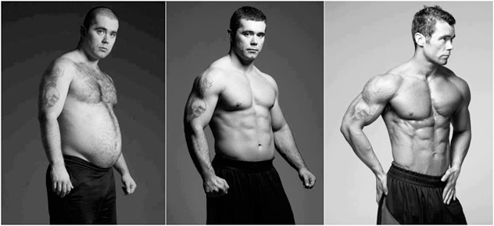
Extreme Makeover
Before and After
Notes:
Image: Five Loaves by Caroline Coolidge Brown. Copyright © Caroline Coolidge Brown. All rights reserved. Used by permission of the artist.

Slide 25
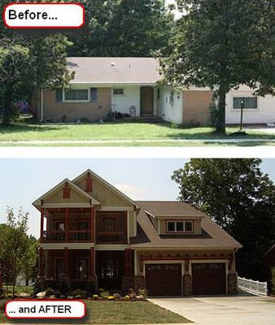
Extreme
Makeover
Home Edition
Notes:
Image: Five Loaves by Caroline Coolidge Brown. Copyright © Caroline Coolidge Brown. All rights reserved. Used by permission of the artist.

Slide 26
Scripture Reading
L: Our scripture reading for this day is from the Gospel of Mark, the 5th Chapter.
C: Glory to you O’ Lord!
Notes:
Image: Five Loaves by Caroline Coolidge Brown. Copyright © Caroline Coolidge Brown. All rights reserved. Used by permission of the artist.

Slide 27
Mark 5:1-20
They came to the other side of the sea, to the country of the Gerasenes. ² And when he had stepped out of the boat, immediately a man out of the tombs with an unclean spirit met him. ³ He lived among the tombs; and no one could restrain him any more, even with a chain; ⁴ for he had often been restrained with shackles and chains, but the chains he wrenched apart, and
Notes:
Image: Five Loaves by Caroline Coolidge Brown. Copyright © Caroline Coolidge Brown. All rights reserved. Used by permission of the artist.

Slide 28
Mark 5:1-20
the shackles he broke in pieces; and no one had the strength to subdue him. ⁵ Night and day among the tombs and on the mountains he was always howling and bruising himself with stones. ⁶ When he saw Jesus from a distance, he ran and bowed down before him; ⁷ and he shouted at the top of his voice, “What have you to do with me, Jesus, Son of the Most High God?
Notes:
Image: Five Loaves by Caroline Coolidge Brown. Copyright © Caroline Coolidge Brown. All rights reserved. Used by permission of the artist.

Slide 29
Mark 5:1-20
I adjure you by God, do not torment me.” ⁸ For he had said to him, “Come out of the man, you unclean spirit!” ⁹ Then Jesus asked him, “What is your name?” He replied, “My name is Legion; for we are many.” ¹⁰ He begged him earnestly not to send them out of the country. ¹¹ Now there on the hillside a great herd of swine was feeding; ¹² and the unclean spirits
Notes:
Image: Five Loaves by Caroline Coolidge Brown. Copyright © Caroline Coolidge Brown. All rights reserved. Used by permission of the artist.

Slide 30
Mark 5:1-20
begged him, “Send us into the swine; let us enter them.” ¹³ So he gave them permission. And the unclean spirits came out and entered the swine; and the herd, numbering about two thousand, rushed down the steep bank into the sea, and were drowned in the sea.
¹⁴ The swineherds ran off and told it in the city and in the country. Then
Notes:
Image: Five Loaves by Caroline Coolidge Brown. Copyright © Caroline Coolidge Brown. All rights reserved. Used by permission of the artist.

Slide 31
Mark 5:1-20
people came to see what it was that had happened. ¹⁵ They came to Jesus and saw the demoniac sitting there, clothed and in his right mind, the very man who had had the legion; and they were afraid. ¹⁶ Those who had seen what had happened to the demoniac and to the swine reported it. ¹⁷ Then they began to beg Jesus to leave their neighborhood. ¹⁸ As he was getting
Notes:
Image: Five Loaves by Caroline Coolidge Brown. Copyright © Caroline Coolidge Brown. All rights reserved. Used by permission of the artist.

Slide 32
Mark 5:1-20
into the boat, the man who had been possessed by demons begged him that he might be with him. ¹⁹ But Jesus refused, and said to him, “Go home to your friends, and tell them how much the Lord has done for you, and what mercy he has shown you.” ²⁰ And he went away and began to proclaim in the Decapolis how much Jesus had done for him; and everyone was amazed.
Notes:
Image: Five Loaves by Caroline Coolidge Brown. Copyright © Caroline Coolidge Brown. All rights reserved. Used by permission of the artist.

Slide 33
Mark 5:1-20
R: This is the Word of the Lord.
C: Praise to You, O Christ
Notes:
Image: Five Loaves by Caroline Coolidge Brown. Copyright © Caroline Coolidge Brown. All rights reserved. Used by permission of the artist.

Slide 34
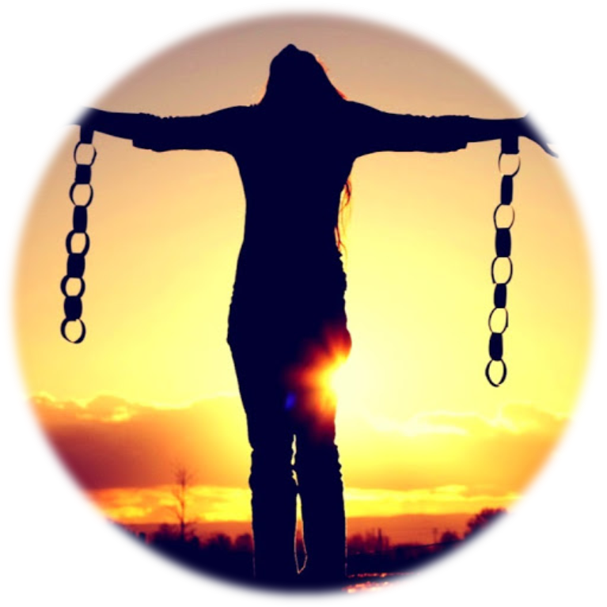
Sermon

Slide 35
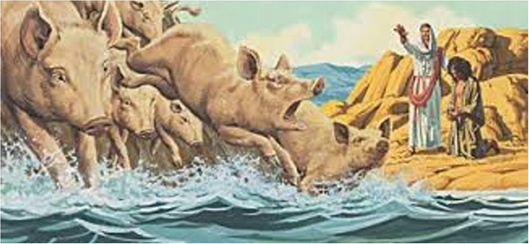
Sermon

Slide 36
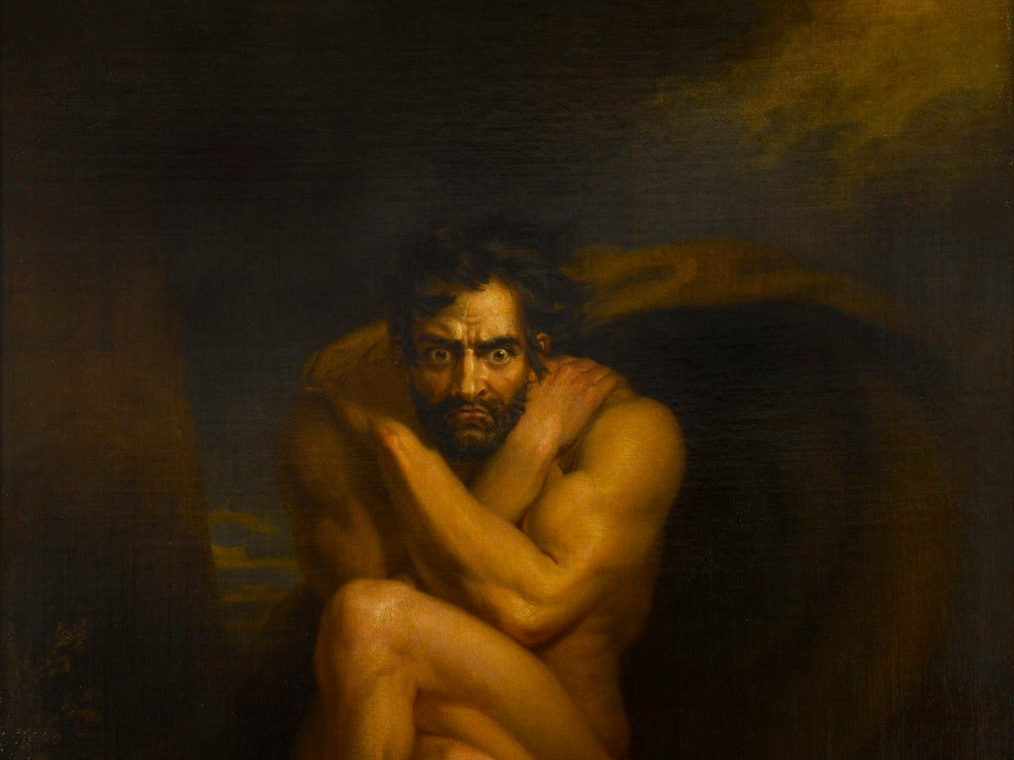
Sermon

Slide 37
Come, Lord Jesus.
Heal me, heal us, heal our world… Amen.

Slide 38
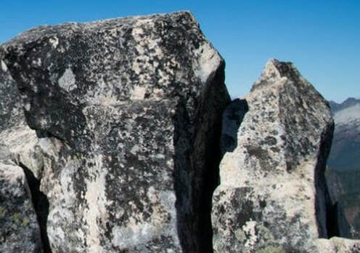
HYMN OF THE DAY
“Rock of Ages, Cleft for Me”
LBW 327

Slide 39
“Rock of Ages” LBW 327
1 Rock of Ages, cleft for me,
let me hide myself in thee;
let the water and the blood,
from thy riven side which flowed,
be of sin the double cure;
cleanse me from its guilt and pow'r.

Slide 40
“Rock of Ages” LBW 327
2 Not the labors of my hands
can fulfill thy law's demands;
could my zeal no respite know,
could my tears forever flow,
all for sin could not atone;
thou must save, and thou alone.

Slide 41
“Rock of Ages” LBW 327
3 Nothing in my hand I bring;
simply to thy cross I cling.
Naked, come to thee for dress;
helpless, look to thee for grace;
foul, I to the fountain fly;
wash me, Savior, or I die.

Slide 42
“Rock of Ages” LBW 327
4 While I draw this fleeting breath,
when mine eyelids close in death,
when I soar to worlds unknown,
see thee on thy judgment throne,
Rock of Ages, cleft for me,
let me hide myself in thee.

Slide 43
APOSTLE’S CREED
C: I believe in God, the Father almighty, creator of heaven and earth.

Slide 44
APOSTLE’S CREED
C: I believe in Jesus Christ, his only Son, our Lord. He was conceived by the power of the Holy Spirit and born of the virgin Mary. He suffered under Pontius Pilate, was crucified, died, and was buried.

Slide 45
APOSTLE’S CREED
C: He descended into hell. On the third day he rose again. He ascended into heaven, and is seated at the right hand of the Father. He will come again to judge the living and the dead.

Slide 46
APOSTLE’S CREED
C: I believe in the Holy Spirit, the holy catholic Church, the communion of saints, the forgiveness of sins, the resurrection of the body, and the life everlasting. Amen.

Slide 47
NICENE CREED
C: We believe in one God, the Father, the Almighty, maker of heaven and earth, of all that is, seen and unseen.

Slide 48
NICENE CREED
C: We believe in one Lord, Jesus Christ, the only Son of God, eternally begotten of the Father, God from God, Light from Light, true God from true God, begotten, not made, of one Being with the Father.

Slide 49
NICENE CREED
C: Through him all things were made. For us and for our salvation he came down from heaven; by the power of the Holy Spirit he became incarnate from the virgin Mary, and was made man. For our sake he was crucified under Pontius Pilate;

Slide 50
NICENE CREED
C: he suffered death and was buried. On the third day he rose again in accordance with the Scriptures; he ascended into heaven and is seated at the right hand of the Father. He will come again in glory to judge the living and the dead, and his kingdom will have no end.

Slide 51
NICENE CREED
C: We believe in the Holy Spirit, the Lord, the giver of life, who proceeds from the Father and the Son. With the Father and the Son he is worshiped and glorified. He has spoken through the prophets. We believe in one holy catholic and apostolic Church.

Slide 52
NICENE CREED
C: We acknowledge one Baptism for the forgiveness of sins. We look for the resurrection of the dead, and the life of the world to come. Amen.

Slide 53
QUILT TYING AND PRESENTATION
This Quilt was lovingly crafted for recovery and healing especially for XXX.
Let us pray…

Slide 54
PRAYERS OF INTERCESSION
Each petition will end with the words,
A: God our teacher and healer,
The congregation will respond with:
C: In mercy, hear our prayer.

Slide 55
PRAYERS OF INTERCESSION
The prayer concludes…
P: Confident that in Christ Jesus you answer prayer, we lift to you all for whom pray, aloud and in our hearts, through Jesus Christ, our savior.
C: Amen.

Slide 56
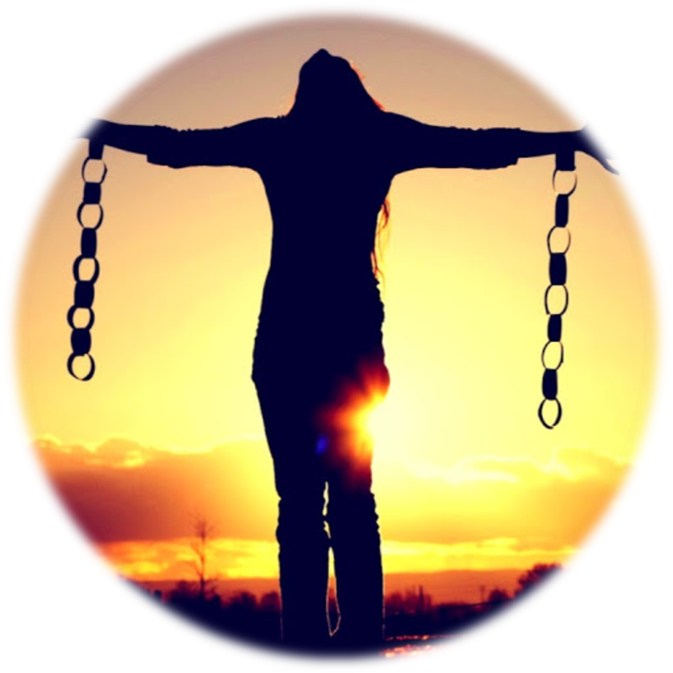
OFFERING
Notes:
Image: Five Loaves by Caroline Coolidge Brown. Copyright © Caroline Coolidge Brown. All rights reserved. Used by permission of the artist.

Slide 57
OFFERING PRAYER
Notes:
Image: Five Loaves by Caroline Coolidge Brown. Copyright © Caroline Coolidge Brown. All rights reserved. Used by permission of the artist.

Slide 58
THE GREAT THANKSGIVING
All the Baptized are welcome to celebrate this Holy Meal.

Slide 59
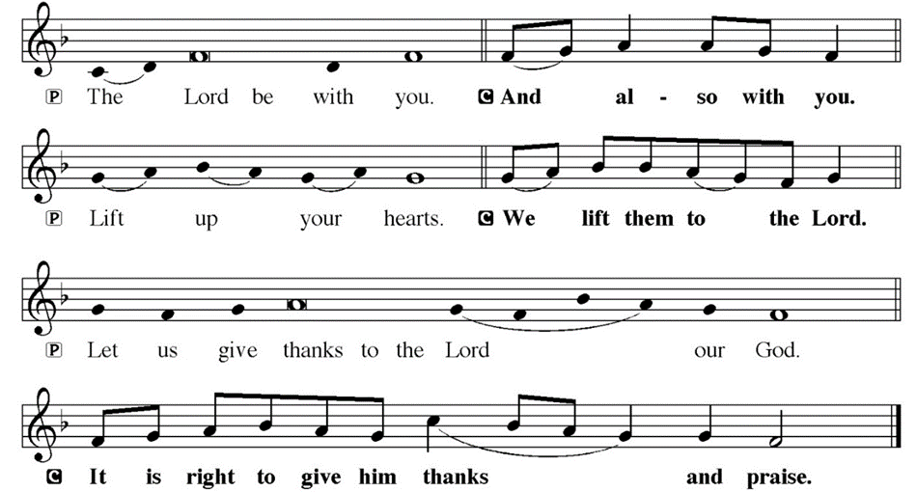
DIALOGUE

Slide 60
THE PREFACE
P: It is indeed right and salutary…
… we praise your name and join their unending hymn.

Slide 61
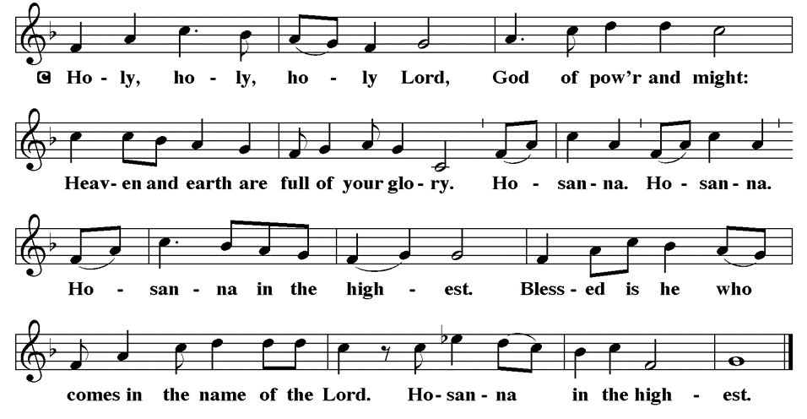
THE SANCTUS

Slide 62
EUCHARISTIC PRAYER
P: Holy God…
…both now and forever.
C: Amen.

Slide 63
THE LORD’S PRAYER
C: Our Father, who art in heaven, hallowed be thy name, thy kingdom come, thy will be done, on earth as it is in heaven. Give us this day our daily bread; and forgive us our trespasses, as we forgive those who trespass against us; and lead us not into temptation, but deliver us from evil.

Slide 64
THE LORD’S PRAYER
C: For thine is the kingdom, and the power, and the glory, forever and ever. Amen.

Slide 65
INVITATION TO COMMUNION
P: Jesus who will never leave us now invites us to the table to share in the feast of life. Come and dine, for all is prepared for you.

Slide 66
COMMUNION DISTRIBUTION
All will commune “By Station”.
The bread may be broken for distribution. As the ministers give the bread and wine, they say these words :
The body of Christ, given for you.
The blood of Christ, shed for you.
The communicant may say: Amen.

Slide 67
POST COMMUNION BLESSING
P: May this body and blood of our Lord and Savior, Jesus Christ, strengthen, keep, and unity us, ☩ now and forever,
C: Amen.

Slide 68
POST COMMUNION CANTACLE

Slide 69
POST COMMUNION CANTACLE

Slide 70
POST COMMUNION PRAYER
P: Let us pray… Blessed be your name, O God, for we have feasted on your Word, Christ Jesus, the joy and delight of our hearts. Strengthened by this food, send us to gather the world to your banquet, where none are left out and all are satisfied. In Jesus’ name we pray.
C: Amen

Slide 71
ANNOUNCEMENTS
Notes:
Image: Five Loaves by Caroline Coolidge Brown. Copyright © Caroline Coolidge Brown. All rights reserved. Used by permission of the artist.

Slide 72
SENDING BLESSING
P: God who names you, Christ who claims you, and the Holy Spirit who dwells in you, ☩ bless you and remain with you always.
C: Amen.

Slide 73
Sending Song
“Oh, For A Thousand Tongues to Sing”
LBW 559
Notes:
Image: Five Loaves by Caroline Coolidge Brown. Copyright © Caroline Coolidge Brown. All rights reserved. Used by permission of the artist.

Slide 74
“Oh, For A Thousand Tongues to Sing” LBW 559
1 Oh, for a thousand tongues to sing
my great Redeemer’s praise,
the glories of my God and King,
the triumphs of his grace!
2 My gracious Master and my God,
assist me to proclaim,
to spread through all the earth abroad
the honors of your name.
Notes:
Image: Preparing yeast dough. Copyright © tomasworks/iStock/Thinkstock. Used by permission.

Slide 75
“Oh, For A Thousand Tongues to Sing” LBW 559
3 The name of Jesus charms our fears
and bids our sorrows cease,
sings music in the sinner’s ears,
brings life and health and peace.
4 He breaks the pow’r of canceled sin;
he sets the pris’ner free.
His blood can make the foulest clean;
his blood avails for me.
Notes:
Image: Preparing yeast dough. Copyright © tomasworks/iStock/Thinkstock. Used by permission.

Slide 76
“Oh, For A Thousand Tongues to Sing” LBW 559
5 To God all glory, praise, and love
be now and ever giv’n
by saints below and saints above,
the church in earth and heav’n.
Notes:
Image: Preparing yeast dough. Copyright © tomasworks/iStock/Thinkstock. Used by permission.

Slide 77
DISMISSAL
P: … Depart in Christ’s Love.
C: Seeking, welcoming, and serving all. Amen!
POSTLUDE
By
Roxanne Groff
From sundaysandseasons.com. Copyright © 2024 Augsburg Fortress. All rights reserved. Reprinted by permission under Augsburg Fortress Liturgies Annual License #SAS023830. New Revised Standard Version Bible, Copyright © 1989, Division of Christian Education of the National Council of the Churches of Christ in the United States of America. Used by permission. All rights reserved. Revised Common Lectionary, Copyright © 1992 Consultation on Common Texts, admin Augsburg Fortress. Used by permission.

