Slide 1
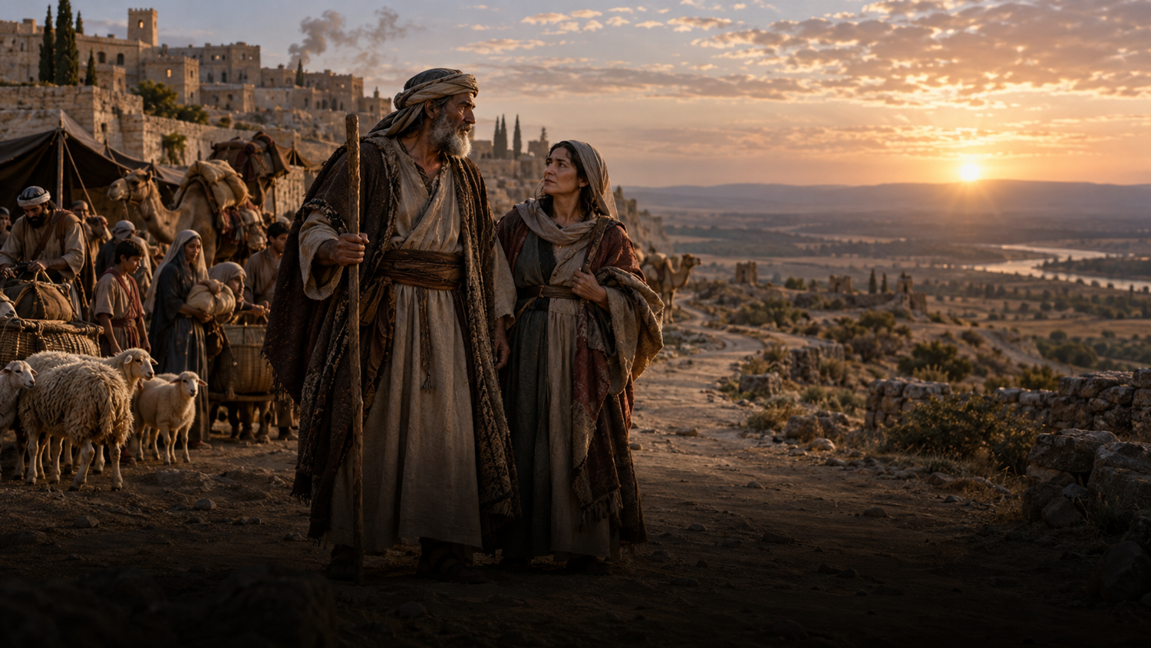
Trinity Evangelical Lutheran Church
September 20, 2026
WELCOME!
A Journey Without An Itinerary

Slide 2
= Please stand if able
= Please be seated
  Prelude by Roxanne Groff
  Office of the Acolyte
  Ringing of the Bell
  Welcome

Slide 3
CONFESSION AND FORGIVENESS
All may make the sign of the cross, the sign marked at baptism…
P: We confess our sins before God and one another.
Pause for silence and reflection.
P: Creating and renewing God,

Slide 4
CONFESSION AND FORGIVENESS
C: You have made us in your image to carry your life-giving love as a blessing to all the world. Yet we fail again and again to live out your call. We place our trust in money and possessions, in flawed people and broken relationships, in the things that cannot sustain us.

Slide 5
CONFESSION AND FORGIVENESS
C: We do the things we do not want to do, and we fail to do the things we know you would have us do. Forgive us for all the ways we fall short. Open our eyes, hearts, and minds to your presence, and re-create us in your image each day, for the good of all that you have made.

Slide 6
CONFESSION AND FORGIVENESS
P: The God whose love outpoured caused the world to be, continues to pour this creative love on us. The God whose love outpoured in the life, death, and resurrection of Jesus Christ continues to pour this redeeming love upon us.

Slide 7
CONFESSION AND FORGIVENESS
P: Children of God, know that you are forgiven, and go forth refreshed and ready to answer God’s call to love and serve the whole of creation. In Jesus’ holy name.
C: Amen.

Slide 8
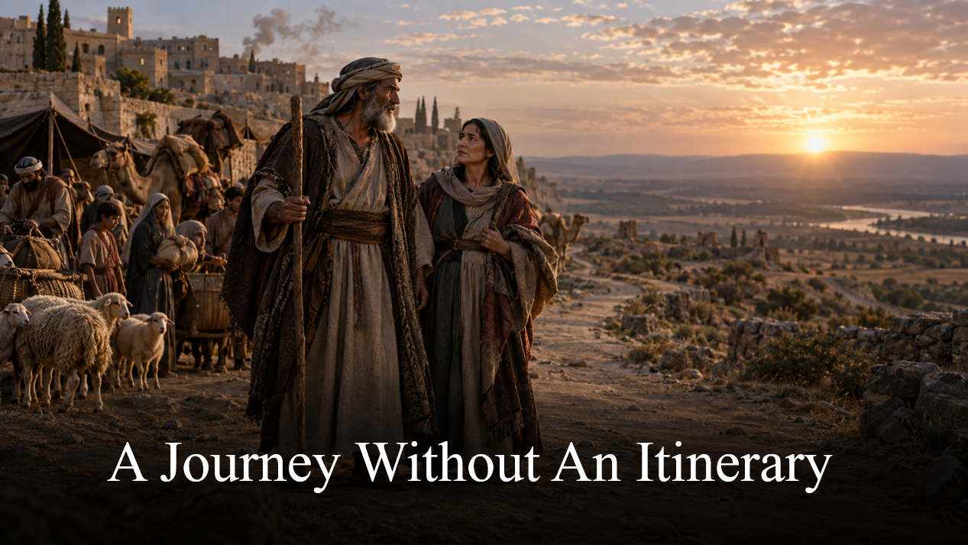
Gathering Song
“Take My Life, That I May Be”
LBW 406
Taking Hold of the Life That Really Is Life

Slide 9
“Take My Life, That I May Be” LBW 406
1 Take my life, that I may be
consecrated, Lord, to thee;
take my moments and my days;
let them flow in ceaseless praise.
2 Take my hands and let them move
at the impulse of thy love;
take my feet and let them be
swift and beautiful for thee.

Slide 10
“Take My Life, That I May Be” LBW 406
3 Take my voice and let me sing
always, only, for my King;
take my lips and let them be
filled with messages from thee.
4 Take my silver and my gold,
not a mite would I withhold;
take my intellect and use
ev'ry pow'r as thou shall choose.

Slide 11
“Take My Life, That I May Be” LBW 406
5 Take my will and make it thine,
it shall be no longer mine.
Take my heart, it is thine own,
it shall be thy royal throne.
6 Take my love; my Lord, I pour
at thy feet its treasure store;
take myself, and I will be
ever, only, all for thee.

Slide 12
APOSTOLIC GREETING
P: The grace of our Lord Jesus Christ, the love of God, and the communion of the Holy Spirit be with you all.
C: And also with you.

Slide 13
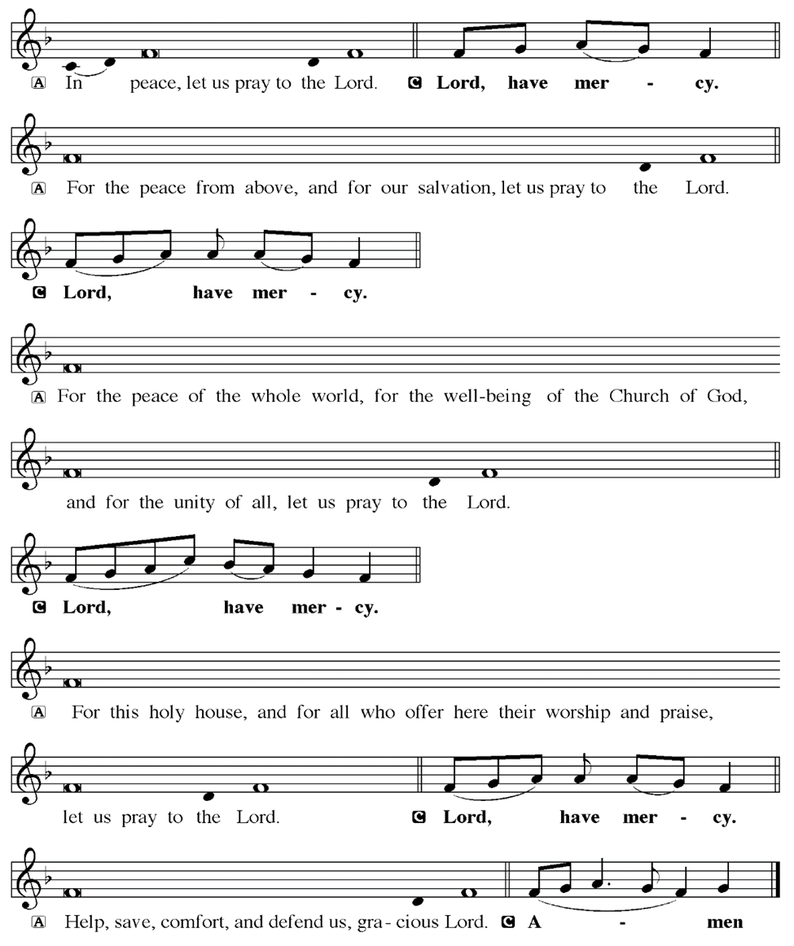
KYRIE

Slide 14
KYRIE

Slide 15
KYRIE

Slide 16
HYMN OF PRAISE
Glory be to God in heaven;
peace, goodwill to all the earth.
Mighty God of all creation,
Father of surpassing worth:
we exalt you, we adore you,
we lift high our thanks and praise.
Saints and angels bow before you; here on earth our songs we raise.

Slide 17
HYMN OF PRAISE
Glory be to Christ forever,
Lamb of God and Lord of love.
Son of God and gracious Savior, you have come from heav’n above;
on the cross you died to save us; now you reign at God’s right hand.
Hear our prayer; restore, forgive us; in your promise firm we stand.

Slide 18
HYMN OF PRAISE
Holy One we now acclaim you;
Lord alone, to you we call;
Holy One in faith we name you,
God most high, yet near to all:
Jesus Christ, with God the Spirit,
in the Father’s splendor bright.
For the peace that we inherit,
glory be to God on high!

Slide 19
PRAYER OF THE DAY
P: Let us pray… God of blessing, as you called Abram and Sarai into relationship with you, and charged them with being a blessing to all of creation, remind us today and every day of all the ways in which your blessings upon us make it possible for us to bless others. May we shine as beacons of your loving grace in all we do and say. In Jesus’ name we pray.
C: Amen

Slide 20


Slide 21
Scripture Reading
R: Our scripture reading is from the Book of Genesis, Chapter 12.
C: Glory to you O’ Lord!

Slide 22
Genesis 12:1-9
Now the Lord said to Abram, “Go from your country and your kindred and your father’s house to the land that I will show you. 2I will make of you a great nation, and I will bless you, and make your name great, so that you will be a blessing. 3I will bless those who bless you, and the one who curses you I will curse; and in you all the families of the

Slide 23
Genesis 12:1-9
earth shall be blessed.”
4So Abram went, as the Lord had told him; and Lot went with him. Abram was seventy-five years old when he departed from Haran. 5Abram took his wife Sarai and his brother’s son Lot, and all the possessions that they had gathered, and the persons whom they had acquired in Haran; and

Slide 24
Genesis 12:1-9
they set forth to go to the land of Canaan. When they had come to the land of Canaan,
6Abram passed through the land to the place at Shechem, to the oak of Moreh. At that time the Canaanites were in the land. 7Then the Lord appeared to Abram, and said, “To your offspring I will give this land.” So he built there an altar to the

Slide 25
Genesis 12:1-9
Lord, who had appeared to him. 8From there he moved on to the hill country on the east of Bethel, and pitched his tent, with Bethel on the west and Ai on the east; and there he built an altar to the Lord and invoked the name of the Lord. 9And Abram journeyed on by stages toward the Negeb.

Slide 26
Genesis 12:1-9
R: This is the Word of the Lord.
C: Praise to You, O Christ

Slide 27
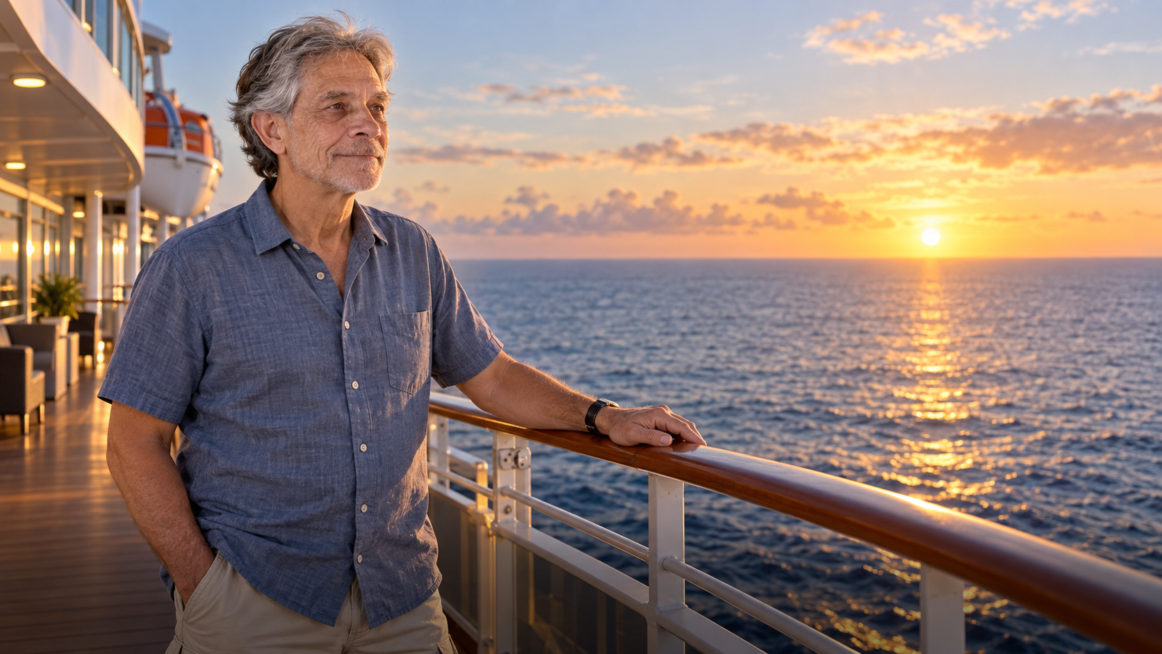
Sermon
Go From Here as a Blessing

Slide 28
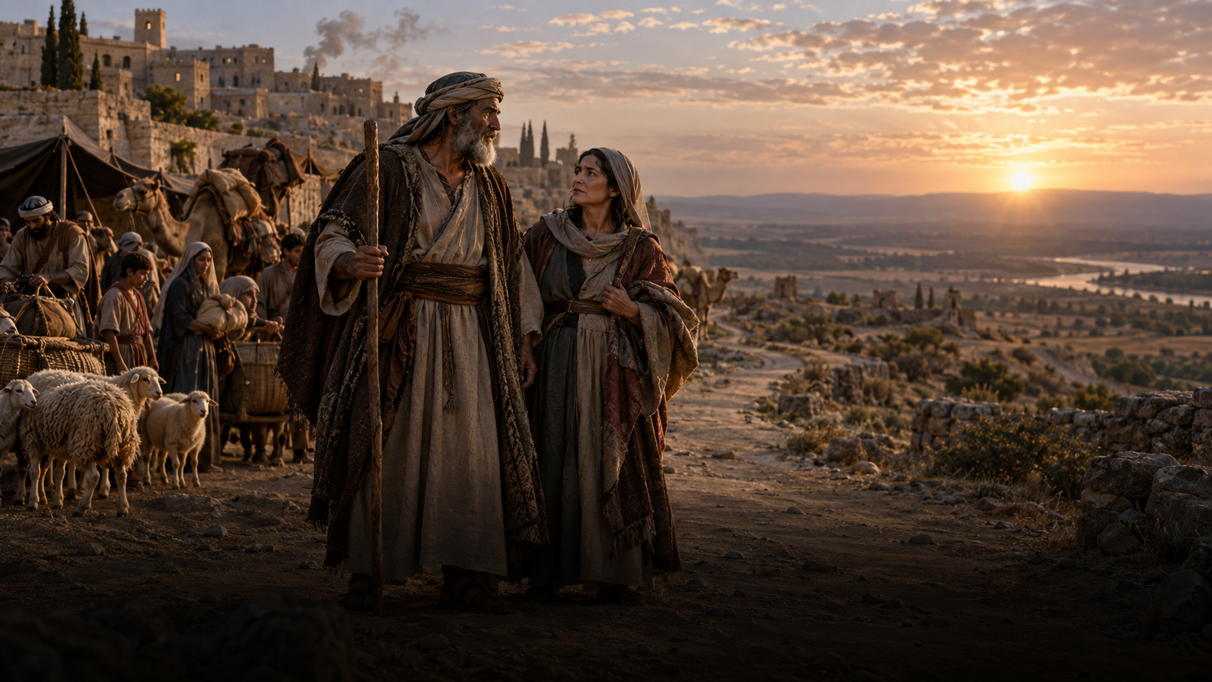
Sermon
A Journey Without an Itinerary

Slide 29
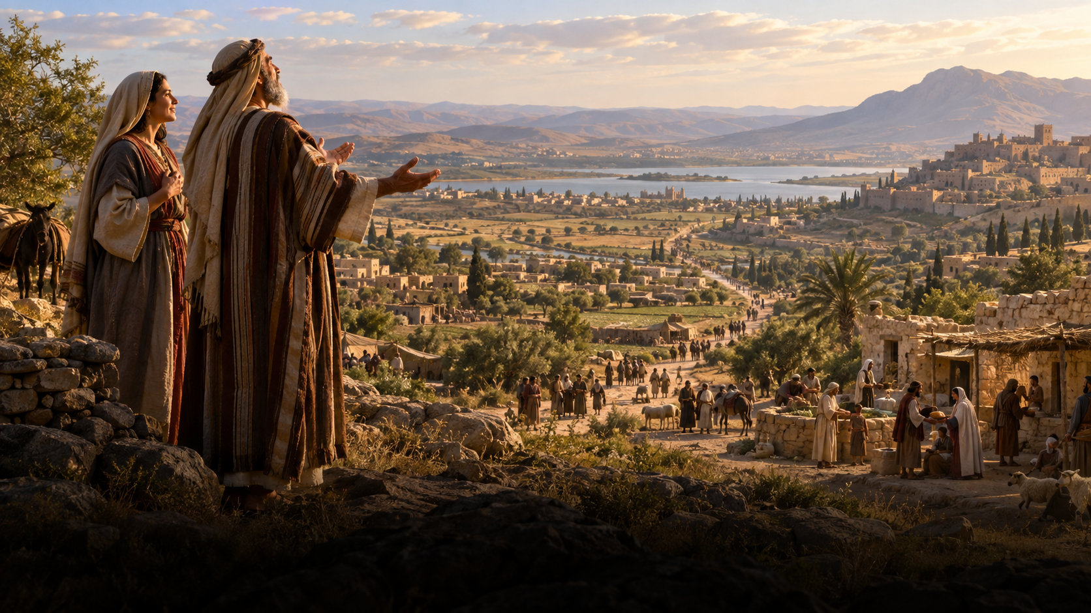
Sermon
Blessed to Be a Blessing

Slide 30
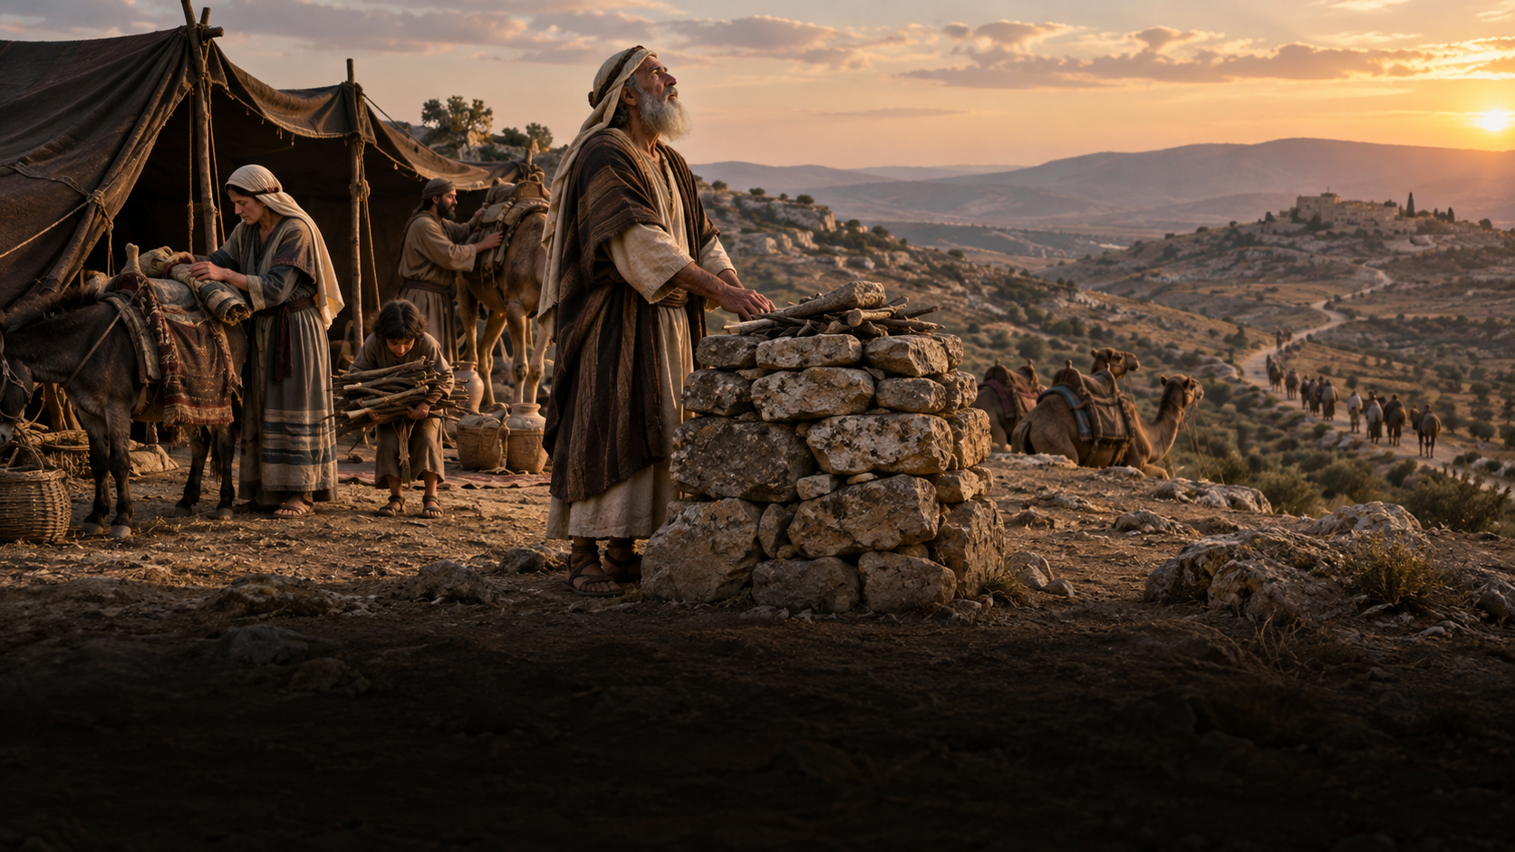
Sermon
Journeyed by Stages

Slide 31
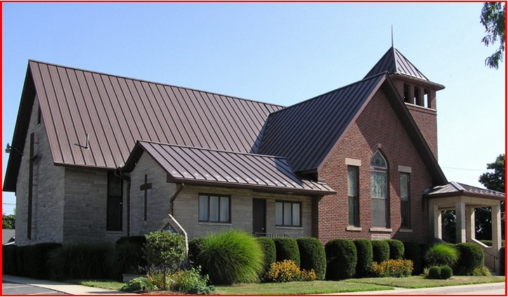
Sermon
A New Stage

Slide 32
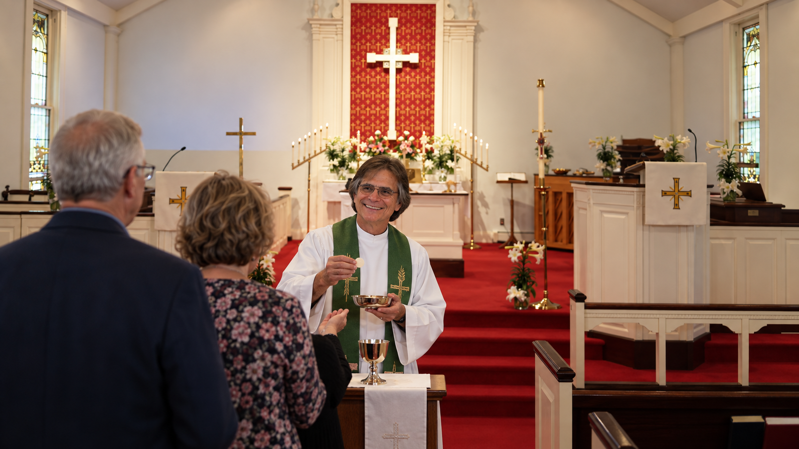
Sermon
Food for the Next Stage

Slide 33
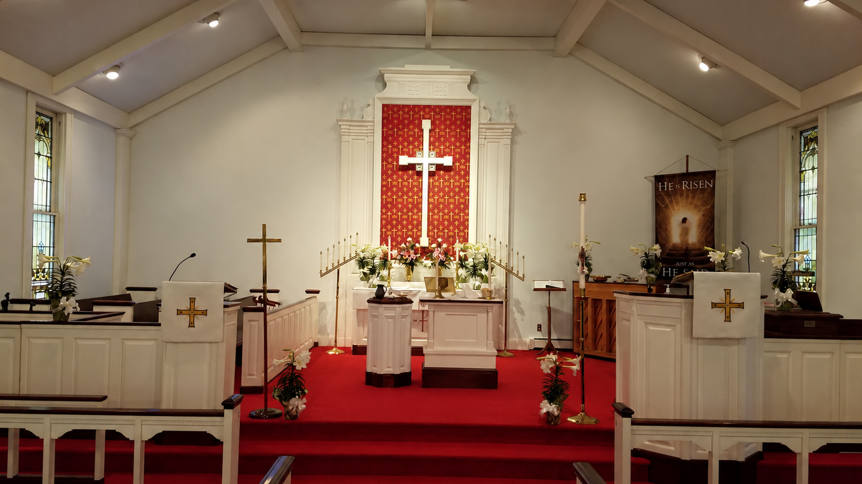
Sermon
Go From Here as a Blessing

Slide 34
APOSTLE’S CREED
C: I believe in God, the Father almighty, creator of heaven and earth.

Slide 35
APOSTLE’S CREED
C: I believe in Jesus Christ, his only Son, our Lord. He was conceived by the power of the Holy Spirit and born of the virgin Mary. He suffered under Pontius Pilate, was crucified, died, and was buried.

Slide 36
APOSTLE’S CREED
C: He descended into hell. On the third day he rose again. He ascended into heaven, and is seated at the right hand of the Father. He will come again to judge the living and the dead.

Slide 37
APOSTLE’S CREED
C: I believe in the Holy Spirit, the holy catholic Church, the communion of saints, the forgiveness of sins, the resurrection of the body, and the life everlasting. Amen.

Slide 38
PRAYERS OF INTERCESSION
L: Confident that our Creator God listens and answers prayer, we pray for the church, the world, and all who are in need.
A brief silence.

Slide 39
PRAYERS
Each petition will end with the words,
A: God of mercy and grace,
C: We lift our prayers to you.

Slide 40
PRAYERS OF INTERCESSION
The prayer concludes…
P: God who created all that is, we place all for whom we pray, both aloud and in the silence of our hearts, into your loving arms.
C: Amen.

Slide 41
OFFERING/OFFERING PRAYER

Slide 42
THE GREAT THANKSGIVING
Communion is “Continuous, by Station”.
All the Baptized are welcome to celebrate this Holy Meal.

Slide 43
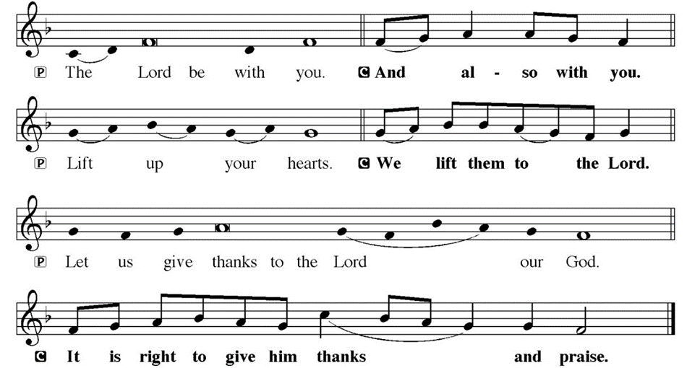
DIALOGUE

Slide 44
THE PREFACE
P: It is indeed right and salutary…
… we praise your name and join their unending hymn.

Slide 45
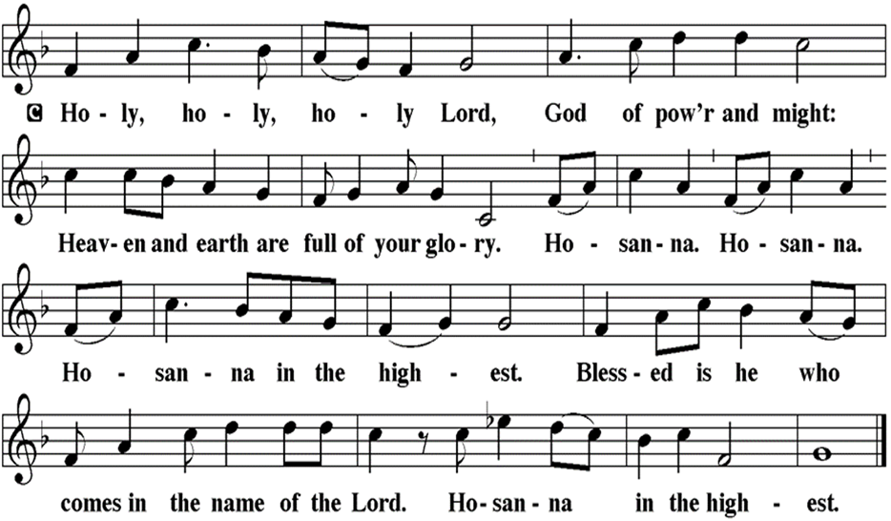
THE SANCTUS

Slide 46
EUCHARISTIC PRAYER
P: Holy God, our Maker, Redeemer…
…both now and forever.
C: Amen.

Slide 47
THE LORD’S PRAYER
C: Our Father, who art in heaven, hallowed be thy name, thy kingdom come, thy will be done, on earth as it is in heaven. Give us this day our daily bread; and forgive us our trespasses, as we forgive those who trespass against us; and lead us not into temptation, but deliver us from evil.

Slide 48
THE LORD’S PRAYER
C: For thine is the kingdom, and the power, and the glory, forever and ever. Amen.

Slide 49
INVITATION TO COMMUNION
P: The one who called Abram and Sarai to follow into the unknown also calls you to this table where Christ is made known in the breaking of the bread. Come. Join your siblings at the feast of life.

Slide 50
COMMUNION DISTRIBUTION
All may commune “Continuously, by Station”. The bread may be broken for distribution. As the ministers give the bread and wine, they say these words :
The body of Christ, given for you.
The blood of Christ, shed for you.
The communicant may say: Amen.

Slide 51
POST COMMUNION BLESSING
P: May this Body and Blood of our Lord and Savior, Jesus Christ, strengthen, keep, and unite us, ☩ now and forever.
C: Amen.

Slide 52
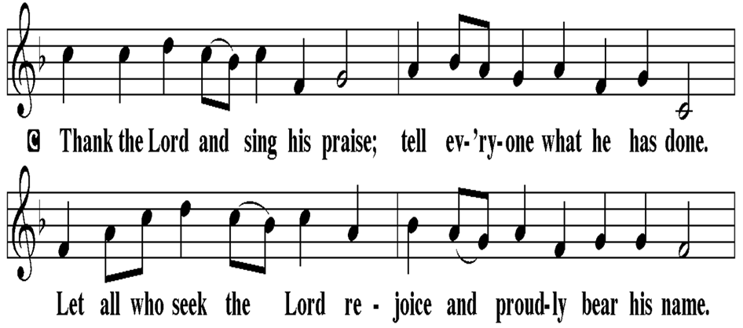
POST COMMUNION CANTACLE

Slide 53
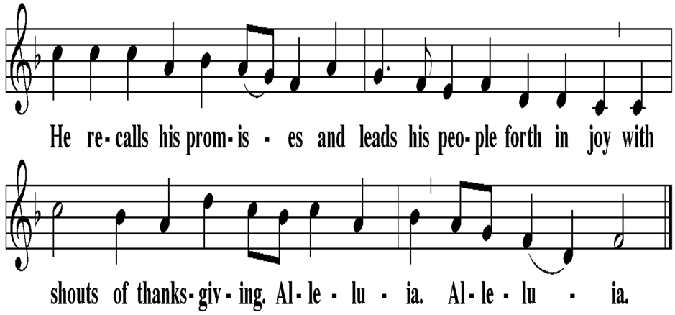
POST COMMUNION CANTACLE

Slide 54
POST COMMUNION PRAYER
P: Let us pray… Sustaining God, with this bread and cup, you nourish us with mercy and abundant life. By your Spirit, send us from this table to serve a needy world. Make us living signs of your liberation, healing, and love, following the way of Jesus, in whose name we pray.
C: Amen

Slide 55
SENDING OF HOMEBOUND COMMUNION
P: Gracious God, whose mercy endures from generation to generation: bless those who go forth to share your word and sacrament with our sisters and brothers who are sick or homebound.

Slide 56
SENDING OF HOMEBOUND COMMUNION
P: In your love and care, nourish and strengthen those to whom we bring this communion, that through the body and blood of your Son we may all know the hope of your promised coming in Jesus Christ our Lord.
C: Amen.

Slide 57
ANNOUNCEMENTS

Slide 58
SENDING BLESSING

Slide 59
FAREWELL AND GODSPEED
P: Simon and Tina Wolfe , as you leave our congregation, we wish to bid you farewell.
A reading from Exodus: The Lord said, “I am going to send an angel in front of you, to guard you on the way and to bring you to the place that I have prepared.” (Exodus 23:20)

Slide 60
FAREWELL AND GODSPEED
P: In holy baptism our Lord Jesus Christ received you and made you members of his church. When you came to this congregation we rejoiced to welcome you into the mission we share as the people of God. In this community you have come to know and to share in God’s loving purpose for you and for all creation. God has blessed you in this community, and God has blessed us through you.

Slide 61
FAREWELL AND GODSPEED
P: We encourage you to continue to receive and share God’s gifts in your new congregation in West Virginia , united with us in the body of Christ and the mission we share.

Slide 62
FAREWELL AND GODSPEED
P: Let us pray… Eternal God, we thank you for Simon and Tina Wolfe and for the time we have shared with them. As they have been a blessing to us, so now send them forth to be a blessing to others; through Jesus Christ, our Savior and Lord.
C: Amen.

Slide 63
SENDING BLESSING
P: Creator, Redeemer, Sustainer, one God, bless, heal, and hold you today and always.
C: Amen.

Slide 64
SENDING SONG
“Here I Am, Lord”
ELW 574

Slide 65
“Here I Am, Lord” ELW 574
1 I, the Lord of sea and sky, I have heard my people’s cry. All who dwell in dark and sin my hand will save. I, who made the stars of night, I will make their darkness bright. Who will bear my light to them? Whom shall I send?

Slide 66
“Here I Am, Lord” ELW 574
Refrain:
  Here I am, Lord. Is it I, Lord?
  I have heard you calling in the night.
  I will go, Lord, if you lead me.
  I will hold your people in my heart.

Slide 67
“Here I Am, Lord” ELW 574
2 I, the Lord of snow and rain, I have borne my people’s pain. I have wept for love of them. They turn away. I will break their hearts of stone, give them hearts for love alone. I will speak my word to them. Whom shall I send?

Slide 68
“Here I Am, Lord” ELW 574
Refrain:
  Here I am, Lord. Is it I, Lord?
  I have heard you calling in the night.
  I will go, Lord, if you lead me.
  I will hold your people in my heart.

Slide 69
“Here I Am, Lord” ELW 574
3 I, the Lord of wind and flame, I will tend the poor and lame. I will set a feast for them. My hand will save. Finest bread I will provide till their hearts be satisfied. I will give my life to them. Whom shall I send?

Slide 70
“Here I Am, Lord” ELW 574
Refrain:
  Here I am, Lord. Is it I, Lord?
  I have heard you calling in the night.
  I will go, Lord, if you lead me.
  I will hold your people in my heart.

Slide 71
DISMISSAL
P: Depart in Christ’s Love.
C: Seeking, welcoming, and serving all. Amen!
POSTLUDE
By Roxanne Groff
From sundaysandseasons.com. Copyright © 2026 Augsburg Fortress. All rights reserved. Reprinted by permission under Augsburg Fortress Liturgies Annual License #SAS023830. New Revised Standard Version Bible, Copyright © 1989, Division of Christian Education of the National Council of the Churches of Christ in the United States of America. Used by permission. All rights reserved. Revised Common Lectionary, Copyright © 1992 Consultation on Common Texts, admin Augsburg Fortress. Used by permission. Some images generated with ChatGPT (“Theo”) using OpenAI.

