Slide 1
Trinity Evangelical Lutheran Church April 14, 2024
WELCOME!
Notes:
Image: Five Loaves by Caroline Coolidge Brown. Copyright © Caroline Coolidge Brown. All rights reserved. Used by permission of the artist.

Slide 2
Prelude By Roxanne Groff
= Please stand if able
= Please be seated
Office of the Acolyte and Ringing of the Bell
Welcome
Notes:
Image: Five Loaves by Caroline Coolidge Brown. Copyright © Caroline Coolidge Brown. All rights reserved. Used by permission of the artist.

Slide 3
CONFESSION AND FORGIVENESS
All may make the sign of the cross, the sign marked at baptism…
L: We confess our sins before God and one another.
Pause for silence and reflection.
L: Risen God,
Notes:
Image: Five Loaves by Caroline Coolidge Brown. Copyright © Caroline Coolidge Brown. All rights reserved. Used by permission of the artist.

Slide 4
CONFESSION AND FORGIVENESS
C: We confess to you, to ourselves, and to one another that we have caused harm by the things we have said and done, and by the things we have not said and not done.
Notes:
Image: Five Loaves by Caroline Coolidge Brown. Copyright © Caroline Coolidge Brown. All rights reserved. Used by permission of the artist.

Slide 5
CONFESSION AND FORGIVENESS
C: Take away our sins that we might fully embody your commandment to love you with all our hearts, souls, minds, and strength, and to love our neighbors as ourselves.
Notes:
Image: Five Loaves by Caroline Coolidge Brown. Copyright © Caroline Coolidge Brown. All rights reserved. Used by permission of the artist.

Slide 6
CONFESSION AND FORGIVENESS
L: In grace and mercy, God forgives all our sins, and with joy and expectation calls us into new life for the sake of the world, through Jesus Christ our savior.
C: Amen.
Notes:
Image: Five Loaves by Caroline Coolidge Brown. Copyright © Caroline Coolidge Brown. All rights reserved. Used by permission of the artist.

Slide 7
Gathering Song
“When Peace, Like A River”
LBW 346
Notes:
Image: Five Loaves by Caroline Coolidge Brown. Copyright © Caroline Coolidge Brown. All rights reserved. Used by permission of the artist.

Slide 8
“When Peace, Like A River” LBW 346
1 When peace, like a river, attendeth my way;
when sorrows, like sea billows, roll;
whatever my lot, thou hast taught me to say,
it is well, it is well with my soul.
Notes:
Image: Five Loaves by Caroline Coolidge Brown. Copyright © Caroline Coolidge Brown. All rights reserved. Used by permission of the artist.

Slide 9
“When Peace, Like A River” LBW 346
Refrain
It is well (it is well)
with my soul, (with my soul,)
it is well, it is well with my soul.
Notes:
Image: Five Loaves by Caroline Coolidge Brown. Copyright © Caroline Coolidge Brown. All rights reserved. Used by permission of the artist.

Slide 10
“When Peace, Like A River” LBW 346
2 Though Satan should buffet, though trials should come,
let this blest assurance control,
that Christ hath regarded my helpless estate,
and hath shed his own blood for my soul.
Notes:
Image: Five Loaves by Caroline Coolidge Brown. Copyright © Caroline Coolidge Brown. All rights reserved. Used by permission of the artist.

Slide 11
“When Peace, Like A River” LBW 346
Refrain
It is well (it is well)
with my soul, (with my soul,)
it is well, it is well with my soul.
Notes:
Image: Five Loaves by Caroline Coolidge Brown. Copyright © Caroline Coolidge Brown. All rights reserved. Used by permission of the artist.

Slide 12
“When Peace, Like A River” LBW 346
3 He lives--oh, the bliss of this glorious thought;
my sin, not in part, but the whole,
is nailed to his cross and I bear it no more.
Praise the Lord, praise the Lord, O my soul!
Notes:
Image: Five Loaves by Caroline Coolidge Brown. Copyright © Caroline Coolidge Brown. All rights reserved. Used by permission of the artist.

Slide 13
“When Peace, Like A River” LBW 346
Refrain
It is well (it is well)
with my soul, (with my soul,)
it is well, it is well with my soul.
Notes:
Image: Five Loaves by Caroline Coolidge Brown. Copyright © Caroline Coolidge Brown. All rights reserved. Used by permission of the artist.

Slide 14
“When Peace, Like A River” LBW 346
4 And Lord, haste the day when our faith shall be sight,
the clouds be rolled back as a scroll,
the trumpet shall sound and the Lord shall descend;
even so it is well with my soul.
Notes:
Image: Five Loaves by Caroline Coolidge Brown. Copyright © Caroline Coolidge Brown. All rights reserved. Used by permission of the artist.

Slide 15
“When Peace, Like A River” LBW 346
Refrain
It is well (it is well)
with my soul, (with my soul,)
it is well, it is well with my soul.
Notes:
Image: Five Loaves by Caroline Coolidge Brown. Copyright © Caroline Coolidge Brown. All rights reserved. Used by permission of the artist.

Slide 16
APOSTOLIC GREETING
P: The grace of our Lord Jesus Christ, the love of God, and the communion of the Holy Spirit be with you all.
C: And also with you.
Notes:
Image: Five Loaves by Caroline Coolidge Brown. Copyright © Caroline Coolidge Brown. All rights reserved. Used by permission of the artist.

Slide 17
KYRIE
Notes:
Image: Five Loaves by Caroline Coolidge Brown. Copyright © Caroline Coolidge Brown. All rights reserved. Used by permission of the artist.

Slide 18
KYRIE
Notes:
Image: Five Loaves by Caroline Coolidge Brown. Copyright © Caroline Coolidge Brown. All rights reserved. Used by permission of the artist.

Slide 19
KYRIE
Notes:
Image: Five Loaves by Caroline Coolidge Brown. Copyright © Caroline Coolidge Brown. All rights reserved. Used by permission of the artist.

Slide 20
HYMN OF PRAISE
Glory be to God in heaven;
peace, goodwill to all the earth.
Mighty God of all creation,
Father of surpassing worth:
we exalt you, we adore you,
we lift high our thanks and praise.
Saints and angels bow before you; here on earth our songs we raise.
Notes:
Image: Five Loaves by Caroline Coolidge Brown. Copyright © Caroline Coolidge Brown. All rights reserved. Used by permission of the artist.

Slide 21
HYMN OF PRAISE
Glory be to Christ forever,
Lamb of God and Lord of love.
Son of God and gracious Savior, you have come from heav’n above;
on the cross you died to save us; now you reign at God’s right hand.
Hear our prayer; restore, forgive us; in your promise firm we stand.
Notes:
Image: Five Loaves by Caroline Coolidge Brown. Copyright © Caroline Coolidge Brown. All rights reserved. Used by permission of the artist.

Slide 22
HYMN OF PRAISE
Holy One we now acclaim you;
Lord alone, to you we call;
Holy One in faith we name you,
God most high, yet near to all:
Jesus Christ, with God the Spirit,
in the Father’s splendor bright.
For the peace that we inherit,
glory be to God on high!
Notes:
Image: Five Loaves by Caroline Coolidge Brown. Copyright © Caroline Coolidge Brown. All rights reserved. Used by permission of the artist.

Slide 23
PRAYER OF THE DAY
P: Let us pray… Merciful God, in and through Jesus you reached out in healing love to all who came to you for help. Empower us now to extend that same healing love to one another, our community, and the world. In Jesus’ name we pray.
C: Amen
Notes:
Image: Five Loaves by Caroline Coolidge Brown. Copyright © Caroline Coolidge Brown. All rights reserved. Used by permission of the artist.

Slide 24
Notes:
Image: Preparing yeast dough. Copyright © tomasworks/iStock/Thinkstock. Used by permission.

Slide 25
Canon Hey Bell
Notes:
Image: Preparing yeast dough. Copyright © tomasworks/iStock/Thinkstock. Used by permission.

Slide 26
Canon Hey Bell
Cain and Abel
Notes:
Image: Preparing yeast dough. Copyright © tomasworks/iStock/Thinkstock. Used by permission.

Slide 27
Day Fit Angle Eye Hath
Notes:
Image: Preparing yeast dough. Copyright © tomasworks/iStock/Thinkstock. Used by permission.

Slide 28
Day Fit Angle Eye Hath
David and Goliath
Notes:
Image: Preparing yeast dough. Copyright © tomasworks/iStock/Thinkstock. Used by permission.

Slide 29
Chose If Fan Mare He
Joseph and Mary
Notes:
Image: Preparing yeast dough. Copyright © tomasworks/iStock/Thinkstock. Used by permission.

Slide 30
Notes:
Image: Preparing yeast dough. Copyright © tomasworks/iStock/Thinkstock. Used by permission.

Slide 31
Scripture Reading
R: The Scripture reading is from the Book of Acts, chapter 3.
C: Glory to you O’ Lord! (Spoken)
Notes:
Image: Five Loaves by Caroline Coolidge Brown. Copyright © Caroline Coolidge Brown. All rights reserved. Used by permission of the artist.

Slide 32
Acts 3:1-10
One day Peter and John were going up to the temple at the hour of prayer, at three o’clock in the afternoon. ² And a man lame from birth was being carried in. People would lay him daily at the gate of the temple called the Beautiful Gate so that he could ask for alms from those entering the temple. ³ When he saw Peter and John about to go into the temple, he asked them for alms.
Notes:
Image: Five Loaves by Caroline Coolidge Brown. Copyright © Caroline Coolidge Brown. All rights reserved. Used by permission of the artist.

Slide 33
Acts 3:1-10
⁴ Peter looked intently at him, as did John, and said, “Look at us.” ⁵ And he fixed his attention on them, expecting to receive something from them. ⁶ But Peter said, “I have no silver or gold, but what I have I give you; in the name of Jesus Christ of Nazareth, stand up and walk.” ⁷ And he took him by the right hand and raised him up; and
Notes:
Image: Five Loaves by Caroline Coolidge Brown. Copyright © Caroline Coolidge Brown. All rights reserved. Used by permission of the artist.

Slide 34
Acts 3:1-10
immediately his feet and ankles were made strong. ⁸Jumping up, he stood and began to walk, and he entered the temple with them, walking and leaping and praising God. ⁹ All the people saw him walking and praising God, ¹⁰ and they recognized him as the one who used to sit and ask for alms at the Beautiful Gate of the temple;
Notes:
Image: Five Loaves by Caroline Coolidge Brown. Copyright © Caroline Coolidge Brown. All rights reserved. Used by permission of the artist.

Slide 35
Acts 3:1-10
and they were filled with wonder and amazement at what had happened to him.
Notes:
Image: Five Loaves by Caroline Coolidge Brown. Copyright © Caroline Coolidge Brown. All rights reserved. Used by permission of the artist.

Slide 36
Acts 3:1-10
R: This is the Word of the Lord.
C: Praise to You, O Christ (Spoken)
Notes:
Image: Five Loaves by Caroline Coolidge Brown. Copyright © Caroline Coolidge Brown. All rights reserved. Used by permission of the artist.

Slide 37
Sermon
Notes:
Image: Five Loaves by Caroline Coolidge Brown. Copyright © Caroline Coolidge Brown. All rights reserved. Used by permission of the artist.

Slide 38
NICENE CREED
C: We believe in one God, the Father, the Almighty, maker of heaven and earth, of all that is, seen and unseen.

Slide 39
NICENE CREED
C: We believe in one Lord, Jesus Christ, the only Son of God, eternally begotten of the Father, God from God, Light from Light, true God from true God, begotten, not made, of one Being with the Father.

Slide 40
NICENE CREED
C: Through him all things were made. For us and for our salvation he came down from heaven; by the power of the Holy Spirit he became incarnate from the virgin Mary, and was made man. For our sake he was crucified under Pontius Pilate;

Slide 41
NICENE CREED
C: he suffered death and was buried. On the third day he rose again in accordance with the Scriptures; he ascended into heaven and is seated at the right hand of the Father. He will come again in glory to judge the living and the dead, and his kingdom will have no end.

Slide 42
NICENE CREED
C: We believe in the Holy Spirit, the Lord, the giver of life, who proceeds from the Father and the Son. With the Father and the Son he is worshiped and glorified. He has spoken through the prophets. We believe in one holy catholic and apostolic Church.

Slide 43
NICENE CREED
C: We acknowledge one Baptism for the forgiveness of sins. We look for the resurrection of the dead, and the life of the world to come. Amen.

Slide 44
PRAYERS OF INTERCESSION
Each petition will end with the words,
A: God of new life,
The congregation will respond with:
C: In mercy, hear our prayer.

Slide 45
PRAYERS OF INTERCESSION
The prayer concludes…
P: We place in your arms all for whom we pray, out loud or in our hearts, confident in your mercy and grace, through Jesus Christ, our savior.
C: Amen.

Slide 46
OFFERING
Notes:
Image: Five Loaves by Caroline Coolidge Brown. Copyright © Caroline Coolidge Brown. All rights reserved. Used by permission of the artist.

Slide 47
OFFERING PRAYER
Notes:
Image: Five Loaves by Caroline Coolidge Brown. Copyright © Caroline Coolidge Brown. All rights reserved. Used by permission of the artist.

Slide 48
THE GREAT THANKSGIVING
All the Baptized are welcome to celebrate this Holy Meal.

Slide 49
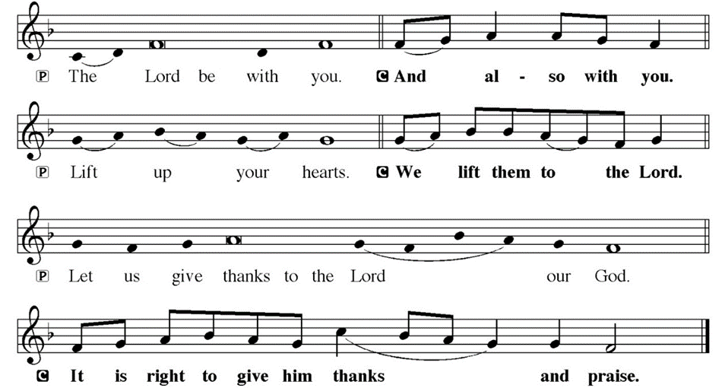
DIALOGUE

Slide 50
THE PREFACE
P: It is indeed right and salutary…
… we praise your name and join their unending hymn.

Slide 51
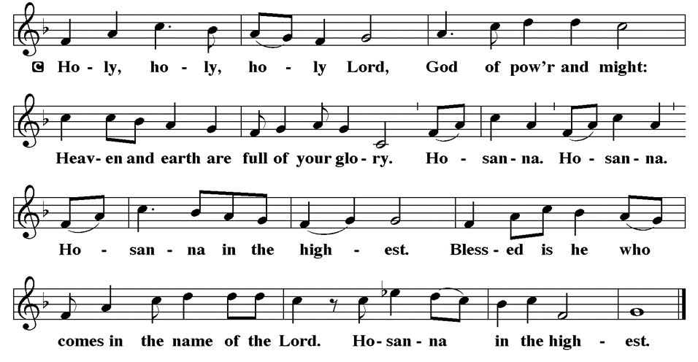
THE SANCTUS

Slide 52
EUCHARISTIC PRAYER
P: Holy, living, and loving God…
…both now and forever.
C: Amen.

Slide 53
THE LORD’S PRAYER
C: Our Father, who art in heaven, hallowed be thy name, thy kingdom come, thy will be done, on earth as it is in heaven. Give us this day our daily bread; and forgive us our trespasses, as we forgive those who trespass against us; and lead us not into temptation, but deliver us from evil.

Slide 54
THE LORD’S PRAYER
C: For thine is the kingdom, and the power, and the glory, forever and ever. Amen.

Slide 55
INVITATION TO COMMUNION
P: The one in whose name Peter healed now invites you to this feast of promise. In bread and wine, Jesus gives his very self to strengthen you in your life of faith. All is now prepared…

Slide 56
COMMUNION DISTRIBUTION
All will commune “By Station”.
The bread may be broken for distribution. As the ministers give the bread and wine, they say these words :
The body of Christ, given for you.
The blood of Christ, shed for you.
The communicant may say: Amen.

Slide 57
POST COMMUNION BLESSING
P: May this body and blood of our Lord and Savior, Jesus Christ, strengthen, keep and unite us, ☩ now and forever, amen.
C: Amen.

Slide 58
POST COMMUNION CANTACLE

Slide 59
POST COMMUNION CANTACLE

Slide 60
POST COMMUNION PRAYER
P: Let us pray… Shepherding God, you have prepared a table before us and nourished us with your love. Send us forth from this banquet to proclaim your goodness and share the abundant mercy of Jesus, our redeemer and friend.
C: Amen

Slide 61
ANNOUNCEMENTS
Notes:
Image: Five Loaves by Caroline Coolidge Brown. Copyright © Caroline Coolidge Brown. All rights reserved. Used by permission of the artist.

Slide 62
SENDING BLESSING
P: Alleluia! Christ is risen!
C: Christ is risen indeed! Alleluia!
P: The God of resurrection power, the Christ of unending joy, and the Spirit of Easter hope bless you now and always.
C: Amen.

Slide 63
Sending Song
“How Firm A Foundation”
LBW 507
Notes:
Image: Five Loaves by Caroline Coolidge Brown. Copyright © Caroline Coolidge Brown. All rights reserved. Used by permission of the artist.

Slide 64
“How Firm A Foundation” LBW 507
1 How firm a foundation, O saints of the Lord,
is laid for your faith in his excellent word!
What more can he say than to you he has said
who unto the Savior for refuge have fled?
Notes:
Image: Preparing yeast dough. Copyright © tomasworks/iStock/Thinkstock. Used by permission.

Slide 65
“How Firm A Foundation” LBW 507
2 “Fear not, I am with you, oh, be not dismayed,
for I am your God and will still give you aid;
I’ll strengthen you, help you, and cause you to stand,
upheld by my righteous, omnipotent hand.
Notes:
Image: Preparing yeast dough. Copyright © tomasworks/iStock/Thinkstock. Used by permission.

Slide 66
“How Firm A Foundation” LBW 507
3 “When through fiery trials your pathway shall lie,
my grace, all-sufficient, shall be your supply.
The flames shall not hurt you; I only design
your dross to consume and your gold to refine.
Notes:
Image: Preparing yeast dough. Copyright © tomasworks/iStock/Thinkstock. Used by permission.

Slide 67
“How Firm A Foundation” LBW 507
4 “Throughout all their lifetime my people shall prove
my sov’reign, eternal, unchangeable love;
and then, when gray hairs shall their temples adorn,
like lambs they shall still in my bosom be borne.”
Notes:
Image: Preparing yeast dough. Copyright © tomasworks/iStock/Thinkstock. Used by permission.

Slide 68
DISMISSAL
P: … Depart in Christ’s Love.
C: Seeking, welcoming, and serving all. Amen!
POSTLUDE
By Roxanne Groff
From sundaysandseasons.com. Copyright © 2024 Augsburg Fortress. All rights reserved. Reprinted by permission under Augsburg Fortress Liturgies Annual License #SAS023830. New Revised Standard Version Bible, Copyright © 1989, Division of Christian Education of the National Council of the Churches of Christ in the United States of America. Used by permission. All rights reserved. Revised Common Lectionary, Copyright © 1992 Consultation on Common Texts, admin Augsburg Fortress. Used by permission.

