Slide 1
February 4, 2024
WELCOME!
Trinity
Lutheran Church
Notes:
Image: Five Loaves by Caroline Coolidge Brown. Copyright © Caroline Coolidge Brown. All rights reserved. Used by permission of the artist.

Slide 2
= Please stand if able
= Please be seated
Prelude - By Roxanne Groff
Office of the Acolyte
Ringing of the Bell
Welcome

Slide 3
THANKSGIVING FOR BAPTISM
All may make the sign of the cross, the sign marked at baptism, as the presiding minister begins.
P: Blessed be the holy Trinity, ☩ one God, the fountain of living water, the rock who gave us birth, our light and our salvation.
C: Amen.
Notes:
Image: Preparing yeast dough. Copyright © tomasworks/iStock/Thinkstock. Used by permission.

Slide 4
P: Joined to Christ in the waters of baptism, we are clothed with God's mercy and forgiveness. Let us give thanks for the gift of baptism. Water may be poured into the font as the presiding minister gives thanks.
THANKSGIVING FOR BAPTISM
Notes:
Image: Preparing yeast dough. Copyright © tomasworks/iStock/Thinkstock. Used by permission.

Slide 5
P: We give you thanks, O God, for in the beginning your Spirit moved over the waters and by your Word you created the world, calling forth life in which you took delight. Through the waters of the flood you delivered Noah and his family. Through the sea you led your people Israel from slavery into freedom.
THANKSGIVING FOR BAPTISM
Notes:
Image: Preparing yeast dough. Copyright © tomasworks/iStock/Thinkstock. Used by permission.

Slide 6
P: At the river your Son was baptized by John and anointed with the Holy Spirit. By water and your Word you claim us as daughters and sons, making us heirs of your promise and servants of all. We praise you for the gift of water that sustains life, and above all we praise you for the gift of new life in Jesus Christ.
THANKSGIVING FOR BAPTISM
Notes:
Image: Preparing yeast dough. Copyright © tomasworks/iStock/Thinkstock. Used by permission.

Slide 7
P: Shower us with your Spirit, and renew our lives with your forgiveness, grace, and love. To you be given honor and praise through Jesus Christ our Lord in the unity of the Holy Spirit, now and forever.
THANKSGIVING FOR BAPTISM
C: Amen.
Notes:
Image: Preparing yeast dough. Copyright © tomasworks/iStock/Thinkstock. Used by permission.

Slide 8
CONFESSION AND FORGIVENESS
All may make the sign of the cross, the sign marked at baptism…
L: We confess our sins before God and one another.
Pause for silence and reflection.
L: Guiding God,
Notes:
Image: Five Loaves by Caroline Coolidge Brown. Copyright © Caroline Coolidge Brown. All rights reserved. Used by permission of the artist.

Slide 9
CONFESSION AND FORGIVENESS
C: We have failed to follow you as we ought. We have not reached out to our neighbors with the selfless and sacrificial love you modeled for us. We have caused harm to others and your creation by our actions and by our unwillingness to act.
Notes:
Image: Five Loaves by Caroline Coolidge Brown. Copyright © Caroline Coolidge Brown. All rights reserved. Used by permission of the artist.

Slide 10
CONFESSION AND FORGIVENESS
C: Forgive us our sins and lead us back onto the path you have trod for the sake of others.
Notes:
Image: Five Loaves by Caroline Coolidge Brown. Copyright © Caroline Coolidge Brown. All rights reserved. Used by permission of the artist.

Slide 11
CONFESSION AND FORGIVENESS
L: In Christ, God meets us where we are and as we are and for his sake, God makes us whole and holy. ☩ Go forth to follow Jesus in the knowledge that your sins are forgiven.
C: Amen.
Notes:
Image: Five Loaves by Caroline Coolidge Brown. Copyright © Caroline Coolidge Brown. All rights reserved. Used by permission of the artist.

Slide 12
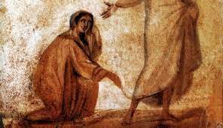
Gathering Song/Hymn of Praise
“Lord Jesus, Think on Me”
LBW 309

Slide 13
“Lord Jesus, Think On Me” LBW 309
1 Lord Jesus, think on me,
and purge away my sin;
from selfish passions set me free
and make me pure within.
2 Lord Jesus, think on me,
by anxious thoughts oppressed;
let me your loving servant be
and taste your promised rest.
Notes:
Image: Five Loaves by Caroline Coolidge Brown. Copyright © Caroline Coolidge Brown. All rights reserved. Used by permission of the artist.

Slide 14
“Lord Jesus, Think On Me” LBW 309
3 Lord Jesus, think on me,
nor let me go astray;
through darkness and perplexity
point out your chosen way.
4 Lord Jesus, think on me,
that, when the flood is past,
I may the eternal brightness see
and share your joy at last.
Notes:
Image: Five Loaves by Caroline Coolidge Brown. Copyright © Caroline Coolidge Brown. All rights reserved. Used by permission of the artist.

Slide 15
APOSTOLIC GREETING
P: The grace of our Lord Jesus Christ, the love of God, and the communion of the Holy Spirit be with you all.
C: And also with you.
Notes:
Image: Five Loaves by Caroline Coolidge Brown. Copyright © Caroline Coolidge Brown. All rights reserved. Used by permission of the artist.

Slide 16
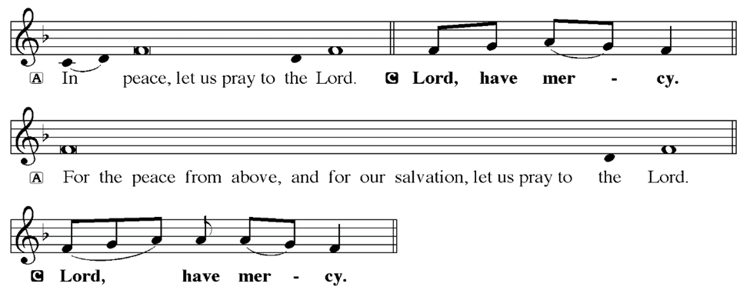
KYRIE
Notes:
Image: Five Loaves by Caroline Coolidge Brown. Copyright © Caroline Coolidge Brown. All rights reserved. Used by permission of the artist.

Slide 17
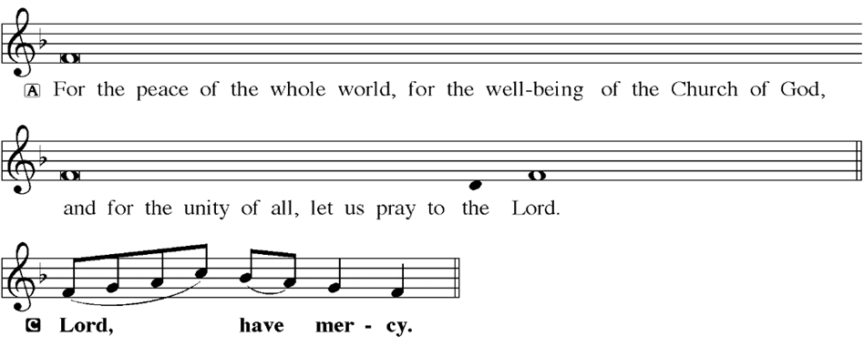
KYRIE
Notes:
Image: Five Loaves by Caroline Coolidge Brown. Copyright © Caroline Coolidge Brown. All rights reserved. Used by permission of the artist.

Slide 18
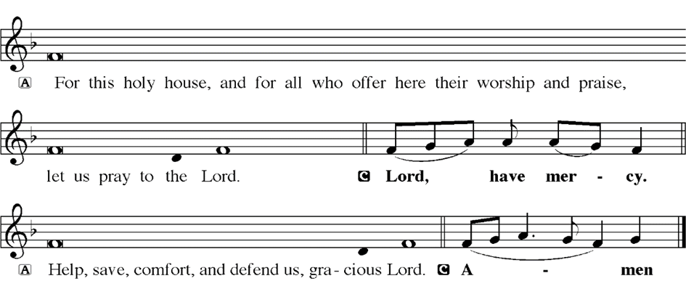
KYRIE
Notes:
Image: Five Loaves by Caroline Coolidge Brown. Copyright © Caroline Coolidge Brown. All rights reserved. Used by permission of the artist.

Slide 19
HYMN OF PRAISE
Glory be to God in heaven;
peace, goodwill to all the earth.
Mighty God of all creation,
Father of surpassing worth:
we exalt you, we adore you,
we lift high our thanks and praise.
Saints and angels bow before you; here on earth our songs we raise.
Notes:
Image: Five Loaves by Caroline Coolidge Brown. Copyright © Caroline Coolidge Brown. All rights reserved. Used by permission of the artist.

Slide 20
HYMN OF PRAISE
Glory be to Christ forever,
Lamb of God and Lord of love.
Son of God and gracious Savior, you have come from heav’n above;
on the cross you died to save us; now you reign at God’s right hand.
Hear our prayer; restore, forgive us; in your promise firm we stand.
Notes:
Image: Five Loaves by Caroline Coolidge Brown. Copyright © Caroline Coolidge Brown. All rights reserved. Used by permission of the artist.

Slide 21
HYMN OF PRAISE
Holy One we now acclaim you;
Lord alone, to you we call;
Holy One in faith we name you,
God most high, yet near to all:
Jesus Christ, with God the Spirit,
in the Father’s splendor bright.
For the peace that we inherit,
glory be to God on high!
Notes:
Image: Five Loaves by Caroline Coolidge Brown. Copyright © Caroline Coolidge Brown. All rights reserved. Used by permission of the artist.

Slide 22
PRAYER OF THE DAY
P: Let us pray… Mothering God, high and low, rich and poor, healthy and ailing, joyous and sorrowful, we come to you, knowing that in you is rest and restoration. Quiet our spirits that we might be open to receive your blessings in word and meal, for our own good and for the good of all. In Jesus’ name we pray.
C: Amen
Notes:
Image: Five Loaves by Caroline Coolidge Brown. Copyright © Caroline Coolidge Brown. All rights reserved. Used by permission of the artist.

Slide 23
Notes:
Image: Five Loaves by Caroline Coolidge Brown. Copyright © Caroline Coolidge Brown. All rights reserved. Used by permission of the artist.

Slide 24
Scripture Reading
L: Our scripture reading for this day is from the Gospel of Mark, the 5th Chapter.
C: Glory to you O’ Lord!
Notes:
Image: Five Loaves by Caroline Coolidge Brown. Copyright © Caroline Coolidge Brown. All rights reserved. Used by permission of the artist.

Slide 25
Mark 5:21-43
²¹ When Jesus had crossed again in the boat to the other side, a great crowd gathered around him; and he was by the sea. ²² Then one of the leaders of the synagogue named Jairus came and, when he saw him, fell at his feet ²³ and begged him repeatedly, “My little daughter is at the point of death. Come and lay your hands on her, so that she may be
Notes:
Image: Five Loaves by Caroline Coolidge Brown. Copyright © Caroline Coolidge Brown. All rights reserved. Used by permission of the artist.

Slide 26
Mark 5:21-43
made well, and live.” ²⁴ So he went with him.
And a large crowd followed him and pressed in on him. ²⁵ Now there was a woman who had been suffering from hemorrhages for twelve years. ²⁶ She had endured much under many physicians, and had spent all that she had; and she was no better, but rather grew worse. ²⁷ She had heard about
Notes:
Image: Five Loaves by Caroline Coolidge Brown. Copyright © Caroline Coolidge Brown. All rights reserved. Used by permission of the artist.

Slide 27
Mark 5:21-43
Jesus, and came up behind him in the crowd and touched his cloak, ²⁸ for she said, “If I but touch his clothes, I will be made well.” ²⁹ Immediately her hemorrhage stopped; and she felt in her body that she was healed of her disease. ³⁰ Immediately aware that power had gone forth from him, Jesus turned about in the crowd and said, “Who touched my clothes?” ³¹ And his
Notes:
Image: Five Loaves by Caroline Coolidge Brown. Copyright © Caroline Coolidge Brown. All rights reserved. Used by permission of the artist.

Slide 28
Mark 5:21-43
disciples said to him, “You see the crowd pressing in on you; how can you say, ‘Who touched me?’” ³² He looked all around to see who had done it. ³³ But the woman, knowing what had happened to her, came in fear and trembling, fell down before him, and told him the whole truth. ³⁴ He said to her, “Daughter, your faith has made you well; go in peace, and
Notes:
Image: Five Loaves by Caroline Coolidge Brown. Copyright © Caroline Coolidge Brown. All rights reserved. Used by permission of the artist.

Slide 29
Mark 5:21-43
be healed of your disease.”
³⁵ While he was still speaking, some people came from the leader’s house to say, “Your daughter is dead. Why trouble the teacher any further?” ³⁶ But overhearing what they said, Jesus said to the leader of the synagogue, “Do not fear, only believe.” ³⁷ He allowed no one to follow him except Peter, James, and John, the brother
Notes:
Image: Five Loaves by Caroline Coolidge Brown. Copyright © Caroline Coolidge Brown. All rights reserved. Used by permission of the artist.

Slide 30
Mark 5:21-43
of James. ³⁸ When they came to the house of the leader of the synagogue, he saw a commotion, people weeping and wailing loudly. ³⁹When he had entered, he said to them, “Why do you make a commotion and weep? The child is not dead but sleeping.” ⁴⁰ And they laughed at him. Then he put them all outside, and took the child’s father and mother and those who were with
Notes:
Image: Five Loaves by Caroline Coolidge Brown. Copyright © Caroline Coolidge Brown. All rights reserved. Used by permission of the artist.

Slide 31
Mark 5:21-43
him, and went in where the child was. ⁴¹ He took her by the hand and said to her, “Talitha cum,” which means, “Little girl, get up!” ⁴² And immediately the girl got up and began to walk about (she was twelve years of age). At this they were overcome with amazement. ⁴³ He strictly ordered them that no one should know this, and told them to give her something to eat.
Notes:
Image: Five Loaves by Caroline Coolidge Brown. Copyright © Caroline Coolidge Brown. All rights reserved. Used by permission of the artist.

Slide 32
Mark 5:21-43
R: This is the Word of the Lord.
C: Praise to You, O Christ
Notes:
Image: Five Loaves by Caroline Coolidge Brown. Copyright © Caroline Coolidge Brown. All rights reserved. Used by permission of the artist.

Slide 33
Sermon

Slide 34
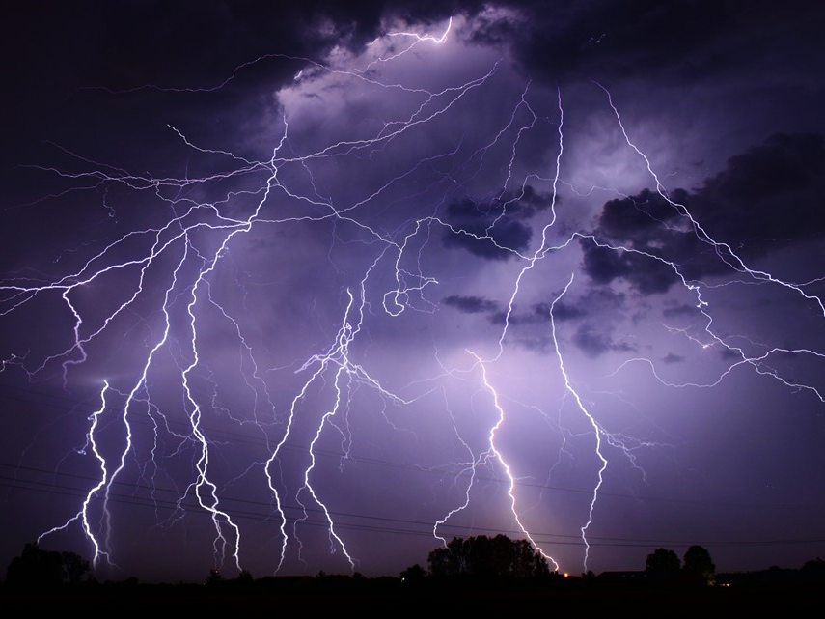
Sermon

Slide 35
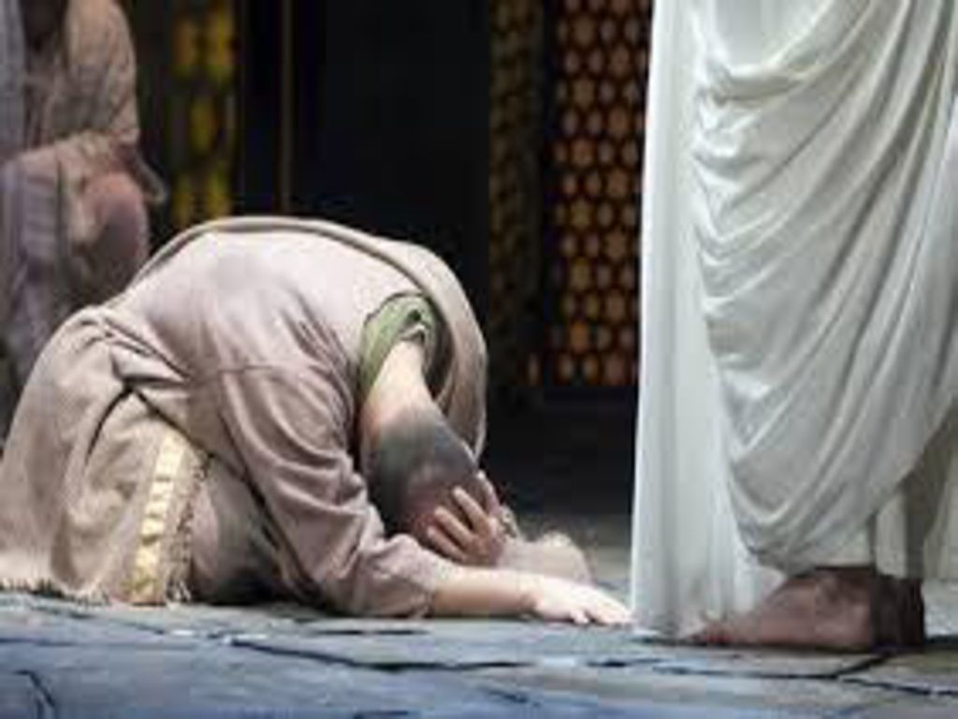
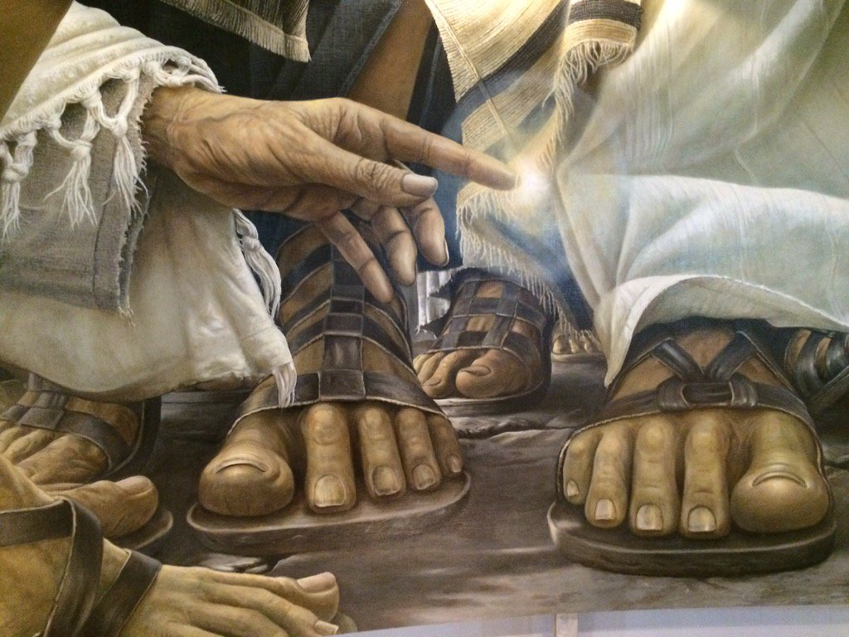
Sermon

Slide 36
Sermon

Slide 37
Sermon

Slide 38
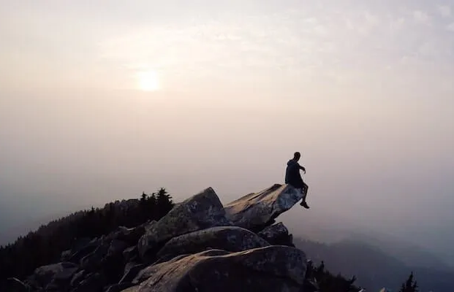
Sermon

Slide 39
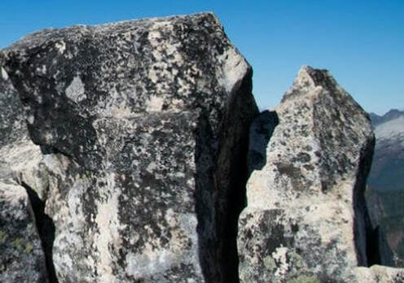
HYMN OF THE DAY
“XXX”
LBW XXX

Slide 40
“XXX” LBW XXX

Slide 41
APOSTLE’S CREED
C: I believe in God, the Father almighty, creator of heaven and earth.

Slide 42
APOSTLE’S CREED
C: I believe in Jesus Christ, his only Son, our Lord. He was conceived by the power of the Holy Spirit and born of the virgin Mary. He suffered under Pontius Pilate, was crucified, died, and was buried.

Slide 43
APOSTLE’S CREED
C: He descended into hell. On the third day he rose again. He ascended into heaven, and is seated at the right hand of the Father. He will come again to judge the living and the dead.

Slide 44
APOSTLE’S CREED
C: I believe in the Holy Spirit, the holy catholic Church, the communion of saints, the forgiveness of sins, the resurrection of the body, and the life everlasting. Amen.

Slide 45
NICENE CREED
C: We believe in one God, the Father, the Almighty, maker of heaven and earth, of all that is, seen and unseen.

Slide 46
NICENE CREED
C: We believe in one Lord, Jesus Christ, the only Son of God, eternally begotten of the Father, God from God, Light from Light, true God from true God, begotten, not made, of one Being with the Father.

Slide 47
NICENE CREED
C: Through him all things were made. For us and for our salvation he came down from heaven; by the power of the Holy Spirit he became incarnate from the virgin Mary, and was made man. For our sake he was crucified under Pontius Pilate;

Slide 48
NICENE CREED
C: he suffered death and was buried. On the third day he rose again in accordance with the Scriptures; he ascended into heaven and is seated at the right hand of the Father. He will come again in glory to judge the living and the dead, and his kingdom will have no end.

Slide 49
NICENE CREED
C: We believe in the Holy Spirit, the Lord, the giver of life, who proceeds from the Father and the Son. With the Father and the Son he is worshiped and glorified. He has spoken through the prophets. We believe in one holy catholic and apostolic Church.

Slide 50
NICENE CREED
C: We acknowledge one Baptism for the forgiveness of sins. We look for the resurrection of the dead, and the life of the world to come. Amen.

Slide 51
QUILT TYING AND PRESENTATION
This Quilt was lovingly crafted for recovery and healing especially for XXX.
Let us pray…

Slide 52
PRAYERS OF INTERCESSION
Each petition will end with the words,
A: God our teacher and healer,
The congregation will respond with:
C: In mercy, hear our prayer.

Slide 53
PRAYERS OF INTERCESSION
The prayer concludes…
P: Confident that in Christ Jesus you answer prayer, we lift to you all for whom pray, aloud and in our hearts, through Jesus Christ, our savior.
C: Amen.

Slide 54
OFFERING
Notes:
Image: Five Loaves by Caroline Coolidge Brown. Copyright © Caroline Coolidge Brown. All rights reserved. Used by permission of the artist.

Slide 55
OFFERING PRAYER
Notes:
Image: Five Loaves by Caroline Coolidge Brown. Copyright © Caroline Coolidge Brown. All rights reserved. Used by permission of the artist.

Slide 56
THE GREAT THANKSGIVING
All the Baptized are welcome to celebrate this Holy Meal.

Slide 57
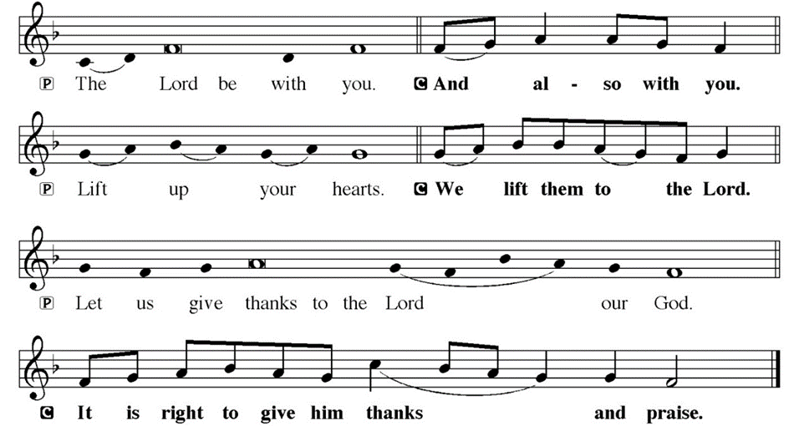
DIALOGUE

Slide 58
THE PREFACE
P: It is indeed right and salutary…
… we praise your name and join their unending hymn.

Slide 59
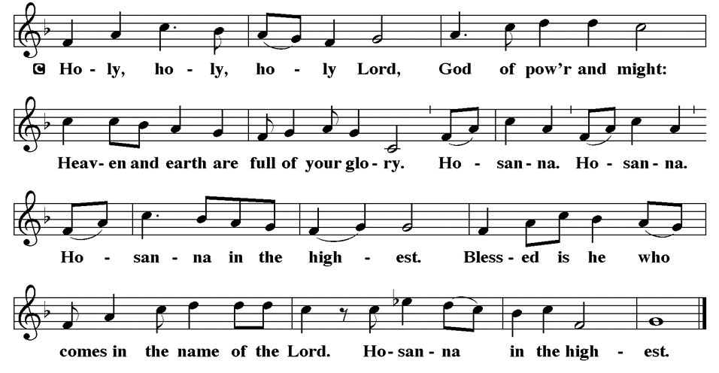
THE SANCTUS

Slide 60
EUCHARISTIC PRAYER
P: Holy God…
…both now and forever.
C: Amen.

Slide 61
THE LORD’S PRAYER
C: Our Father, who art in heaven, hallowed be thy name, thy kingdom come, thy will be done, on earth as it is in heaven. Give us this day our daily bread; and forgive us our trespasses, as we forgive those who trespass against us; and lead us not into temptation, but deliver us from evil.

Slide 62
THE LORD’S PRAYER
C: For thine is the kingdom, and the power, and the glory, forever and ever. Amen.

Slide 63
INVITATION TO COMMUNION
P: Jesus, whose touch means healing and wholeness, reaches out to you, takes you by the hand, and invites you to this holy table, where all are fed and nourished by his grace. Come and eat. All is prepared for you.

Slide 64
COMMUNION DISTRIBUTION
All will commune “By At the Railing”.
The bread may be broken for distribution. As the ministers give the bread and wine, they say these words :
The body of Christ, given for you.
The blood of Christ, shed for you.
The communicant may say: Amen.

Slide 65
POST COMMUNION BLESSING
P: May this body and blood of our Lord and Savior, Jesus Christ, strengthen, keep, and unity us, ☩ now and forever,
C: Amen.

Slide 66
POST COMMUNION CANTACLE

Slide 67
POST COMMUNION CANTACLE

Slide 68
POST COMMUNION PRAYER
P: Let us pray… Giver of every gift, Christ’s body is our food, and we are Christ’s body. Raise us to life by your power for the benefit of all and to your glory, now and forever.
C: Amen

Slide 69
ANNOUNCEMENTS
Notes:
Image: Five Loaves by Caroline Coolidge Brown. Copyright © Caroline Coolidge Brown. All rights reserved. Used by permission of the artist.

Slide 70
SENDING BLESSING
P: God who names you, Christ who claims you, and the Holy Spirit who dwells in you, ☩ bless you and remain with you always.
C: Amen.

Slide 71
Sending Song
“Joyful, Joyful We Adore Thee”
LBW 551
Notes:
Image: Five Loaves by Caroline Coolidge Brown. Copyright © Caroline Coolidge Brown. All rights reserved. Used by permission of the artist.

Slide 72
“Joyful, Joyful We Adore Thee” LBW 551
1 Joyful, joyful we adore thee,
God of glory, Lord of love!
Hearts unfold like flow’rs before thee,
praising thee, their sun above.
Melt the clouds of sin and sadness,
drive the gloom of doubt away.
Giver of immortal gladness,
fill us with the light of day.
Notes:
Image: Preparing yeast dough. Copyright © tomasworks/iStock/Thinkstock. Used by permission.

Slide 73
“Joyful, Joyful We Adore Thee” LBW 551
2 All thy works with joy surround thee,
earth and heav’n reflect thy rays,
stars and angels sing around thee,
center of unbroken praise.
Field and forest, vale and mountain,
flow’ry meadow, flashing sea,
chanting bird, and flowing fountain
call us to rejoice in thee.
Notes:
Image: Preparing yeast dough. Copyright © tomasworks/iStock/Thinkstock. Used by permission.

Slide 74
“Joyful, Joyful We Adore Thee” LBW 551
3 Thou art giving and forgiving,
ever blessing, ever blest,
wellspring of the joy of living,
ocean-depth of happy rest!
Thou our Father, Christ our brother,
all who live in love are thine;
teach us how to love each other,
lift us to the joy divine!
Notes:
Image: Preparing yeast dough. Copyright © tomasworks/iStock/Thinkstock. Used by permission.

Slide 75
DISMISSAL
P: … Depart in Christ’s Love.
C: Seeking, welcoming, and serving all. Amen!
POSTLUDE
By
Roxanne Groff
From sundaysandseasons.com. Copyright © 2024 Augsburg Fortress. All rights reserved. Reprinted by permission under Augsburg Fortress Liturgies Annual License #SAS023830. New Revised Standard Version Bible, Copyright © 1989, Division of Christian Education of the National Council of the Churches of Christ in the United States of America. Used by permission. All rights reserved. Revised Common Lectionary, Copyright © 1992 Consultation on Common Texts, admin Augsburg Fortress. Used by permission.

