Slide 1
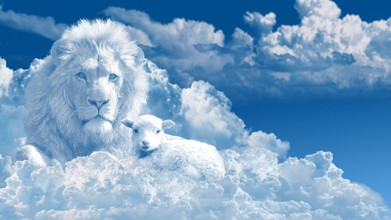
August 10, 2025
WELCOME!
Trinity Lutheran Church
Notes:
Image: Five Loaves by Caroline Coolidge Brown. Copyright © Caroline Coolidge Brown. All rights reserved. Used by permission of the artist.

Slide 2
= Please stand if able
= Please be seated
Prelude - By Roxanne Groff
Office of the Acolyte
Ringing of the Bell
Welcome
Notes:
Image: Five Loaves by Caroline Coolidge Brown. Copyright © Caroline Coolidge Brown. All rights reserved. Used by permission of the artist.

Slide 3
THANKSGIVING FOR BAPTISM
All may make the sign of the cross, the sign marked at baptism, as the presiding minister begins.
P: Blessed be the holy Trinity, ☩ one God, the fountain of living water, the rock who gave us birth, our light and our salvation.
C: Amen.
Notes:
Image: Preparing yeast dough. Copyright © tomasworks/iStock/Thinkstock. Used by permission.

Slide 4
P: Joined to Christ in the waters of baptism, we are clothed with God's mercy and forgiveness. Let us give thanks for the gift of baptism.
Water may be poured into the font as the presiding minister gives thanks.
THANKSGIVING FOR BAPTISM
Notes:
Image: Preparing yeast dough. Copyright © tomasworks/iStock/Thinkstock. Used by permission.

Slide 5
P: We give you thanks, O God, for in the beginning your Spirit moved over the waters and by your Word you created the world, calling forth life in which you took delight. Through the waters of the flood you delivered Noah and his family. Through the sea you led your people Israel from slavery into freedom.
THANKSGIVING FOR BAPTISM
Notes:
Image: Preparing yeast dough. Copyright © tomasworks/iStock/Thinkstock. Used by permission.

Slide 6
P: At the river your Son was baptized by John and anointed with the Holy Spirit. By water and your Word you claim us as daughters and sons, making us heirs of your promise and servants of all. We praise you for the gift of water that sustains life, and above all we praise you for the gift of new life in Jesus Christ.
THANKSGIVING FOR BAPTISM
Notes:
Image: Preparing yeast dough. Copyright © tomasworks/iStock/Thinkstock. Used by permission.

Slide 7
P: Shower us with your Spirit, and renew our lives with your forgiveness, grace, and love. To you be given honor and praise through Jesus Christ our Lord in the unity of the Holy Spirit, now and forever.
THANKSGIVING FOR BAPTISM
C: Amen.
Notes:
Image: Preparing yeast dough. Copyright © tomasworks/iStock/Thinkstock. Used by permission.

Slide 8
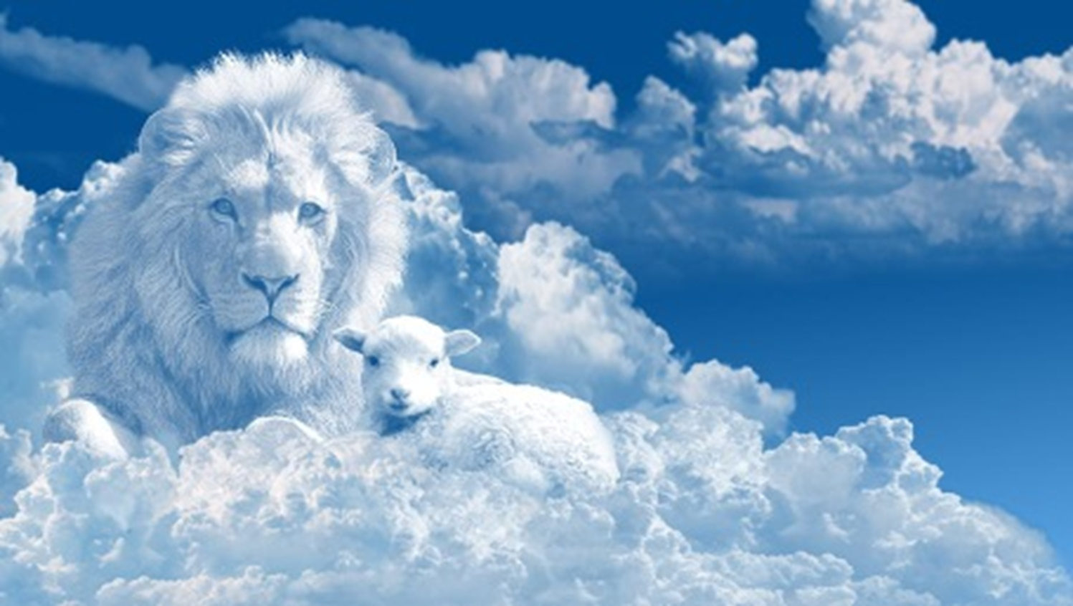
Gathering Song
“All Hail the Power of Jesus’ Name!”
LBW 328
(Verses 1, 2, 3, & 7 Only)

Slide 9
“All Hail the Power of Jesus’ Name!” LBW 328
1 All hail the pow’r of Jesus’ name!
Let angels prostrate fall;
bring forth the royal diadem
and crown him Lord of all.
Bring forth the royal diadem
and crown him Lord of all.
Notes:
Image: Five Loaves by Caroline Coolidge Brown. Copyright © Caroline Coolidge Brown. All rights reserved. Used by permission of the artist.

Slide 10
“All Hail the Power of Jesus’ Name!” LBW 328
2 Crown him, you martyrs of our God,
who from his altar call;
extol the stem of Jesse’s rod
and crown him Lord of all.
Extol the stem of Jesse’s rod
and crown him Lord of all.
Notes:
Image: Five Loaves by Caroline Coolidge Brown. Copyright © Caroline Coolidge Brown. All rights reserved. Used by permission of the artist.

Slide 11
“All Hail the Power of Jesus’ Name!” LBW 328
3 O seed of Israel’s chosen race
now ransomed from the fall,
hail him who saves you by his grace
and crown him Lord of all.
Hail him who saves you by his grace
and crown him Lord of all.
Notes:
Image: Five Loaves by Caroline Coolidge Brown. Copyright © Caroline Coolidge Brown. All rights reserved. Used by permission of the artist.

Slide 12
“All Hail the Power of Jesus’ Name!” LBW 328
7 Oh, that with yonder sacred throng
we at his feet may fall!
We’ll join the everlasting song
and crown him Lord of all.
We’ll join the everlasting song
and crown him Lord of all.
Notes:
Image: Five Loaves by Caroline Coolidge Brown. Copyright © Caroline Coolidge Brown. All rights reserved. Used by permission of the artist.

Slide 13
APOSTOLIC GREETING
P: The grace of our Lord Jesus Christ, the love of God, and the communion of the Holy Spirit be with you all.
C: And also with you.
Notes:
Image: Five Loaves by Caroline Coolidge Brown. Copyright © Caroline Coolidge Brown. All rights reserved. Used by permission of the artist.

Slide 14
PRAYER OF THE DAY
P: Let us pray… God who is One, relieve us of our relentless need to be right about all things, including you. Open our minds and our hearts to the reality that you are present in all things and in all peoples from the beginning of time to the end. Open our eyes to our neighbors, that we might be loving and accepting of different ways of encountering you. Unite all people in your divine will, of which love and justice are the fruits. In Jesus’ name we pray.
C: Amen.
Notes:
Image: Five Loaves by Caroline Coolidge Brown. Copyright © Caroline Coolidge Brown. All rights reserved. Used by permission of the artist.

Slide 15

Notes:
Image: Five Loaves by Caroline Coolidge Brown. Copyright © Caroline Coolidge Brown. All rights reserved. Used by permission of the artist.

Slide 16
Scripture Reading
L: Our scripture reading is from Revelation, Chapter 5.
C: Glory to you O’ Lord!
Notes:
Image: Five Loaves by Caroline Coolidge Brown. Copyright © Caroline Coolidge Brown. All rights reserved. Used by permission of the artist.

Slide 17
Revelation 5:1-13
Then I saw in the right hand of the one seated on the throne a scroll written on the inside and on the back, sealed with seven seals; ²and I saw a mighty angel proclaiming with a loud voice, ‘Who is worthy to open the scroll and break its seals?’ ³And no one in heaven or on earth or under the earth was able to open the scroll or to look into it. ⁴And I began to
Notes:
Image: Five Loaves by Caroline Coolidge Brown. Copyright © Caroline Coolidge Brown. All rights reserved. Used by permission of the artist.

Slide 18
Revelation 5:1-13
weep bitterly because no one was found worthy to open the scroll or to look into it. ⁵Then one of the elders said to me, ‘Do not weep. See, the Lion of the tribe of Judah, the Root of David, has conquered, so that he can open the scroll and its seven seals.’
⁶Then I saw between the throne and the four living creatures and among
Notes:
Image: Five Loaves by Caroline Coolidge Brown. Copyright © Caroline Coolidge Brown. All rights reserved. Used by permission of the artist.

Slide 19
Revelation 5:1-13
the elders a Lamb standing as if it had been slaughtered, having seven horns and seven eyes, which are the seven spirits of God sent out into all the earth. ⁷He went and took the scroll from the right hand of the one who was seated on the throne. ⁸When he had taken the scroll, the four living creatures and the twenty-four elders fell before the Lamb, each
Notes:
Image: Five Loaves by Caroline Coolidge Brown. Copyright © Caroline Coolidge Brown. All rights reserved. Used by permission of the artist.

Slide 20
Revelation 5:1-13
holding a harp and golden bowls full of incense, which are the prayers of the saints. ⁹They sing a new song:
‘You are worthy to take the scroll
and to open its seals,
for you were slaughtered and by your blood you ransomed for God
saints from every tribe and language and people and nation;
¹⁰ you have made them to be a
Notes:
Image: Five Loaves by Caroline Coolidge Brown. Copyright © Caroline Coolidge Brown. All rights reserved. Used by permission of the artist.

Slide 21
Revelation 5:1-13
kingdom and priests serving our God, and they will reign on earth.’
¹¹Then I looked, and I heard the voice of many angels surrounding the throne and the living creatures and the elders; they numbered myriads of myriads and thousands of thousands, ¹²singing with full voice,
‘Worthy is the Lamb that was slaughtered to receive power and
Notes:
Image: Five Loaves by Caroline Coolidge Brown. Copyright © Caroline Coolidge Brown. All rights reserved. Used by permission of the artist.

Slide 22
Revelation 5:1-13
wealth and wisdom and might
and honor and glory and blessing!’
¹³Then I heard every creature in heaven and on earth and under the earth and in the sea, and all that is in them, singing, ‘To the one seated on the throne and to the Lamb be blessing and honor and glory and might for ever and ever!’
Notes:
Image: Five Loaves by Caroline Coolidge Brown. Copyright © Caroline Coolidge Brown. All rights reserved. Used by permission of the artist.

Slide 23
Revelation 5:1-13
R: This is the Word of the Lord!
C: Praise to You, O Christ
Notes:
Image: Five Loaves by Caroline Coolidge Brown. Copyright © Caroline Coolidge Brown. All rights reserved. Used by permission of the artist.

Slide 24
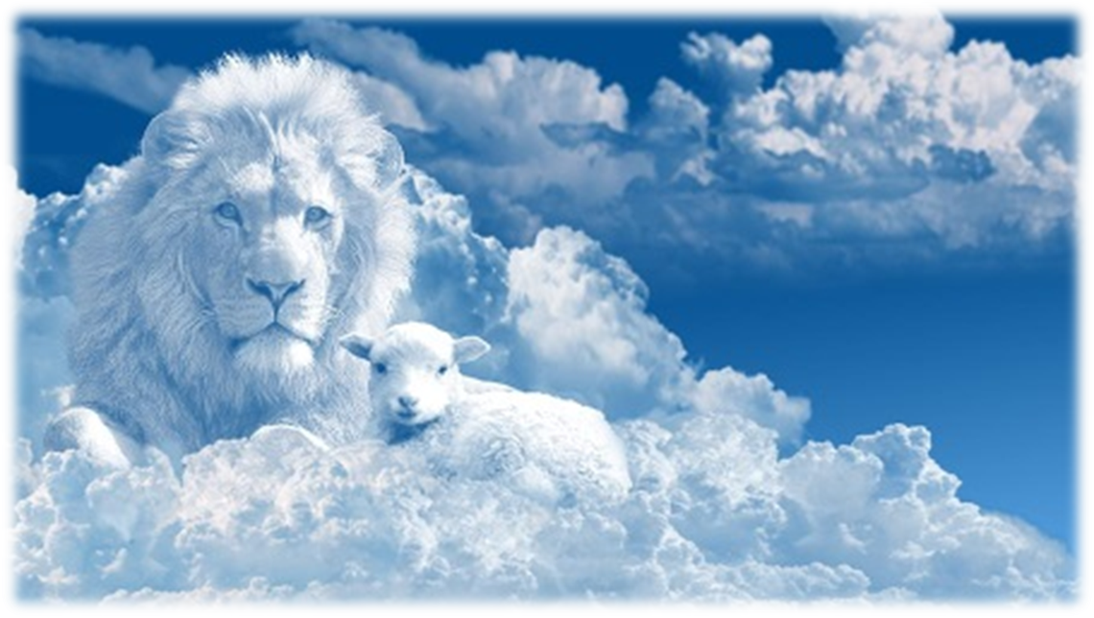
Sermon

Slide 25

Sermon

Slide 26
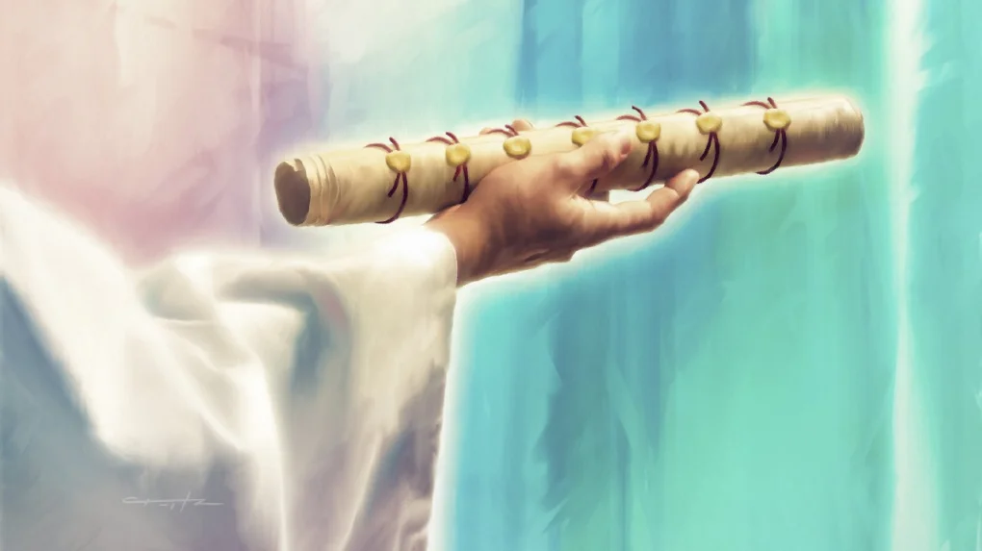
Sermon

Slide 27
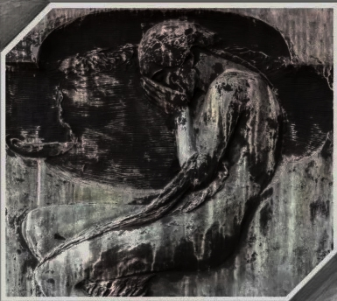
Sermon

Slide 28
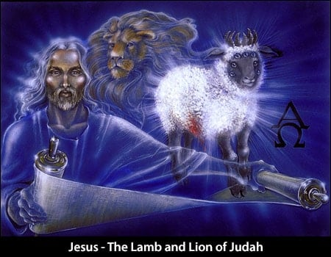
Sermon

Slide 29

Sermon

Slide 30
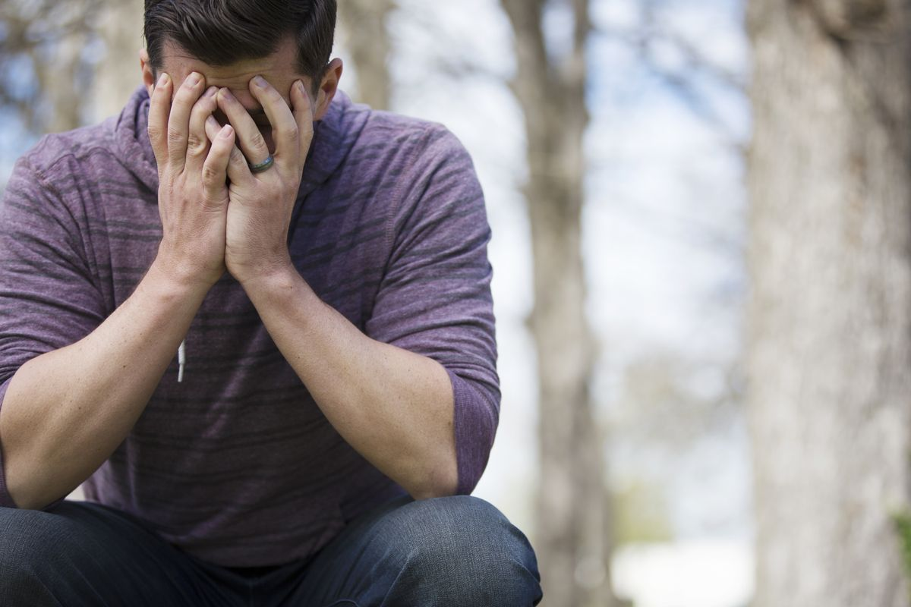
Sermon

Slide 31
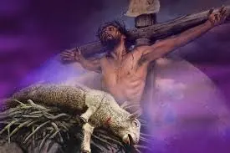
Sermon

Slide 32
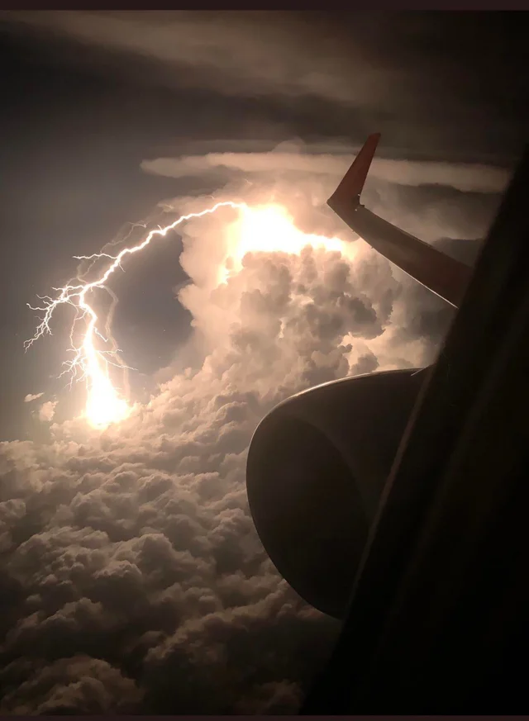
Sermon

Slide 33
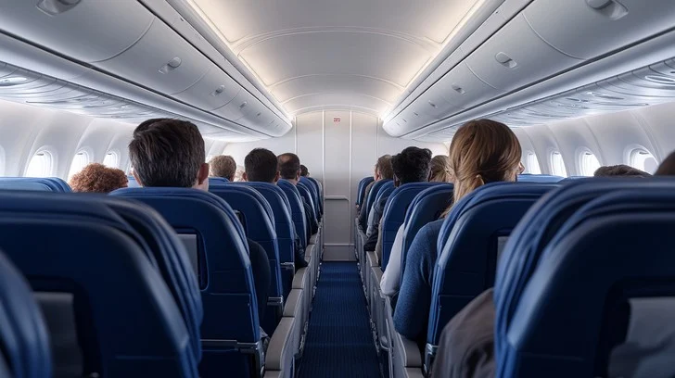
Sermon

Slide 34
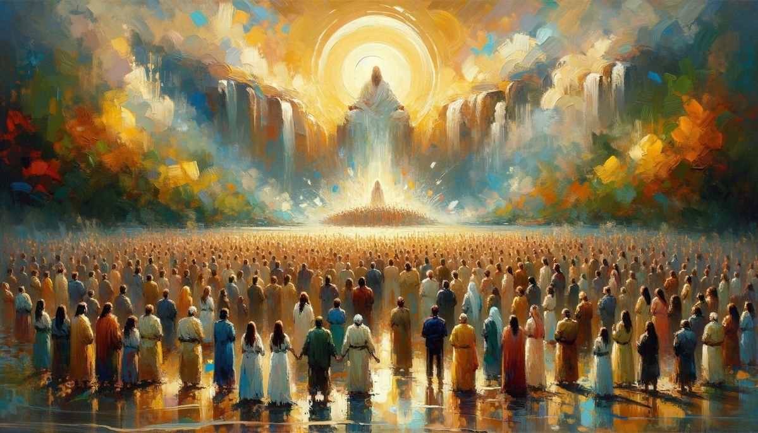
Sermon

Slide 35
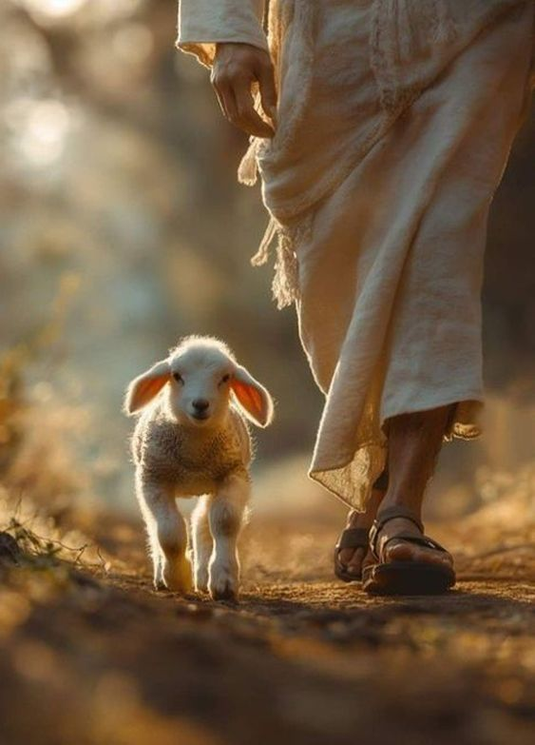

Sermon
Not in Charge…
In Charge…

Slide 36
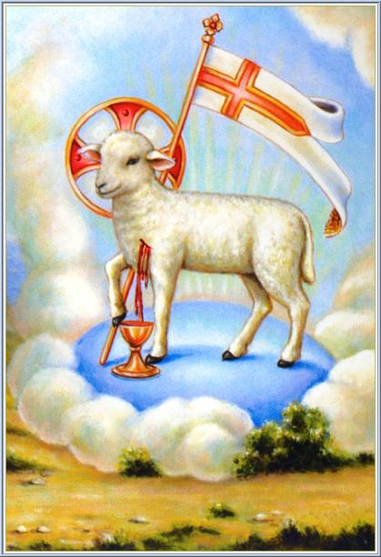
Sermon

Slide 37
Hymn of the Day
“Thine Is the Glory”
LBW 145

Slide 38
“Thine Is the Glory” LBW 145
1 Thine is the glory,
risen, conqu'ring Son;
endless is the vict'ry
thou o'er death hast won!
Angels in bright raiment
rolled the stone away,
kept the folded grave-clothes
where thy body lay.

Slide 39
“Thine Is the Glory” LBW 145
Refrain
Thine is the glory,
risen, conqu'ring Son;
endless is the vict'ry
thou o'er death hast won!

Slide 40
“Thine Is the Glory” LBW 145
2 Lo, Jesus meets thee,
risen from the tomb!
Lovingly he greets thee,
scatters fear and gloom;
let his church with gladness
hymns of triumph sing,
for the Lord now liveth;
death hath lost its sting!

Slide 41
“Thine Is the Glory” LBW 145
Refrain
Thine is the glory,
risen, conqu'ring Son;
endless is the vict'ry
thou o'er death hast won!

Slide 42
“Thine Is the Glory” LBW 145
3 No more we doubt thee,
glorious Prince of life;
life is naught without thee;
aid us in our strife;
make us more than conqu'rors,
through thy deathless love;
bring us safe through Jordan
to thy home above.

Slide 43
“Thine Is the Glory” LBW 145
Refrain
Thine is the glory,
risen, conqu'ring Son;
endless is the vict'ry
thou o'er death hast won!

Slide 44
APOSTLE’S CREED
C: I believe in God, the Father almighty, creator of heaven and earth.

Slide 45
APOSTLE’S CREED
C: I believe in Jesus Christ, his only Son, our Lord. He was conceived by the power of the Holy Spirit and born of the virgin Mary. He suffered under Pontius Pilate, was crucified, died, and was buried.

Slide 46
APOSTLE’S CREED
C: He descended into hell. On the third day he rose again. He ascended into heaven, and is seated at the right hand of the Father. He will come again to judge the living and the dead.

Slide 47
APOSTLE’S CREED
C: I believe in the Holy Spirit, the holy catholic Church, the communion of saints, the forgiveness of sins, the resurrection of the body, and the life everlasting. Amen.

Slide 48
NICENE CREED
C: We believe in one God, the Father, the Almighty, maker of heaven and earth, of all that is, seen and unseen.

Slide 49
NICENE CREED
C: We believe in one Lord, Jesus Christ, the only Son of God, eternally begotten of the Father, God from God, Light from Light, true God from true God, begotten, not made, of one Being with the Father.

Slide 50
NICENE CREED
C: Through him all things were made. For us and for our salvation he came down from heaven; by the power of the Holy Spirit he became incarnate from the virgin Mary, and was made man. For our sake he was crucified under Pontius Pilate;

Slide 51
NICENE CREED
C: he suffered death and was buried. On the third day he rose again in accordance with the Scriptures; he ascended into heaven and is seated at the right hand of the Father. He will come again in glory to judge the living and the dead, and his kingdom will have no end.

Slide 52
NICENE CREED
C: We believe in the Holy Spirit, the Lord, the giver of life, who proceeds from the Father and the Son. With the Father and the Son he is worshiped and glorified. He has spoken through the prophets. We believe in one holy catholic and apostolic Church.

Slide 53
NICENE CREED
C: We acknowledge one Baptism for the forgiveness of sins. We look for the resurrection of the dead, and the life of the world to come. Amen.

Slide 54
PRAYERS OF INTERCESSION
Each petition will end with the words,
A: Alpha and Omega,
The congregation will respond with:
C: Hear our prayer.

Slide 55
PRAYERS OF INTERCESSION
The prayer concludes…
P: All things exist in and through you, loving God. Therefore, we entrust our prayers, our faith, and our lives to you, in the name of Jesus.
C: Amen.

Slide 56
OFFERING/OFFERING PRAYER
Notes:
Image: Five Loaves by Caroline Coolidge Brown. Copyright © Caroline Coolidge Brown. All rights reserved. Used by permission of the artist.

Slide 57
THE LORD’S PRAYER
C: Our Father, who art in heaven, hallowed be thy name, thy kingdom come, thy will be done, on earth as it is in heaven. Give us this day our daily bread; and forgive us our trespasses, as we forgive those who trespass against us; and lead us not into temptation, but deliver us from evil.

Slide 58
THE LORD’S PRAYER
C: For thine is the kingdom, and the power, and the glory, forever and ever. Amen.

Slide 59

ANNOUNCEMENTS
Notes:
Image: Five Loaves by Caroline Coolidge Brown. Copyright © Caroline Coolidge Brown. All rights reserved. Used by permission of the artist.

Slide 60
SENDING BLESSING
P: The love of God abound in you; the grace of our Savior Jesus Christ fill your hearts; and the life of the Spirit ☩ bless you and give you peace.
C: Amen.

Slide 61
SENDING HYMN
“Let All Things Now Living”
LBW 557

Slide 62
“Let All Things Now Living” LBW 557
1 Let all things now living
a song of thanksgiving
to God the creator triumphantly raise,
who fashioned and made us,
protected and stayed us,
who still guides us on to the end of our days.

Slide 63
“Let All Things Now Living” LBW 557
1 God's banners are o'er us,
God's light goes before us,
a pillar of fire shining forth in the night,
till shadows have vanished
and darkness is banished,
as forward we travel from light into light.

Slide 64
“Let All Things Now Living” LBW 557
2 God rules all the forces:
the stars in their courses
and sun in its orbit obediently shine;
the hills and the mountains,
the rivers and fountains,
the deeps of the ocean proclaim God divine.

Slide 65
“Let All Things Now Living” LBW 557
2 We too should be voicing
our love and rejoicing;
with glad adoration a song let us raise
till all things now living
unite in thanksgiving:
"To God in the highest, hosanna and praise!"

Slide 66
DISMISSAL
P: … Depart in Christ’s Love.
C: Seeking, welcoming, and serving all. Amen!
POSTLUDE
By Roxanne Groff
From sundaysandseasons.com. Copyright © 2025 Augsburg Fortress. All rights reserved. Reprinted by permission under Augsburg Fortress Liturgies Annual License #SAS023830. New Revised Standard Version Bible, Copyright © 1989, Division of Christian Education of the National Council of the Churches of Christ in the United States of America. Used by permission. All rights reserved. Revised Common Lectionary, Copyright © 1992 Consultation on Common Texts, admin Augsburg Fortress. Used by permission.

