Slide 1
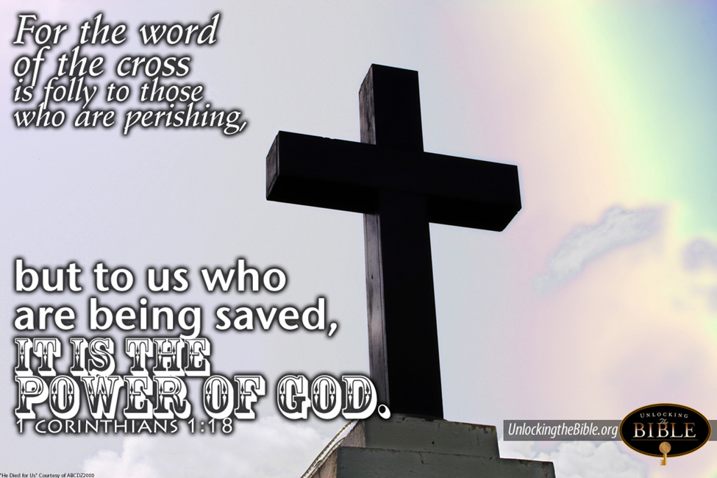
Trinity Evangelical Lutheran Church
Youth Sunday!
April 21, 2024
WELCOME!
Notes:
Image: Five Loaves by Caroline Coolidge Brown. Copyright © Caroline Coolidge Brown. All rights reserved. Used by permission of the artist.

Slide 2
Prelude By Roxanne Groff
= Please stand if able
= Please be seated
Office of the Acolyte and Ringing of the Bell
Welcome – PJ Musser
Notes:
Image: Five Loaves by Caroline Coolidge Brown. Copyright © Caroline Coolidge Brown. All rights reserved. Used by permission of the artist.

Slide 3
CONFESSION AND FORGIVENESS
All may make the sign of the cross, the sign marked at baptism…
P: We confess our sins before God and one another.
Pause for silence and reflection.
P: Risen God,
Notes:
Image: Five Loaves by Caroline Coolidge Brown. Copyright © Caroline Coolidge Brown. All rights reserved. Used by permission of the artist.

Slide 4
CONFESSION AND FORGIVENESS
C: We confess to you, to ourselves, and to one another that we have caused harm by the things we have said and done, and by the things we have not said and not done.
Notes:
Image: Five Loaves by Caroline Coolidge Brown. Copyright © Caroline Coolidge Brown. All rights reserved. Used by permission of the artist.

Slide 5
CONFESSION AND FORGIVENESS
C: Take away our sins that we might fully embody your commandment to love you with all our hearts, souls, minds, and strength, and to love our neighbors as ourselves.
Notes:
Image: Five Loaves by Caroline Coolidge Brown. Copyright © Caroline Coolidge Brown. All rights reserved. Used by permission of the artist.

Slide 6
CONFESSION AND FORGIVENESS
P: In grace and mercy, God forgives all our sins, and with joy and expectation calls us into new life for the sake of the world, through Jesus Christ our savior.
C: Amen.
Notes:
Image: Five Loaves by Caroline Coolidge Brown. Copyright © Caroline Coolidge Brown. All rights reserved. Used by permission of the artist.

Slide 7
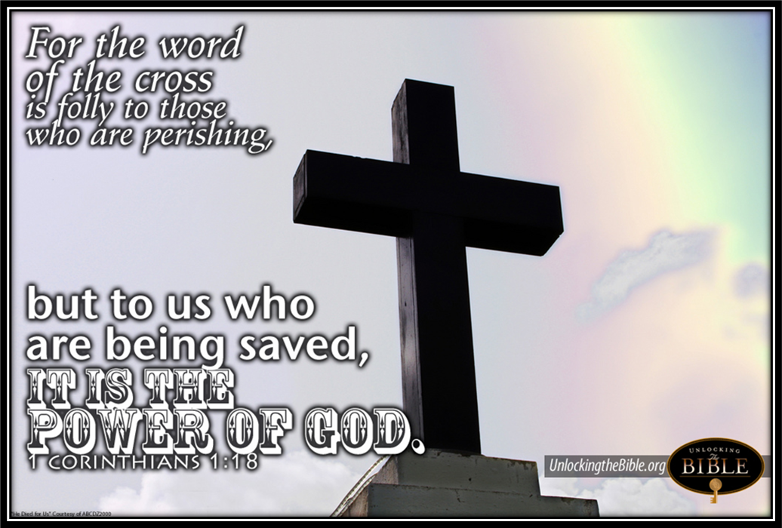
Gathering Song
“Jesus, Keep Me Near the Cross”
ELW 335
Notes:
Image: Five Loaves by Caroline Coolidge Brown. Copyright © Caroline Coolidge Brown. All rights reserved. Used by permission of the artist.

Slide 8
“Jesus, Keep Me Near The Cross” ELW 335
1 Jesus, keep me near the cross,
there's a precious fountain;
free to all, a healing stream
flows from Calv'ry's mountain.
Refrain
In the cross, in the cross
be my glory ever;
till my ransomed soul shall find
rest beyond the river.
Notes:
Image: Five Loaves by Caroline Coolidge Brown. Copyright © Caroline Coolidge Brown. All rights reserved. Used by permission of the artist.

Slide 9
“Jesus, Keep Me Near The Cross” ELW 335
2 Near the cross, a trembling soul,
love and mercy found me;
there the bright and morning star
sheds its beams around me.
Refrain
In the cross, in the cross
be my glory ever;
till my ransomed soul shall find
rest beyond the river.
Notes:
Image: Five Loaves by Caroline Coolidge Brown. Copyright © Caroline Coolidge Brown. All rights reserved. Used by permission of the artist.

Slide 10
“Jesus, Keep Me Near The Cross” ELW 335
3 Near the cross! O Lamb of God,
bring its scenes before me;
help me walk from day to day
with its shadow o'er me.
Refrain
In the cross, in the cross
be my glory ever;
till my ransomed soul shall find
rest beyond the river.
Notes:
Image: Five Loaves by Caroline Coolidge Brown. Copyright © Caroline Coolidge Brown. All rights reserved. Used by permission of the artist.

Slide 11
“Jesus, Keep Me Near The Cross” ELW 335
4 Near the cross I'll watch and wait,
hoping, trusting ever,
till I reach the golden strand
just beyond the river.
Refrain
In the cross, in the cross
be my glory ever;
till my ransomed soul shall find
rest beyond the river.
Notes:
Image: Five Loaves by Caroline Coolidge Brown. Copyright © Caroline Coolidge Brown. All rights reserved. Used by permission of the artist.

Slide 12
APOSTOLIC GREETING
P: The grace of our Lord Jesus Christ, the love of God, and the communion of the Holy Spirit be with you all.
C: And also with you.
Notes:
Image: Five Loaves by Caroline Coolidge Brown. Copyright © Caroline Coolidge Brown. All rights reserved. Used by permission of the artist.

Slide 13
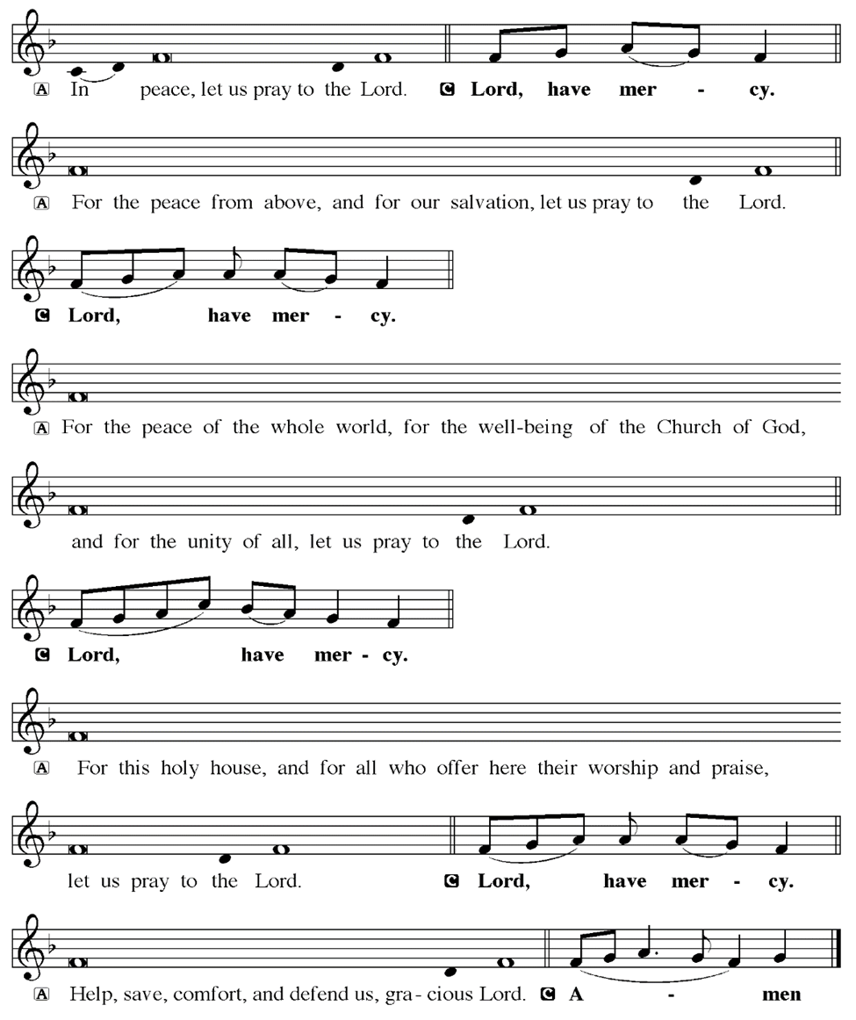
KYRIE
Notes:
Image: Five Loaves by Caroline Coolidge Brown. Copyright © Caroline Coolidge Brown. All rights reserved. Used by permission of the artist.

Slide 14
KYRIE
Notes:
Image: Five Loaves by Caroline Coolidge Brown. Copyright © Caroline Coolidge Brown. All rights reserved. Used by permission of the artist.

Slide 15
KYRIE
Notes:
Image: Five Loaves by Caroline Coolidge Brown. Copyright © Caroline Coolidge Brown. All rights reserved. Used by permission of the artist.

Slide 16
HYMN OF PRAISE
Glory be to God in heaven;
peace, goodwill to all the earth.
Mighty God of all creation,
Father of surpassing worth:
we exalt you, we adore you,
we lift high our thanks and praise.
Saints and angels bow before you; here on earth our songs we raise.
Notes:
Image: Five Loaves by Caroline Coolidge Brown. Copyright © Caroline Coolidge Brown. All rights reserved. Used by permission of the artist.

Slide 17
HYMN OF PRAISE
Glory be to Christ forever,
Lamb of God and Lord of love.
Son of God and gracious Savior, you have come from heav’n above;
on the cross you died to save us; now you reign at God’s right hand.
Hear our prayer; restore, forgive us; in your promise firm we stand.
Notes:
Image: Five Loaves by Caroline Coolidge Brown. Copyright © Caroline Coolidge Brown. All rights reserved. Used by permission of the artist.

Slide 18
HYMN OF PRAISE
Holy One we now acclaim you;
Lord alone, to you we call;
Holy One in faith we name you,
God most high, yet near to all:
Jesus Christ, with God the Spirit,
in the Father’s splendor bright.
For the peace that we inherit,
glory be to God on high!
Notes:
Image: Five Loaves by Caroline Coolidge Brown. Copyright © Caroline Coolidge Brown. All rights reserved. Used by permission of the artist.

Slide 19
PRAYER OF THE DAY
P: Let us pray… God of community, you call us into loving and supportive relationship with one another in our church family. Through the Holy Spirit, unify our hearts and minds, that together we might strive to bring your healing grace into the world. In Jesus’ name we pray.
C: Amen
Notes:
Image: Five Loaves by Caroline Coolidge Brown. Copyright © Caroline Coolidge Brown. All rights reserved. Used by permission of the artist.

Slide 20

Mercedes Angles
Notes:
Image: Preparing yeast dough. Copyright © tomasworks/iStock/Thinkstock. Used by permission.

Slide 21
Scripture Reading Carlee Kemp
R: Our scripture readings are from the Books of Acts, Chapter 18 and 1 Corinthians, Chapter 1.
C: Glory to you O’ Lord! (Spoken)
Notes:
Image: Five Loaves by Caroline Coolidge Brown. Copyright © Caroline Coolidge Brown. All rights reserved. Used by permission of the artist.

Slide 22
Acts 18:1-4; 1 Corinthians 1:10-18
Acts 18
After this Paul left Athens and went to Corinth. ² There he found a Jew named Aquila, a native of Pontus, who had recently come from Italy with his wife Priscilla, because Claudius had ordered all Jews to leave Rome. Paul went to see them,
Notes:
Image: Five Loaves by Caroline Coolidge Brown. Copyright © Caroline Coolidge Brown. All rights reserved. Used by permission of the artist.

Slide 23
Acts 18:1-4; 1 Corinthians 1:10-18
Acts 18
³ and, because he was of the same trade, he stayed with them, and they worked together—by trade they were tentmakers. ⁴ Every sabbath he would argue in the synagogue and would try to convince Jews and Greeks.
Notes:
Image: Five Loaves by Caroline Coolidge Brown. Copyright © Caroline Coolidge Brown. All rights reserved. Used by permission of the artist.

Slide 24
Acts 18:1-4; 1 Corinthians 1:10-18
1 Corinthians 1
¹⁰ Now I appeal to you, brothers and sisters, by the name of our Lord Jesus Christ, that all of you be in agreement and that there be no divisions among you, but that you be united in the same mind and the same purpose. ¹¹ For it has been reported to me by Chloe’s people that there are quarrels among you, my brothers and sisters.
Notes:
Image: Five Loaves by Caroline Coolidge Brown. Copyright © Caroline Coolidge Brown. All rights reserved. Used by permission of the artist.

Slide 25
Acts 18:1-4; 1 Corinthians 1:10-18
1 Corinthians 1
¹² What I mean is that each of you says, “I belong to Paul,” or “I belong to Apollos,” or “I belong to Cephas,” or “I belong to Christ.” ¹³ Has Christ been divided? Was Paul crucified for you? Or were you baptized in the name of Paul? ¹⁴ I thank God that I baptized none of you except Crispus and Gaius, ¹⁵ so that no one can say that you were
Notes:
Image: Five Loaves by Caroline Coolidge Brown. Copyright © Caroline Coolidge Brown. All rights reserved. Used by permission of the artist.

Slide 26
Acts 18:1-4; 1 Corinthians 1:10-18
1 Corinthians 1
baptized in my name. ¹⁶ (I did baptize also the household of Stephanas; beyond that, I do not know whether I baptized anyone else.) ¹⁷ For Christ did not send me to baptize but to proclaim the gospel, and not with eloquent wisdom, so that the cross of Christ might not be emptied of its power.
Notes:
Image: Five Loaves by Caroline Coolidge Brown. Copyright © Caroline Coolidge Brown. All rights reserved. Used by permission of the artist.

Slide 27
Acts 18:1-4; 1 Corinthians 1:10-18
1 Corinthians 1
¹⁸ For the message about the cross is foolishness to those who are perishing, but to us who are being saved it is the power of God.
Notes:
Image: Five Loaves by Caroline Coolidge Brown. Copyright © Caroline Coolidge Brown. All rights reserved. Used by permission of the artist.

Slide 28
Acts 18:1-4; 1 Corinthians 1:10-18
R: This is the Word of the Lord.
C: Praise to You, O Christ (Spoken)
Notes:
Image: Five Loaves by Caroline Coolidge Brown. Copyright © Caroline Coolidge Brown. All rights reserved. Used by permission of the artist.

Slide 29
Sermon
Robbie Arling
Notes:
Image: Five Loaves by Caroline Coolidge Brown. Copyright © Caroline Coolidge Brown. All rights reserved. Used by permission of the artist.

Slide 30
NICENE CREED Micah Angles
C: We believe in one God, the Father, the Almighty, maker of heaven and earth, of all that is, seen and unseen.

Slide 31
NICENE CREED
C: We believe in one Lord, Jesus Christ, the only Son of God, eternally begotten of the Father, God from God, Light from Light, true God from true God, begotten, not made, of one Being with the Father.

Slide 32
NICENE CREED
C: Through him all things were made. For us and for our salvation he came down from heaven; by the power of the Holy Spirit he became incarnate from the virgin Mary, and was made man. For our sake he was crucified under Pontius Pilate;

Slide 33
NICENE CREED
C: he suffered death and was buried. On the third day he rose again in accordance with the Scriptures; he ascended into heaven and is seated at the right hand of the Father. He will come again in glory to judge the living and the dead, and his kingdom will have no end.

Slide 34
NICENE CREED
C: We believe in the Holy Spirit, the Lord, the giver of life, who proceeds from the Father and the Son. With the Father and the Son he is worshiped and glorified. He has spoken through the prophets. We believe in one holy catholic and apostolic Church.

Slide 35
NICENE CREED
C: We acknowledge one Baptism for the forgiveness of sins. We look for the resurrection of the dead, and the life of the world to come. Amen.

Slide 36
PRAYERS OF INTERCESSION
Finley & Callie Schmitmeyer
Each petition will end with the words,
A: God of new life,
The congregation will respond with:
C: In mercy, hear our prayer.

Slide 37
PRAYERS OF INTERCESSION
The prayer concludes…
P: We place in your arms all for whom we pray, out loud or in our hearts, confident in your mercy and grace, through Jesus Christ, our savior.
C: Amen.

Slide 38
OFFERING
Jackson & Miles Baker
Notes:
Image: Five Loaves by Caroline Coolidge Brown. Copyright © Caroline Coolidge Brown. All rights reserved. Used by permission of the artist.

Slide 39
OFFERING PRAYER
Notes:
Image: Five Loaves by Caroline Coolidge Brown. Copyright © Caroline Coolidge Brown. All rights reserved. Used by permission of the artist.

Slide 40
THE GREAT THANKSGIVING
All the Baptized are welcome to celebrate this Holy Meal.

Slide 41
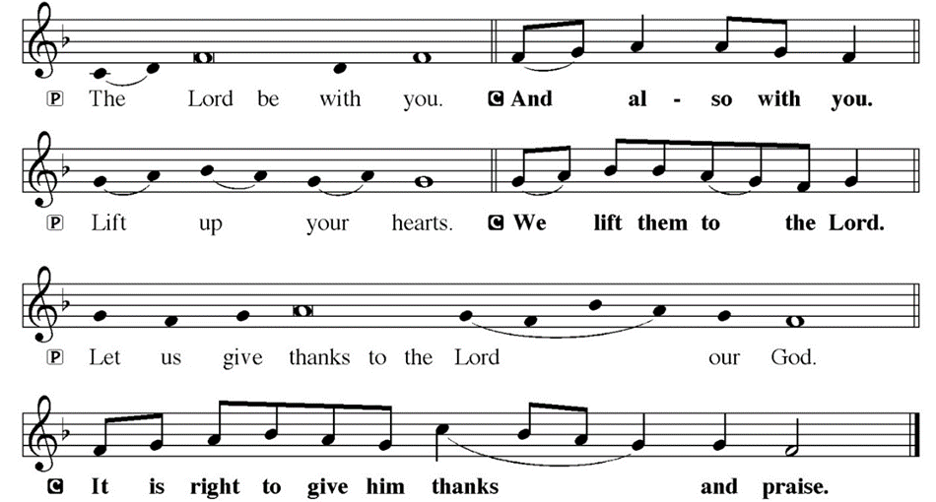
DIALOGUE

Slide 42
THE PREFACE
P: It is indeed right and salutary…
… we praise your name and join their unending hymn.

Slide 43
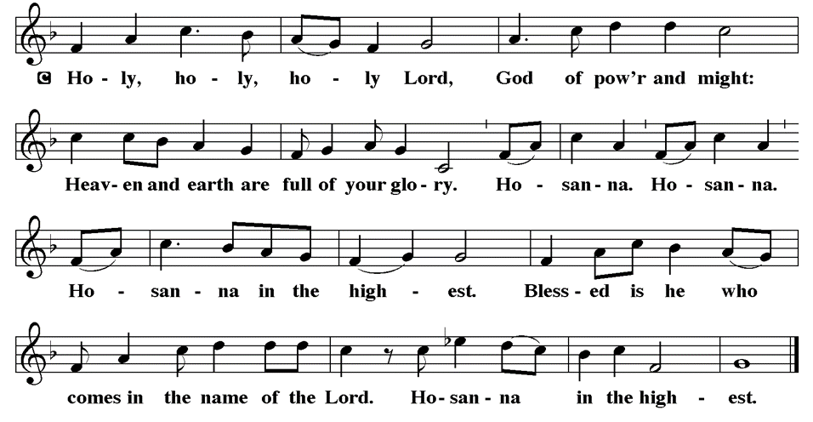
THE SANCTUS

Slide 44
EUCHARISTIC PRAYER
P: Holy, living, and loving God…
…both now and forever.
C: Amen.

Slide 45
THE LORD’S PRAYER
C: Our Father, who art in heaven, hallowed be thy name, thy kingdom come, thy will be done, on earth as it is in heaven. Give us this day our daily bread; and forgive us our trespasses, as we forgive those who trespass against us; and lead us not into temptation, but deliver us from evil.

Slide 46
THE LORD’S PRAYER
C: For thine is the kingdom, and the power, and the glory, forever and ever. Amen.

Slide 47
INVITATION TO COMMUNION
P: Jesus, our brother, invites you to experience his presence fully in this holy meal of bread and wine. Come and be nourished for a life lived in his name. All is prepared for you.

Slide 48
COMMUNION DISTRIBUTION
All will commune “By Station”.
The bread may be broken for distribution. As the ministers give the bread and wine, they say these words :
The body of Christ, given for you.
The blood of Christ, shed for you.
The communicant may say: Amen.

Slide 49
POST COMMUNION BLESSING
P: May this body and blood of our Lord and Savior, Jesus Christ, strengthen, keep and unite us, ☩ now and forever, amen.
C: Amen.

Slide 50
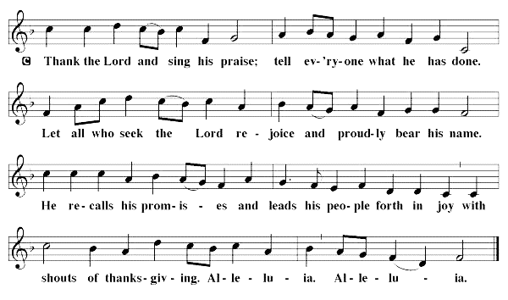
POST COMMUNION CANTACLE

Slide 51
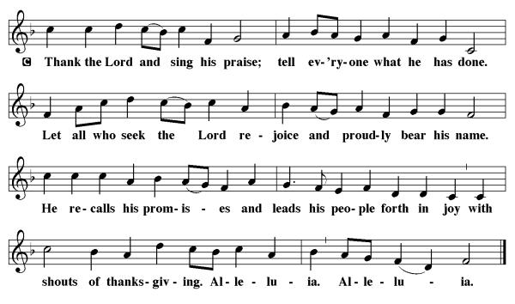
POST COMMUNION CANTACLE

Slide 52
POST COMMUNION PRAYER
P: Let us pray… Shepherding God, you have prepared a table before us and nourished us with your love. Send us forth from this banquet to proclaim your goodness and share the abundant mercy of Jesus, our redeemer and friend.
C: Amen

Slide 53

ANNOUNCEMENTS
Notes:
Image: Five Loaves by Caroline Coolidge Brown. Copyright © Caroline Coolidge Brown. All rights reserved. Used by permission of the artist.

Slide 54
SENDING BLESSING PJ Musser
P: Alleluia! Christ is risen!
C: Christ is risen indeed! Alleluia!
P: The God of resurrection power, the Christ of unending joy, and the Spirit of Easter hope bless you now and always.
C: Amen.

Slide 55
Sending Song
“Beneath the Cross of Jesus”
LBW 107
Notes:
Image: Five Loaves by Caroline Coolidge Brown. Copyright © Caroline Coolidge Brown. All rights reserved. Used by permission of the artist.

Slide 56
“Beneath the Cross of Jesus” LBW 107
1 Beneath the cross of Jesus
I long to take my stand;
the shadow of a mighty rock
within a weary land,
a home within a wilderness,
a rest upon the way,
from the burning of the noontide heat
and burdens of the day.
Notes:
Image: Preparing yeast dough. Copyright © tomasworks/iStock/Thinkstock. Used by permission.

Slide 57
“Beneath the Cross of Jesus” LBW 107
2 Upon the cross of Jesus,
my eye at times can see
the very dying form of one
who suffered there for me.
And from my contrite heart, with tears,
two wonders I confess:
the wonder of his glorious love
and my unworthiness.
Notes:
Image: Preparing yeast dough. Copyright © tomasworks/iStock/Thinkstock. Used by permission.

Slide 58
“Beneath the Cross of Jesus” LBW 107
3 I take, O cross, your shadow
for my abiding place;
I ask no other sunshine than
the sunshine of his face;
content to let the world go by,
to know no gain nor loss,
my sinful self my only shame,
my glory all, the cross.
Notes:
Image: Preparing yeast dough. Copyright © tomasworks/iStock/Thinkstock. Used by permission.

Slide 59
DISMISSAL
P: … Depart in Christ’s Love.
C: Seeking, welcoming, and serving all. Amen!
POSTLUDE
By Roxanne Groff
From sundaysandseasons.com. Copyright © 2024 Augsburg Fortress. All rights reserved. Reprinted by permission under Augsburg Fortress Liturgies Annual License #SAS023830. New Revised Standard Version Bible, Copyright © 1989, Division of Christian Education of the National Council of the Churches of Christ in the United States of America. Used by permission. All rights reserved. Revised Common Lectionary, Copyright © 1992 Consultation on Common Texts, admin Augsburg Fortress. Used by permission.

