Slide 1
Trinity Evangelical Lutheran Church Announcements October 8, 2023
The Commandments

Slide 2
Body, Mind, Spirit
Mind: Read to a young child.
Body: Annual eye exam.
Spirit: Ask someone “How can I pray for you?”

Slide 3
Our Office Secretary Is Sharon Fourman
Church Office Schedule
Tues, Wed, & Thurs
8:00 am – 12:00 noon
Church Office: 937 692-5670
Email: secretary@pitsburgtlc.org

Slide 4
The Trinity Trumpet
A Monthly Newsletter
Published by Trinity Lutheran Church,
Pitsburg, OH
We’re looking for stories and pictures of Trinity people in action!
Submit to Secretary, Sharon Fourman at secretary@pitsburgtlc.org
Articles and Info due on or about the 15th of each month

Slide 5
Trinity Trumpet
Your Trinity Trumpet Newsletter for September is available!
Please take your copy before you leave today!

Slide 6
Trinity Trumpet
Newsletter Deadline is Tuesday, October 24th
Please turn in all your newsworthy items to Sharon Fourman at:
secretary@pitsburgtlc.org

Slide 7
We’re Online!
www.pitsburgtlc.org
Sermons and announcements are posted weekly
Trinity Trumpet is Posted here too!
The ‘Official’ Trinity Calendar is available for you to see!
Pictures, Videos and more!
Also, like us on FaceBook at
facebook.com/pitsburgtrinitylutheran.church

Slide 8
We’re Online!
www.pitsburgtlc.org
We now have our own QR Code!
Scan this code with your Smartphone and you will connect to all our Online media (Facebook, YouTube, and our own Church Website)

Slide 9
Online Giving
www.pitsburgtlc.org
Click the “Give to Trinity” Button
Stay current in your giving even when you can’t make it to Worship!
Separate Giving Categories for:
General Treasury
Benevolence/Mission Support
Building Fund
Annual Christmas Auction
Donald K. Lucas Memorial Fund
Thrive Capital Campaign

Slide 10
Church
Council
Trinity Church Council
Next Meeting:
October 18th
@ 7:00 pm

Slide 11
Trinity’s Team Meetings
Next Meeting
TBD
@ 6:00 pm
On the Agenda – Preparing the proposed 2023 budget

Slide 12
Please Pass the Pew Pads
(We now track Communion on the Pads)

Slide 13
Worship Team
Next Meeting:
TBD

Slide 14
Mutual Ministry Team
Julie Kossler
VACANT
Peggy Didier
Please see one of them with your comments and suggestions
Next Meeting - TBD

Slide 15
Choice FISH Pantry
Please join us every Friday @ 3:30 pm
400 Markwith Dr, Greenville OH
Most Needed Items
Kidney Beans
Canned Peas
Hamburger Helper
Pork & Beans
Canned Mixed Veggies
Large Cans of Soups
Applesauce
Boxed Meals
(i.e. Rice a Roni)

Slide 16
Next Meeting:
Wednesday, October 4, 2023
@ 11:30 am
Please note the Date & Time!!!

Slide 17
Prayers and Squares
Quilting Ministry
October 12 @ 10:00 am
October 31 @ 10:00 am

Slide 18
Ladies and Gents Luncheon
Date: October 19th @ 11:30 am
Where: The Train Stop
121 N. Miami Street, Bradford, OH
For Reservations:
See Linda Baker or call her @ 937 545-0975

Slide 19
Confirmation Program
Classes Resume Oct 11, 2023
Requirements For 2023 Confirmands
Summer Service Project 3-5 hours
Final Exam – Schedule with Pastor Mel BEFORE October 1st
Confirmation Sunday – October 29, 2023

Slide 20
Confirmation Program
Weekly Worship attendance is required (In person or via FaceBook)
Worship Notes may be emailed to pastor@pitsburgtlc.org or placed in Pr Mel’s mailbox outside the Church Office
Confirmands are encouraged to take turns as Acolyte

Slide 21
Who can be an Acolyte? YOU CAN!!!
Please sign up for Acolyte Duty on the chart by the Church Office!
Confirmation Students are Highly Encouraged to perform Acolyte duty…
Please sign up today!

Slide 22
New Member Class
We are forming a “New Member” Class for anyone who wants to learn more about Being Lutheran and what Being a member of Trinity entails
Classes will begin January 8th
Classes start at 12:00 Noon or as soon after Worship as possible
Please see Pastor Mel if Interested in attending

Slide 23
Commemorate special days like Anniversaries, Birthdays, Baptisms and more…
See PJ to Sign Up!

Slide 24
Trinity’s Team Meetings
Youth and Family Ministry Team
Next Meeting
October 5th @ 10:00 am
Purpose -- plan for Fall Festival
Please come if you can!

Slide 25
Blood Pressure Screening
BP Screening
2nd Sundays - After Worship
In The Nursery
Notes:
Cover: Sermon on the Mount by Laura James. Copyright © Laura James. All rights reserved. Used by permission of the artist.

Slide 26
Holy Communion – Today!
Communion Today is “At the Rail”
Safe for all humans (Especially sinners)
Holy Communion Schedule
First and Third Sundays each month
All White and Red Sundays of the Church Year

Slide 27
Calling all Adults!
Join Us For “Christian Conversations”
Not Your Ordinary Adult Sunday School
Sharing – Discussion - Prayer
Free Donuts, Juice, and Coffee
Every Sunday @
9:30 am
Notes:
Cover: Sermon on the Mount by Laura James. Copyright © Laura James. All rights reserved. Used by permission of the artist.

Slide 28
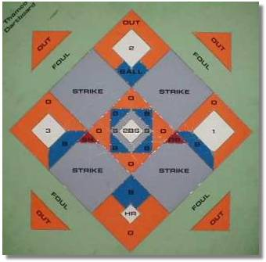
DARTBALL
Monday October 16 @ 7:30 pm
Away Game
St John, Greenville

Slide 29
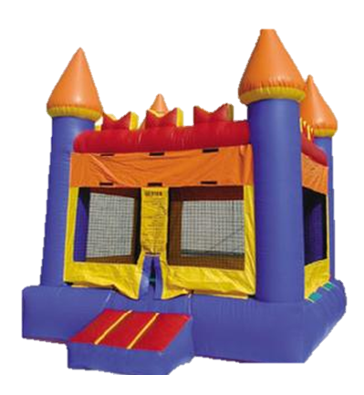
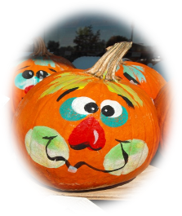
Save The Date!!!
Trinity Fall Festival – October 22nd
3 – 5 pm
Walking Tacos! (Sign-Ups for other food)
Trunk or Treat – Prizes!
Costume Parade
Door Prizes
Bring a Friend!!!
Notes:
Cover: Sermon on the Mount by Laura James. Copyright © Laura James. All rights reserved. Used by permission of the artist.

Slide 30
Date Changed!!!
Confirmation Sunday!
Date changed from October 29th
To November 3rd !
Notes:
Cover: Sermon on the Mount by Laura James. Copyright © Laura James. All rights reserved. Used by permission of the artist.

Slide 31
Save The Date!!!
Nov 5th
After Worship
Annual Reports Due to Church Secretary No Later Than October 12th

Slide 32
Nov 5th
Please provide the Names of your departed loved ones you would like remembered during Worship to our secretary no later than October 31st

Slide 33
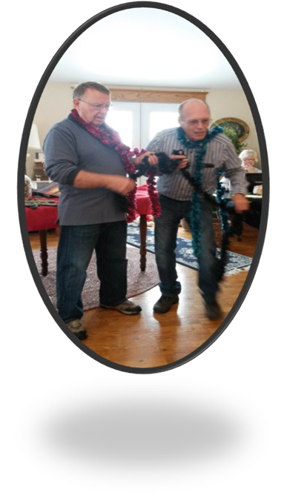
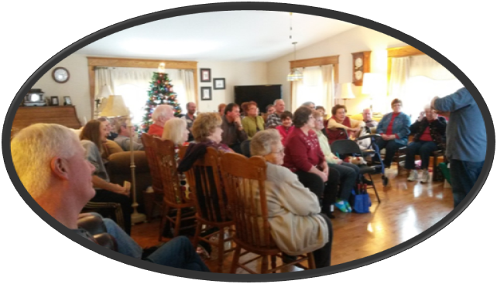
Save The Date!!!
Annual Christmas Auction
Nov 5th @ 3:00 pm
At Bev & Eldon’s Home
1385 Littles Rd., Arcanum OH
Bring an appetizer and an item or two to auction off

Slide 34
Trinity Troops
Date: TODAY!!! After Worship
Where: Trinity Fellowship Hall
Who: Youth 4th – 6th Grades
What: Food – Games – Service Projects
RSVP to PJ or Pastor Mel (for food planning)
Trinity Troops!

