Slide 1
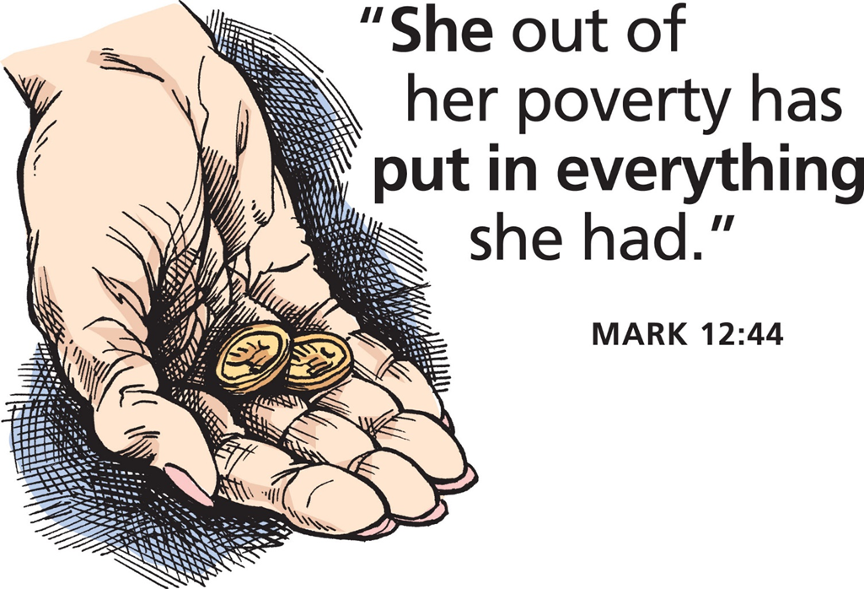
March 10, 2024
WELCOME!
Trinity Lutheran Church
Notes:
Image: Five Loaves by Caroline Coolidge Brown. Copyright © Caroline Coolidge Brown. All rights reserved. Used by permission of the artist.

Slide 2
= Please stand if able
= Please be seated
Prelude - By Pan Sherman
Office of the Acolyte
Ringing of the Bell
Welcome

Slide 3
THANKSGIVING FOR BAPTISM
All may make the sign of the cross, the sign marked at baptism, as the presiding minister begins.
P: Blessed be the holy Trinity, ☩ one God, the fountain of living water, the rock who gave us birth, our light and our salvation.
C: Amen.
Notes:
Image: Preparing yeast dough. Copyright © tomasworks/iStock/Thinkstock. Used by permission.

Slide 4
P: Joined to Christ in the waters of baptism, we are clothed with God's mercy and forgiveness. Let us give thanks for the gift of baptism. Water may be poured into the font as the presiding minister gives thanks.
THANKSGIVING FOR BAPTISM
Notes:
Image: Preparing yeast dough. Copyright © tomasworks/iStock/Thinkstock. Used by permission.

Slide 5
P: We give you thanks, O God, for in the beginning your Spirit moved over the waters and by your Word you created the world, calling forth life in which you took delight. Through the waters of the flood you delivered Noah and his family. Through the sea you led your people Israel from slavery into freedom.
THANKSGIVING FOR BAPTISM
Notes:
Image: Preparing yeast dough. Copyright © tomasworks/iStock/Thinkstock. Used by permission.

Slide 6
P: At the river your Son was baptized by John and anointed with the Holy Spirit. By water and your Word you claim us as daughters and sons, making us heirs of your promise and servants of all. We praise you for the gift of water that sustains life, and above all we praise you for the gift of new life in Jesus Christ.
THANKSGIVING FOR BAPTISM
Notes:
Image: Preparing yeast dough. Copyright © tomasworks/iStock/Thinkstock. Used by permission.

Slide 7
P: Shower us with your Spirit, and renew our lives with your forgiveness, grace, and love. To you be given honor and praise through Jesus Christ our Lord in the unity of the Holy Spirit, now and forever.
THANKSGIVING FOR BAPTISM
C: Amen.
Notes:
Image: Preparing yeast dough. Copyright © tomasworks/iStock/Thinkstock. Used by permission.

Slide 8
CONFESSION AND FORGIVENESS
All may make the sign of the cross, the sign marked at baptism…
L: We confess our sins before God and one another.
Pause for silence and reflection.
L: God of love,
Notes:
Image: Five Loaves by Caroline Coolidge Brown. Copyright © Caroline Coolidge Brown. All rights reserved. Used by permission of the artist.

Slide 9
CONFESSION AND FORGIVENESS
C: When we look inward and are honest with ourselves, we see where we have lived as though you are not our God. We have sought after our own gain rather than the good of all. We have not loved you or our neighbors as ourselves. We have betrayed and denied you in what we have done and not done.
Notes:
Image: Five Loaves by Caroline Coolidge Brown. Copyright © Caroline Coolidge Brown. All rights reserved. Used by permission of the artist.

Slide 10
CONFESSION AND FORGIVENESS
C: Create in us clean hearts, O God, that we might become what you have called us to be.
Notes:
Image: Five Loaves by Caroline Coolidge Brown. Copyright © Caroline Coolidge Brown. All rights reserved. Used by permission of the artist.

Slide 11
CONFESSION AND FORGIVENESS
L: God whose unfathomable love went to the cross for our sake now forgives us all our sins and welcomes us all over again into the promise of eternal life in ☩ Christ’s name.
C: Amen.
Notes:
Image: Five Loaves by Caroline Coolidge Brown. Copyright © Caroline Coolidge Brown. All rights reserved. Used by permission of the artist.

Slide 12
GATHERING SONG
“Spirit of God, Descend Upon My Heart”
LBW 486
Notes:
Image: Five Loaves by Caroline Coolidge Brown. Copyright © Caroline Coolidge Brown. All rights reserved. Used by permission of the artist.

Slide 13
“Spirit of God, Descend Upon My Heart” LBW 486
1 Spirit of God, descend upon my heart;
wean it from earth, through all its pulses move;
stoop to my weakness, strength to me impart,
and make me love you as I ought to love.
Notes:
Image: Five Loaves by Caroline Coolidge Brown. Copyright © Caroline Coolidge Brown. All rights reserved. Used by permission of the artist.

Slide 14
“Spirit of God, Descend Upon My Heart” LBW 486
2 I ask no dream, no prophet ecstasies,
no sudden rending of the veil of clay,
no angel visitant, no op'ning skies;
but take the dimness of my soul away.
Notes:
Image: Five Loaves by Caroline Coolidge Brown. Copyright © Caroline Coolidge Brown. All rights reserved. Used by permission of the artist.

Slide 15
“Spirit of God, Descend Upon My Heart” LBW 486
3 Have you not bid me love you, God and King;
all, all your own, soul, heart, and strength, and mind?
I see your cross; there teach my heart to cling.
Oh, let me seek you and, oh, let me find!
Notes:
Image: Five Loaves by Caroline Coolidge Brown. Copyright © Caroline Coolidge Brown. All rights reserved. Used by permission of the artist.

Slide 16
“Spirit of God, Descend Upon My Heart” LBW 486
4 Teach me to love you as your angels love,
one holy passion filling all my frame:
the baptism of the heav'n-descended dove,
my heart an altar, and your love the flame.
Notes:
Image: Five Loaves by Caroline Coolidge Brown. Copyright © Caroline Coolidge Brown. All rights reserved. Used by permission of the artist.

Slide 17
APOSTOLIC GREETING
P: The grace of our Lord Jesus Christ, the love of God, and the communion of the Holy Spirit be with you all.
C: And also with you.
Notes:
Image: Five Loaves by Caroline Coolidge Brown. Copyright © Caroline Coolidge Brown. All rights reserved. Used by permission of the artist.

Slide 18
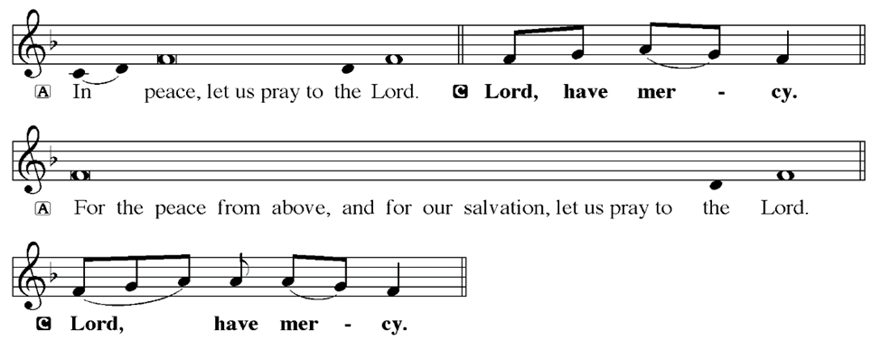
KYRIE
Notes:
Image: Five Loaves by Caroline Coolidge Brown. Copyright © Caroline Coolidge Brown. All rights reserved. Used by permission of the artist.

Slide 19
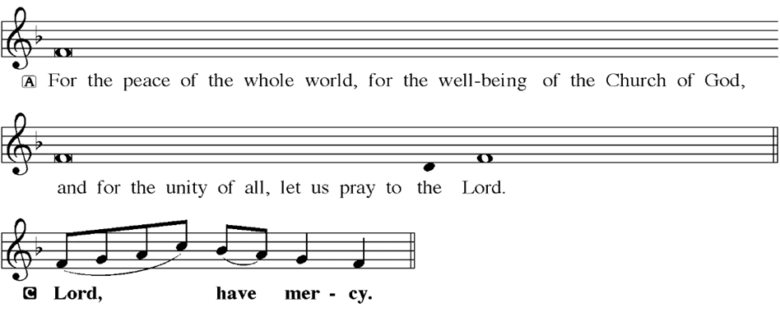
KYRIE
Notes:
Image: Five Loaves by Caroline Coolidge Brown. Copyright © Caroline Coolidge Brown. All rights reserved. Used by permission of the artist.

Slide 20
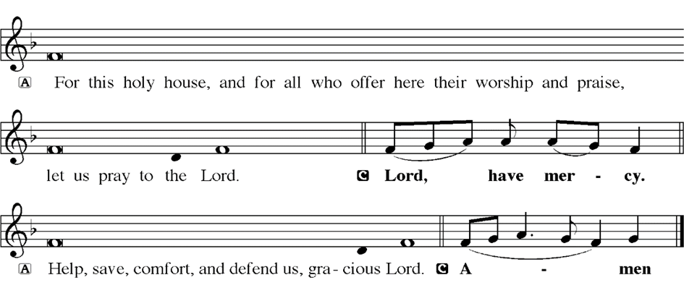
KYRIE
Notes:
Image: Five Loaves by Caroline Coolidge Brown. Copyright © Caroline Coolidge Brown. All rights reserved. Used by permission of the artist.

Slide 21
HYMN OF PRAISE
Glory be to God in heaven;
peace, goodwill to all the earth.
Mighty God of all creation,
Father of surpassing worth:
we exalt you, we adore you,
we lift high our thanks and praise.
Saints and angels bow before you; here on earth our songs we raise.
Notes:
Image: Five Loaves by Caroline Coolidge Brown. Copyright © Caroline Coolidge Brown. All rights reserved. Used by permission of the artist.

Slide 22
HYMN OF PRAISE
Glory be to Christ forever,
Lamb of God and Lord of love.
Son of God and gracious Savior, you have come from heav’n above;
on the cross you died to save us; now you reign at God’s right hand.
Hear our prayer; restore, forgive us; in your promise firm we stand.
Notes:
Image: Five Loaves by Caroline Coolidge Brown. Copyright © Caroline Coolidge Brown. All rights reserved. Used by permission of the artist.

Slide 23
HYMN OF PRAISE
Holy One we now acclaim you;
Lord alone, to you we call;
Holy One in faith we name you,
God most high, yet near to all:
Jesus Christ, with God the Spirit,
in the Father’s splendor bright.
For the peace that we inherit,
glory be to God on high!
Notes:
Image: Five Loaves by Caroline Coolidge Brown. Copyright © Caroline Coolidge Brown. All rights reserved. Used by permission of the artist.

Slide 24
PRAYER OF THE DAY
P: Let us pray… Holy God, you have taught us what it is to live in community with one another in sacrificial love. Give us hearts for service so that all might have their needs met, and be freed to give back for the good of others and of all creation. In Jesus’ name we pray.
C: Amen
Notes:
Image: Five Loaves by Caroline Coolidge Brown. Copyright © Caroline Coolidge Brown. All rights reserved. Used by permission of the artist.

Slide 25
Notes:
Image: Five Loaves by Caroline Coolidge Brown. Copyright © Caroline Coolidge Brown. All rights reserved. Used by permission of the artist.

Slide 26
Scripture Reading
L: Our scripture reading for this day is from the Gospel of Mark, the 12th Chapter.
C: Glory to you O’ Lord!
Notes:
Image: Five Loaves by Caroline Coolidge Brown. Copyright © Caroline Coolidge Brown. All rights reserved. Used by permission of the artist.

Slide 27
Mark 12:28-44
²⁸ One of the scribes came near and heard them disputing with one another, and seeing that he answered them well, he asked him, “Which commandment is the first of all?” ²⁹ Jesus answered, “The first is, ‘Hear, O Israel: the Lord our God, the Lord is one; ³⁰ you shall love the Lord your God with all your heart, and with all your soul, and with all your mind, and with all your
Notes:
Image: Five Loaves by Caroline Coolidge Brown. Copyright © Caroline Coolidge Brown. All rights reserved. Used by permission of the artist.

Slide 28
Mark 12:28-44
strength.’ ³¹ The second is this, ‘You shall love your neighbor as yourself.’ There is no other commandment greater than these.” ³² Then the scribe said to him, “You are right, Teacher; you have truly said that ‘he is one, and besides him there is no other’; ³³ and ‘to love him with all the heart, and with all the understanding, and with all the strength,’ and ‘to love one’s neighbor
Notes:
Image: Five Loaves by Caroline Coolidge Brown. Copyright © Caroline Coolidge Brown. All rights reserved. Used by permission of the artist.

Slide 29
Mark 12:28-44
as oneself,’—this is much more important than all whole burnt offerings and sacrifices.” ³⁴ When Jesus saw that he answered wisely, he said to him, “You are not far from the kingdom of God.” After that no one dared to ask him any question.
³⁵ While Jesus was teaching in the temple, he said, “How can the scribes say that the Messiah is the son of
Notes:
Image: Five Loaves by Caroline Coolidge Brown. Copyright © Caroline Coolidge Brown. All rights reserved. Used by permission of the artist.

Slide 30
Mark 12:28-44
David? ³⁶ David himself, by the Holy Spirit, declared,
‘The Lord said to my Lord, “Sit at my right hand, until I put your enemies under your feet.”’
³⁷ David himself calls him Lord; so how can he be his son?” And the large crowd was listening to him with delight.
Notes:
Image: Five Loaves by Caroline Coolidge Brown. Copyright © Caroline Coolidge Brown. All rights reserved. Used by permission of the artist.

Slide 31
Mark 12:28-44
³⁸ As he taught, he said, “Beware of the scribes, who like to walk around in long robes, and to be greeted with respect in the marketplaces, ³⁹ and to have the best seats in the synagogues and places of honor at banquets! ⁴⁰ They devour widows’ houses and for the sake of appearance say long prayers. They will receive the greater condemnation.”
Notes:
Image: Five Loaves by Caroline Coolidge Brown. Copyright © Caroline Coolidge Brown. All rights reserved. Used by permission of the artist.

Slide 32
Mark 12:28-44
⁴¹ He sat down opposite the treasury, and watched the crowd putting money into the treasury. Many rich people put in large sums. ⁴² A poor widow came and put in two small copper coins, which are worth a penny. ⁴³ Then he called his disciples and said to them,
Notes:
Image: Five Loaves by Caroline Coolidge Brown. Copyright © Caroline Coolidge Brown. All rights reserved. Used by permission of the artist.

Slide 33
Mark 12:28-44
“Truly I tell you, this poor widow has put in more than all those who are contributing to the treasury. ⁴⁴For all of them have contributed out of their abundance; but she out of her poverty has put in everything she had, all she had to live on.”
Notes:
Image: Five Loaves by Caroline Coolidge Brown. Copyright © Caroline Coolidge Brown. All rights reserved. Used by permission of the artist.

Slide 34
Mark 12:28-44
R: This is the Word of the Lord.
C: Praise to You, O Christ
Notes:
Image: Five Loaves by Caroline Coolidge Brown. Copyright © Caroline Coolidge Brown. All rights reserved. Used by permission of the artist.

Slide 35
Sermon

Slide 36
Sermon

Slide 37
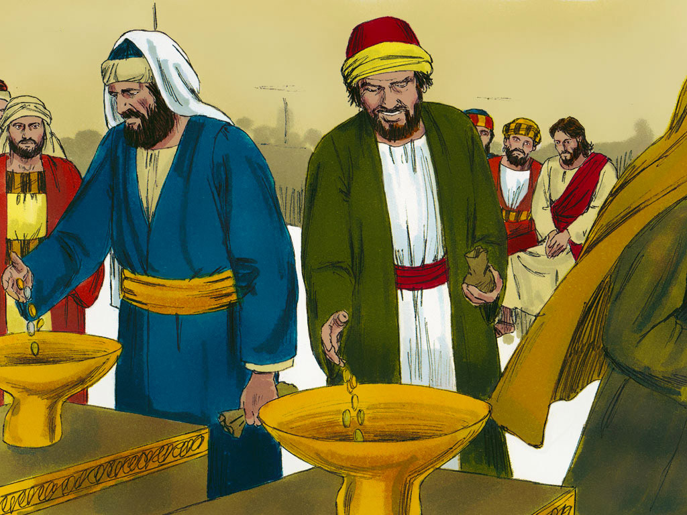
Sermon

Slide 38
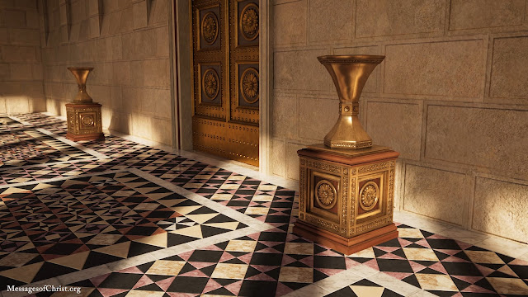
Sermon

Slide 39
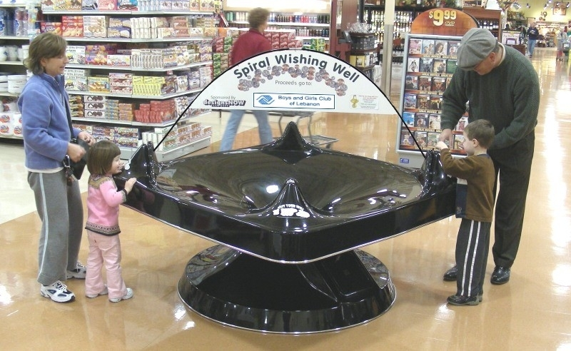
Sermon

Slide 40
Sermon
Ancient Near Eastern Culture
Our Culture Today

Slide 41
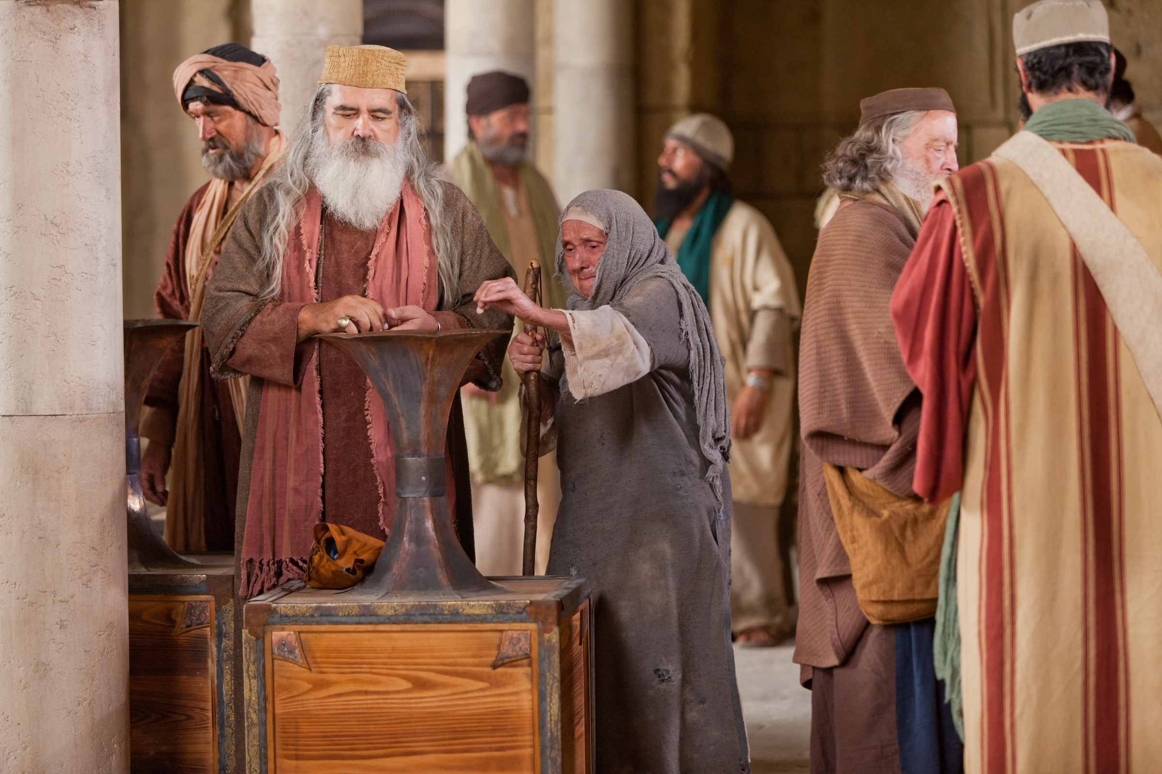
Sermon

Slide 42
Sermon

Slide 43
Sermon

Slide 44
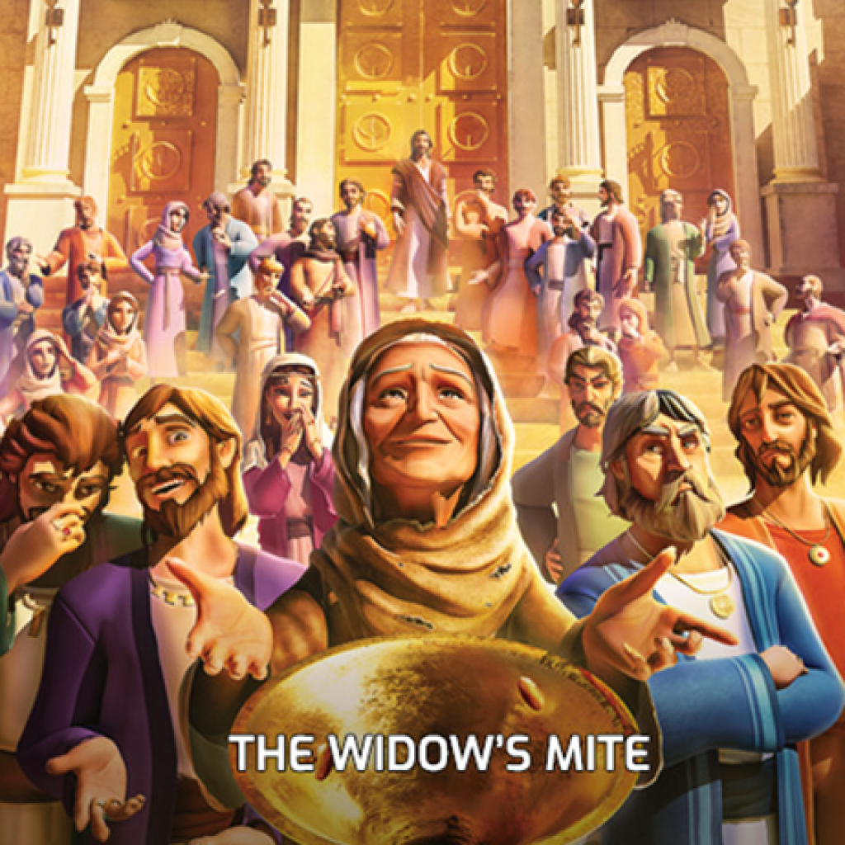
Sermon

Slide 45
Sermon
“The first is, ‘Hear, O Israel: the Lord our God, the Lord is one; you shall love the Lord your God with all your heart, and with all your soul, and with all your mind, and with all your strength.’ The second is this, ‘You shall love your neighbor as yourself.’ There is no other commandment greater than these.”

Slide 46
HYMN OF THE DAY
“Amazing Grace, How Sweet the Sound”
ELW 779

Slide 47
Amazing Grace, How Sweet the Sound ELW 779
1 Amazing grace, how sweet the sound,
that saved a wretch like me!
I once was lost, but now am found;
was blind, but now I see.

Slide 48
Amazing Grace, How Sweet the Sound ELW 779
2 ’Twas grace that taught my heart to fear,
and grace my fears relieved;
how precious did that grace appear
the hour I first believed!

Slide 49
Amazing Grace, How Sweet the Sound ELW 779
3 Through many dangers, toils, and snares
I have already come;
’tis grace has brought me safe thus far,
and grace will lead me home.

Slide 50
Amazing Grace, How Sweet the Sound ELW 779
4 The Lord has promised good to me;
his word my hope secures;
he will my shield and portion be
as long as life endures.

Slide 51
APOSTLE’S CREED
C: I believe in God, the Father almighty, creator of heaven and earth.

Slide 52
APOSTLE’S CREED
C: I believe in Jesus Christ, his only Son, our Lord. He was conceived by the power of the Holy Spirit and born of the virgin Mary. He suffered under Pontius Pilate, was crucified, died, and was buried.

Slide 53
APOSTLE’S CREED
C: He descended into hell. On the third day he rose again. He ascended into heaven, and is seated at the right hand of the Father. He will come again to judge the living and the dead.

Slide 54
APOSTLE’S CREED
C: I believe in the Holy Spirit, the holy catholic Church, the communion of saints, the forgiveness of sins, the resurrection of the body, and the life everlasting. Amen.

Slide 55
NICENE CREED
C: We believe in one God, the Father, the Almighty, maker of heaven and earth, of all that is, seen and unseen.

Slide 56
NICENE CREED
C: We believe in one Lord, Jesus Christ, the only Son of God, eternally begotten of the Father, God from God, Light from Light, true God from true God, begotten, not made, of one Being with the Father.

Slide 57
NICENE CREED
C: Through him all things were made. For us and for our salvation he came down from heaven; by the power of the Holy Spirit he became incarnate from the virgin Mary, and was made man. For our sake he was crucified under Pontius Pilate;

Slide 58
NICENE CREED
C: he suffered death and was buried. On the third day he rose again in accordance with the Scriptures; he ascended into heaven and is seated at the right hand of the Father. He will come again in glory to judge the living and the dead, and his kingdom will have no end.

Slide 59
NICENE CREED
C: We believe in the Holy Spirit, the Lord, the giver of life, who proceeds from the Father and the Son. With the Father and the Son he is worshiped and glorified. He has spoken through the prophets. We believe in one holy catholic and apostolic Church.

Slide 60
NICENE CREED
C: We acknowledge one Baptism for the forgiveness of sins. We look for the resurrection of the dead, and the life of the world to come. Amen.

Slide 61
QUILT TYING AND PRESENTATION
This Quilt was lovingly crafted for recovery and healing especially the Trinity Prayers and Squares Quilting Ministry…
Let us pray…

Slide 62
PRAYERS OF INTERCESSION
Each petition will end with the words,
A: God of the journey,
The congregation will respond with:
C: In mercy, hear our prayer.

Slide 63
PRAYERS OF INTERCESSION
The prayer concludes…
P: Confident that you walk alongside us in our need, we lift to you all our prayers, spoken and unspoken, through Jesus Christ our savior.
C: Amen.

Slide 64
OFFERING
Notes:
Image: Five Loaves by Caroline Coolidge Brown. Copyright © Caroline Coolidge Brown. All rights reserved. Used by permission of the artist.

Slide 65
OFFERING PRAYER
Notes:
Image: Five Loaves by Caroline Coolidge Brown. Copyright © Caroline Coolidge Brown. All rights reserved. Used by permission of the artist.

Slide 66
THE GREAT THANKSGIVING
All the Baptized are welcome to celebrate this Holy Meal.

Slide 67
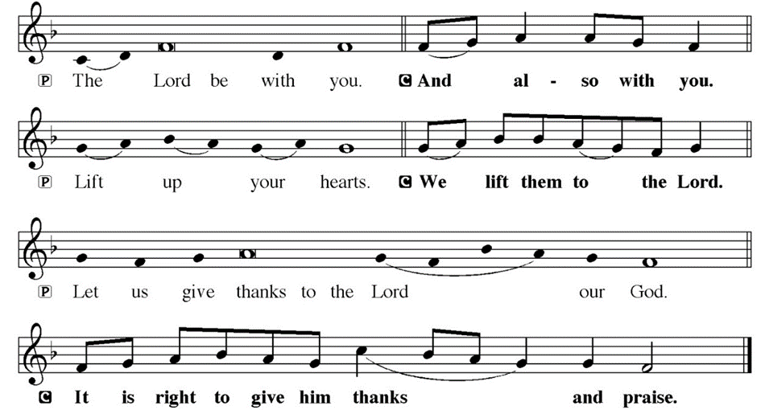
DIALOGUE

Slide 68
THE PREFACE
P: It is indeed right and salutary…
… we praise your name and join their unending hymn.

Slide 69
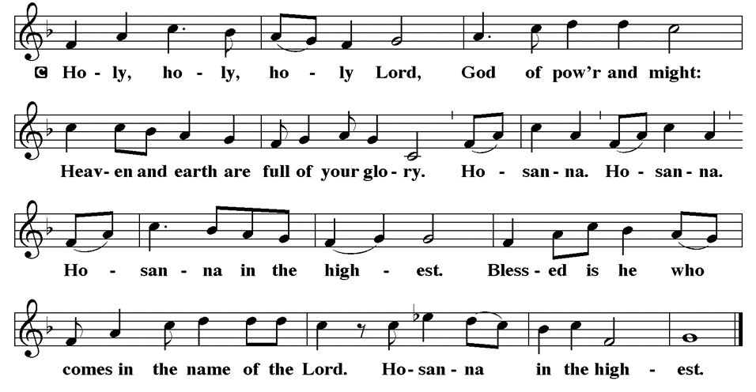
THE SANCTUS

Slide 70
EUCHARISTIC PRAYER
P: Holy God, our living Water…
…both now and forever.
C: Amen.

Slide 71
THE LORD’S PRAYER
C: Our Father, who art in heaven, hallowed be thy name, thy kingdom come, thy will be done, on earth as it is in heaven. Give us this day our daily bread; and forgive us our trespasses, as we forgive those who trespass against us; and lead us not into temptation, but deliver us from evil.

Slide 72
THE LORD’S PRAYER
C: For thine is the kingdom, and the power, and the glory, forever and ever. Amen.

Slide 73
INVITATION TO COMMUNION
P: You are invited now to the feast in which Jesus meets us and strengthens us for the work of the gospel. Come and be fed, for all is prepared.

Slide 74
COMMUNION DISTRIBUTION
All will commune “By Station”.
The bread may be broken for distribution. As the ministers give the bread and wine, they say these words :
The body of Christ, given for you.
The blood of Christ, shed for you.
The communicant may say: Amen.

Slide 75
POST COMMUNION BLESSING
P: May this body and blood of our Lord and Savior, Jesus Christ, strengthen, keep, and unity us, ☩ now and forever,
C: Amen.

Slide 76
POST COMMUNION CANTACLE

Slide 77
POST COMMUNION CANTACLE

Slide 78
POST COMMUNION PRAYER
P: Let us pray… Giver of every gift, Christ’s body is our food, and we are Christ’s body. Raise us to life by your power for the benefit of all and to your glory, now and forever.
C: Amen

Slide 79
ANNOUNCEMENTS
Notes:
Image: Five Loaves by Caroline Coolidge Brown. Copyright © Caroline Coolidge Brown. All rights reserved. Used by permission of the artist.

Slide 80
SENDING BLESSING
P: Beloved, we are God’s own people, holy, washed, renewed. God bless you and keep you, shower you with mercy, fill you with courage, and ☩ give you peace.
C: Amen.

Slide 81
Sending Song
“I Love to Tell the Story”
ELW 661
Notes:
Image: Five Loaves by Caroline Coolidge Brown. Copyright © Caroline Coolidge Brown. All rights reserved. Used by permission of the artist.

Slide 82
“I Love to Tell the Story” ELW 661
1 I love to tell the story
of unseen things above,
of Jesus and his glory,
of Jesus and his love.
I love to tell the story,
because I know it's true;
it satisfies my longings
as nothing else would do.
Notes:
Image: Preparing yeast dough. Copyright © tomasworks/iStock/Thinkstock. Used by permission.

Slide 83
“I Love to Tell the Story” ELW 661
Refrain
I love to tell the story;
'twill be my theme in glory
to tell the old, old story
of Jesus and his love.
Notes:
Image: Preparing yeast dough. Copyright © tomasworks/iStock/Thinkstock. Used by permission.

Slide 84
“I Love to Tell the Story” ELW 661
2 I love to tell the story:
how pleasant to repeat
what seems, each time I tell it,
more wonderfully sweet!
I love to tell the story,
for some have never heard
the message of salvation
from God's own holy word.
Notes:
Image: Preparing yeast dough. Copyright © tomasworks/iStock/Thinkstock. Used by permission.

Slide 85
“I Love to Tell the Story” ELW 661
Refrain
I love to tell the story;
'twill be my theme in glory
to tell the old, old story
of Jesus and his love.
Notes:
Image: Preparing yeast dough. Copyright © tomasworks/iStock/Thinkstock. Used by permission.

Slide 86
“I Love to Tell the Story” ELW 661
3 I love to tell the story,
for those who know it best
seem hungering and thirsting
to hear it like the rest.
And when, in scenes of glory,
I sing the new, new song,
I'll sing the old, old story
that I have loved so long.
Notes:
Image: Preparing yeast dough. Copyright © tomasworks/iStock/Thinkstock. Used by permission.

Slide 87
“I Love to Tell the Story” ELW 661
Refrain
I love to tell the story;
'twill be my theme in glory
to tell the old, old story
of Jesus and his love.
Notes:
Image: Preparing yeast dough. Copyright © tomasworks/iStock/Thinkstock. Used by permission.

Slide 88
DISMISSAL
P: … Depart in Christ’s Love.
C: Seeking, welcoming, and serving all. Amen!
POSTLUDE
By
Pam Sherman
From sundaysandseasons.com. Copyright © 2024 Augsburg Fortress. All rights reserved. Reprinted by permission under Augsburg Fortress Liturgies Annual License #SAS023830. New Revised Standard Version Bible, Copyright © 1989, Division of Christian Education of the National Council of the Churches of Christ in the United States of America. Used by permission. All rights reserved. Revised Common Lectionary, Copyright © 1992 Consultation on Common Texts, admin Augsburg Fortress. Used by permission.

