Slide 1
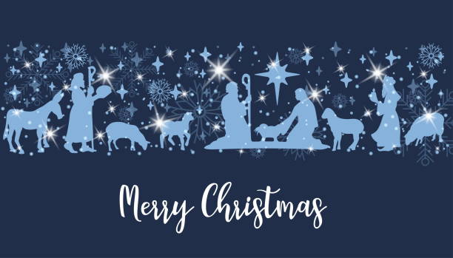
Nativity of Our Lord December 24, 2023
WELCOME!
Trinity Lutheran Church
Notes:
Image: Five Loaves by Caroline Coolidge Brown. Copyright © Caroline Coolidge Brown. All rights reserved. Used by permission of the artist.

Slide 2
= Please stand if able
= Please be seated
Prelude –by Roxanne Groff
Office of the Acolyte
Ringing of the Bell
Welcome

Slide 3
Lighting of the Advent Wreath
R: (light candle 1) This is the candle of hope, and it illuminates God’s promise.
R: (light candle 2) This is the candle of love, and its light leads us in God’s way.
R: (light candle 3) This is the candle of joy, and it shows us God’s healing and wholeness.
Notes:
Image: Preparing yeast dough. Copyright © tomasworks/iStock/Thinkstock. Used by permission.

Slide 4
Lighting of the Advent Wreath
R: (light candle 4) This is the candle of peace, and it proclaims Christ’s coming reign of justice, when we will make war no more.
C: (light candle 5) This is the Christ candle, and its light declares that he is here among us now. Thanks be to God.
Notes:
Image: Preparing yeast dough. Copyright © tomasworks/iStock/Thinkstock. Used by permission.

Slide 5
THANKSGIVING FOR BAPTISM
All may make the sign of the cross, the sign marked at baptism, as the presiding minister begins.
P: Blessed be the holy Trinity, ☩ one God, the fountain of living water, the rock who gave us birth, our light and our salvation.
C: Amen.
Notes:
Image: Preparing yeast dough. Copyright © tomasworks/iStock/Thinkstock. Used by permission.

Slide 6
P: Joined to Christ in the waters of baptism, we are clothed with God's mercy and forgiveness. Let us give thanks for the gift of baptism. Water may be poured into the font as the presiding minister gives thanks.
THANKSGIVING FOR BAPTISM
Notes:
Image: Preparing yeast dough. Copyright © tomasworks/iStock/Thinkstock. Used by permission.

Slide 7
P: We give you thanks, O God, for in the beginning your Spirit moved over the waters and by your Word you created the world, calling forth life in which you took delight. Through the waters of the flood you delivered Noah and his family. Through the sea you led your people Israel from slavery into freedom.
THANKSGIVING FOR BAPTISM
Notes:
Image: Preparing yeast dough. Copyright © tomasworks/iStock/Thinkstock. Used by permission.

Slide 8
P: At the river your Son was baptized by John and anointed with the Holy Spirit. By water and your Word you claim us as daughters and sons, making us heirs of your promise and servants of all. We praise you for the gift of water that sustains life, and above all we praise you for the gift of new life in Jesus Christ.
THANKSGIVING FOR BAPTISM
Notes:
Image: Preparing yeast dough. Copyright © tomasworks/iStock/Thinkstock. Used by permission.

Slide 9
P: Shower us with your Spirit, and renew our lives with your forgiveness, grace, and love. To you be given honor and praise through Jesus Christ our Lord in the unity of the Holy Spirit, now and forever.
THANKSGIVING FOR BAPTISM
C: Amen.
Notes:
Image: Preparing yeast dough. Copyright © tomasworks/iStock/Thinkstock. Used by permission.

Slide 10
CONFESSION AND FORGIVENESS
All may make the sign of the cross, the sign marked at baptism…
P: We confess our sins before God and one another.
Pause for silence and reflection.
P: Ever-present God,
Notes:
Image: Five Loaves by Caroline Coolidge Brown. Copyright © Caroline Coolidge Brown. All rights reserved. Used by permission of the artist.

Slide 11
CONFESSION AND FORGIVENESS
C: We come before you in need of grace. Too often our thoughts are judgmental and condemning of others. Too often our words are sarcastic or harsh, as harmful as weapons. Too often our actions are motivated by selfishness and we do not recognize the hurt or need in others.
Notes:
Image: Five Loaves by Caroline Coolidge Brown. Copyright © Caroline Coolidge Brown. All rights reserved. Used by permission of the artist.

Slide 12
CONFESSION AND FORGIVENESS
C: Forgive us, O God, and draw us back into right relationship with you, our neighbors, and your creation.
Notes:
Image: Five Loaves by Caroline Coolidge Brown. Copyright © Caroline Coolidge Brown. All rights reserved. Used by permission of the artist.

Slide 13
CONFESSION AND FORGIVENESS
P: The promise is sure: Christ’s advent is near, and in Christ we are forgiven all our sin. Know that you are a beloved child of God, and be strengthened in all goodness.
C: Amen.
Notes:
Image: Five Loaves by Caroline Coolidge Brown. Copyright © Caroline Coolidge Brown. All rights reserved. Used by permission of the artist.

Slide 14
Gathering Song/Hymn of Praise
“Hark! The Herald Angels Sing”
LBW 60

Slide 15
“Hark! The Herald Angels Sing” LBW 60
1 Hark! The herald angels sing,
"Glory to the newborn king;
peace on earth, and mercy mild,
God and sinners reconciled."
Joyful, all you nations, rise;
join the triumph of the skies;
with angelic hosts proclaim,
"Christ is born in Bethlehem!"

Slide 16
“Hark! The Herald Angels Sing” LBW 60
Refrain
Hark! The herald angels sing,
"Glory to the newborn king!"

Slide 17
“Hark! The Herald Angels Sing” LBW 60
2 Christ, by highest heav'n adored,
Christ, the everlasting Lord,
late in time behold him come,
offspring of a virgin's womb.
Veiled in flesh the Godhead see!
Hail, incarnate deity!
Pleased as man with us to dwell,
Jesus, our Emmanuel!

Slide 18
“Hark! The Herald Angels Sing” LBW 60
Refrain
Hark! The herald angels sing,
"Glory to the newborn king!"

Slide 19
“Hark! The Herald Angels Sing” LBW 60
3 Hail the heav'n-born Prince of peace!
Hail the Sun of righteousness!
Light and life to all he brings,
ris'n with healing in his wings.
Mild he lays his glory by,
born that we no more may die,
born to raise each child of earth,
born to give us second birth.

Slide 20
“Hark! The Herald Angels Sing” LBW 60
Refrain
Hark! The herald angels sing,
"Glory to the newborn king!"

Slide 21
APOSTOLIC GREETING
P: The grace of our Lord Jesus Christ, the love of God, and the communion of the Holy Spirit be with you all.
C: And also with you.
Notes:
Image: Five Loaves by Caroline Coolidge Brown. Copyright © Caroline Coolidge Brown. All rights reserved. Used by permission of the artist.

Slide 22
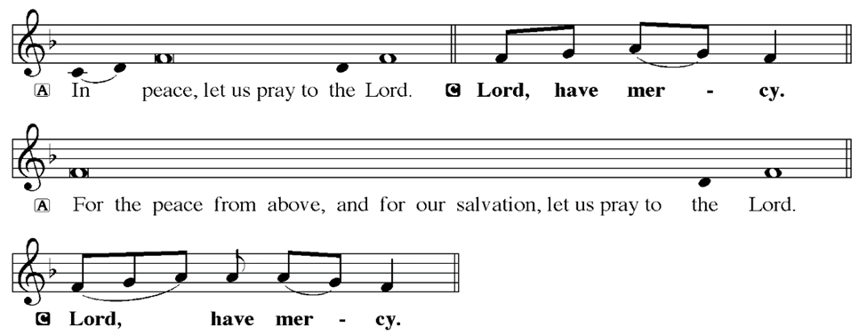
KYRIE
Notes:
Image: Five Loaves by Caroline Coolidge Brown. Copyright © Caroline Coolidge Brown. All rights reserved. Used by permission of the artist.

Slide 23
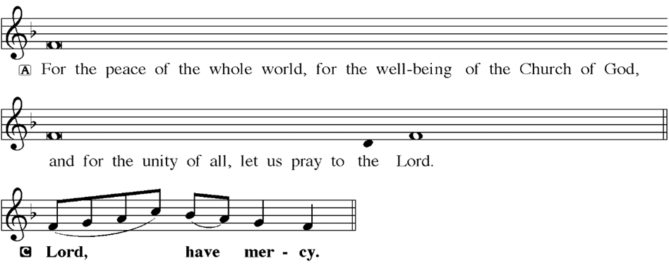
KYRIE
Notes:
Image: Five Loaves by Caroline Coolidge Brown. Copyright © Caroline Coolidge Brown. All rights reserved. Used by permission of the artist.

Slide 24
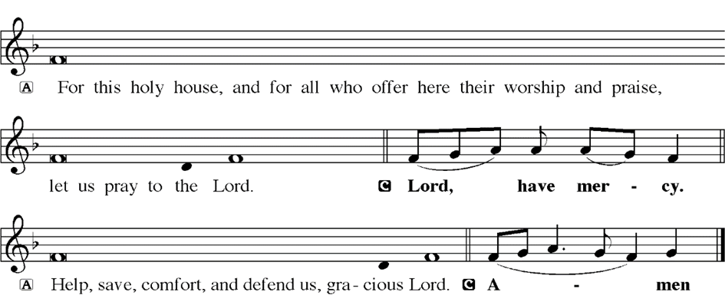
KYRIE
Notes:
Image: Five Loaves by Caroline Coolidge Brown. Copyright © Caroline Coolidge Brown. All rights reserved. Used by permission of the artist.

Slide 25
HYMN OF PRAISE
Glory be to God in heaven;
peace, goodwill to all the earth.
Mighty God of all creation,
Father of surpassing worth:
we exalt you, we adore you,
we lift high our thanks and praise.
Saints and angels bow before you; here on earth our songs we raise.
Notes:
Image: Five Loaves by Caroline Coolidge Brown. Copyright © Caroline Coolidge Brown. All rights reserved. Used by permission of the artist.

Slide 26
HYMN OF PRAISE
Glory be to Christ forever,
Lamb of God and Lord of love.
Son of God and gracious Savior, you have come from heav’n above;
on the cross you died to save us; now you reign at God’s right hand.
Hear our prayer; restore, forgive us; in your promise firm we stand.
Notes:
Image: Five Loaves by Caroline Coolidge Brown. Copyright © Caroline Coolidge Brown. All rights reserved. Used by permission of the artist.

Slide 27
HYMN OF PRAISE
Holy One we now acclaim you;
Lord alone, to you we call;
Holy One in faith we name you,
God most high, yet near to all:
Jesus Christ, with God the Spirit,
in the Father’s splendor bright.
For the peace that we inherit,
glory be to God on high!
Notes:
Image: Five Loaves by Caroline Coolidge Brown. Copyright © Caroline Coolidge Brown. All rights reserved. Used by permission of the artist.

Slide 28
PRAYER OF THE DAY
P: Let us pray… God of mystery and grace, you came to us not in power and might, not with armies of angels or men, but as a vulnerable baby in an animal’s stall. Teach us the transformative power of your loving and peaceful way, that we might work for your justice in the world.
C: Amen
Notes:
Image: Five Loaves by Caroline Coolidge Brown. Copyright © Caroline Coolidge Brown. All rights reserved. Used by permission of the artist.

Slide 29
Notes:
Image: Five Loaves by Caroline Coolidge Brown. Copyright © Caroline Coolidge Brown. All rights reserved. Used by permission of the artist.

Slide 30
Scripture Reading
L: Our scripture reading for this day is from Luke, Chapter 2.
C: Glory to you O’ Lord!
Notes:
Image: Five Loaves by Caroline Coolidge Brown. Copyright © Caroline Coolidge Brown. All rights reserved. Used by permission of the artist.

Slide 31
Luke 2:1-20
¹In those days a decree went out from Emperor Augustus that all the world should be registered. ²This was the first registration and was taken while Quirinius was governor of Syria. ³ All went to their own towns to be registered. ⁴ Joseph also went from the town of Nazareth in Galilee to Judea, to the city of David called
Notes:
Image: Five Loaves by Caroline Coolidge Brown. Copyright © Caroline Coolidge Brown. All rights reserved. Used by permission of the artist.

Slide 32
Luke 2:1-20
Bethlehem, because he was descended from the house and family of David. ⁵ He went to be registered with Mary, to whom he was engaged and who was expecting a child. ⁶ While they were there, the time came for her to deliver her child. ⁷ And she gave birth to her firstborn son and wrapped him in bands of cloth, and laid him in a
Notes:
Image: Five Loaves by Caroline Coolidge Brown. Copyright © Caroline Coolidge Brown. All rights reserved. Used by permission of the artist.

Slide 33
Luke 2:1-20
manger, because there was no place for them in the inn.
⁸ In that region there were shepherds living in the fields, keeping watch over their flock by night. ⁹ Then an angel of the Lord stood before them, and the glory of the Lord shone around them, and they were terrified. ¹⁰ But the angel said to them, “Do not be afraid; for
Notes:
Image: Five Loaves by Caroline Coolidge Brown. Copyright © Caroline Coolidge Brown. All rights reserved. Used by permission of the artist.

Slide 34
Luke 2:1-20
see—I am bringing you good news of great joy for all the people: ¹¹ to you is born this day in the city of David a Savior, who is the Messiah, the Lord. ¹² This will be a sign for you: you will find a child wrapped in bands of cloth and lying in a manger.” ¹³And suddenly there was with the angel a multitude of the heavenly host, praising God and
Notes:
Image: Five Loaves by Caroline Coolidge Brown. Copyright © Caroline Coolidge Brown. All rights reserved. Used by permission of the artist.

Slide 35
Luke 2:1-20
saying,
¹⁴ “Glory to God in the highest heaven, and on earth peace among those whom he favors!”
¹⁵ When the angels had left them and gone into heaven, the shepherds said to one another, “Let us go now to Bethlehem and see this thing that has taken place, which the Lord has made
Notes:
Image: Five Loaves by Caroline Coolidge Brown. Copyright © Caroline Coolidge Brown. All rights reserved. Used by permission of the artist.

Slide 36
Luke 2:1-20
known to us.” ¹⁶ So they went with haste and found Mary and Joseph, and the child lying in the manger. ¹⁷ When they saw this, they made known what had been told them about this child; ¹⁸ and all who heard it were amazed at what the shepherds told them.
Notes:
Image: Five Loaves by Caroline Coolidge Brown. Copyright © Caroline Coolidge Brown. All rights reserved. Used by permission of the artist.

Slide 37
Luke 2:1-20
¹⁹ But Mary treasured all these words and pondered them in her heart. ²⁰ The shepherds returned, glorifying and praising God for all they had heard and seen, as it had been told them.
Notes:
Image: Five Loaves by Caroline Coolidge Brown. Copyright © Caroline Coolidge Brown. All rights reserved. Used by permission of the artist.

Slide 38
Luke 2:1-20
R: This is the Word of the Lord.
C: Praise to You, O Christ
Notes:
Image: Five Loaves by Caroline Coolidge Brown. Copyright © Caroline Coolidge Brown. All rights reserved. Used by permission of the artist.

Slide 39
Sermon

Slide 40
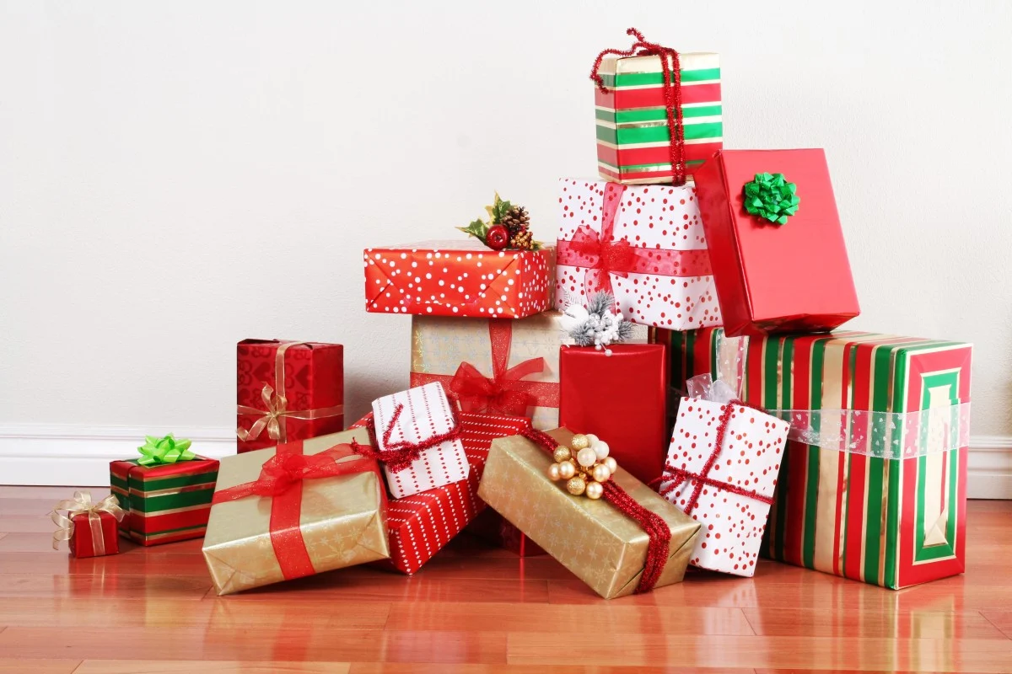
Sermon

Slide 41
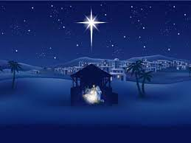
Sermon
Magic
Mystery
Miracle

Slide 42
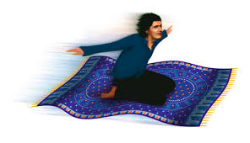
Sermon

Slide 43
Sermon

Slide 44
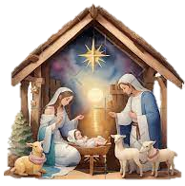
Sermon

Slide 45
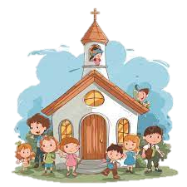
Sermon

Slide 46
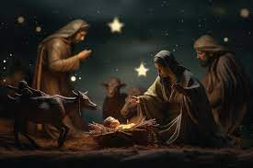
Sermon

Slide 47
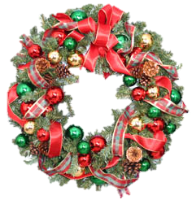
Sermon

Slide 48
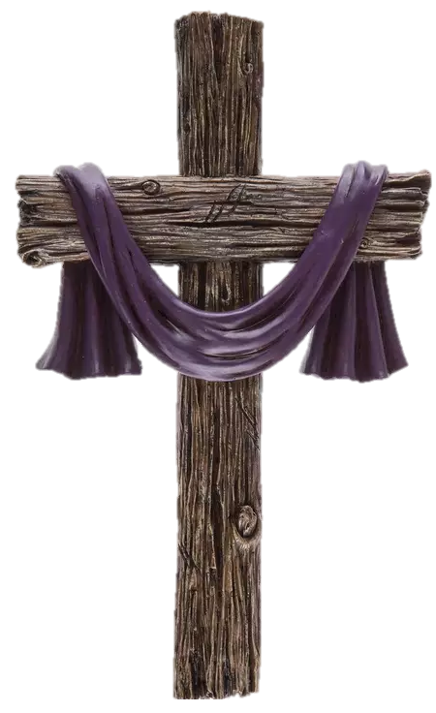
Sermon

Slide 49
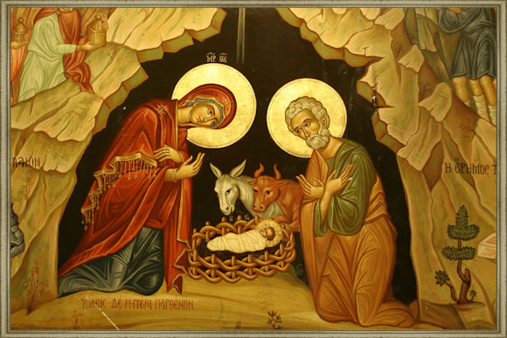
Sermon

Slide 50
Sermon

Slide 51
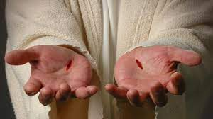
Sermon

Slide 52
Sermon

Slide 53
SPECIAL MUSIC
“Would I Know My Savior?”
by
Larry Harter

Slide 54
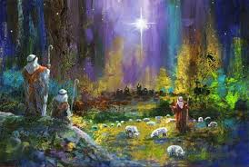
Hymn of the Day
“The First Noel”
LBW 56
(Verses 1-4 Only)

Slide 55
“The First Noel”
LBW 56
1 The first Noel the angel did say
was to certain poor shepherds in fields as they lay;
in fields where they lay, keeping their sheep,
on a cold winter's night that was so deep.

Slide 56
“The First Noel”
LBW 56
Refrían
Noel, Noel, Noel, Noel!
Born is the King of Israel.

Slide 57
“The First Noel”
LBW 56
2 They looked up and saw a star
shining in the east beyond them far;
and to the earth it gave great light,
and so it continued both day and night.

Slide 58
“The First Noel”
LBW 56
Refrían
Noel, Noel, Noel, Noel!
Born is the King of Israel.

Slide 59
“The First Noel”
LBW 56
4 This star drew near to the northwest,
o'er Bethlehem it took its rest;
and there it did both stop and stay
right over the place where Jesus lay.

Slide 60
“The First Noel”
LBW 56
Refrían
Noel, Noel, Noel, Noel!
Born is the King of Israel.

Slide 61
“The First Noel”
LBW 56
3 And by the light of that same star
three wise men came from country far;
to seek for a king was their intent,
and to follow the star wherever it went.

Slide 62
“The First Noel”
LBW 56
Refrían
Noel, Noel, Noel, Noel!
Born is the King of Israel.

Slide 63
APOSTLE’S CREED
C: I believe in God, the Father almighty, creator of heaven and earth.

Slide 64
APOSTLE’S CREED
C: I believe in Jesus Christ, his only Son, our Lord. He was conceived by the power of the Holy Spirit and born of the virgin Mary. He suffered under Pontius Pilate, was crucified, died, and was buried.

Slide 65
APOSTLE’S CREED
C: He descended into hell. On the third day he rose again. He ascended into heaven, and is seated at the right hand of the Father. He will come again to judge the living and the dead.

Slide 66
APOSTLE’S CREED
C: I believe in the Holy Spirit, the holy catholic Church, the communion of saints, the forgiveness of sins, the resurrection of the body, and the life everlasting. Amen.

Slide 67
NICENE CREED
C: We believe in one God, the Father, the Almighty, maker of heaven and earth, of all that is, seen and unseen.

Slide 68
NICENE CREED
C: We believe in one Lord, Jesus Christ, the only Son of God, eternally begotten of the Father, God from God, Light from Light, true God from true God, begotten, not made, of one Being with the Father.

Slide 69
NICENE CREED
C: Through him all things were made. For us and for our salvation he came down from heaven; by the power of the Holy Spirit he became incarnate from the virgin Mary, and was made man. For our sake he was crucified under Pontius Pilate;

Slide 70
NICENE CREED
C: he suffered death and was buried. On the third day he rose again in accordance with the Scriptures; he ascended into heaven and is seated at the right hand of the Father. He will come again in glory to judge the living and the dead, and his kingdom will have no end.

Slide 71
NICENE CREED
C: We believe in the Holy Spirit, the Lord, the giver of life, who proceeds from the Father and the Son. With the Father and the Son he is worshiped and glorified. He has spoken through the prophets. We believe in one holy catholic and apostolic Church.

Slide 72
NICENE CREED
C: We acknowledge one Baptism for the forgiveness of sins. We look for the resurrection of the dead, and the life of the world to come. Amen.

Slide 73
PRAYERS OF INTERCESSION
Each petition will end with the words,
A: God of Promise,
The congregation will respond with:
C: In mercy, hear our prayer.

Slide 74
PRAYERS OF INTERCESSION
The prayer concludes…
P: We lift all our prayers, spoken and unspoken, into your loving arms, trusting in your love and mercy, through Jesus Christ, our Savior.
C: Amen.

Slide 75
SHARING OF THE Peace
The Sharing of the Peace that began when the congregation arrived is now shared with the Pastor at this time...
P: The peace of the Lord be with you always.
C: And also with you.

Slide 76
OFFERING
Notes:
Image: Five Loaves by Caroline Coolidge Brown. Copyright © Caroline Coolidge Brown. All rights reserved. Used by permission of the artist.

Slide 77
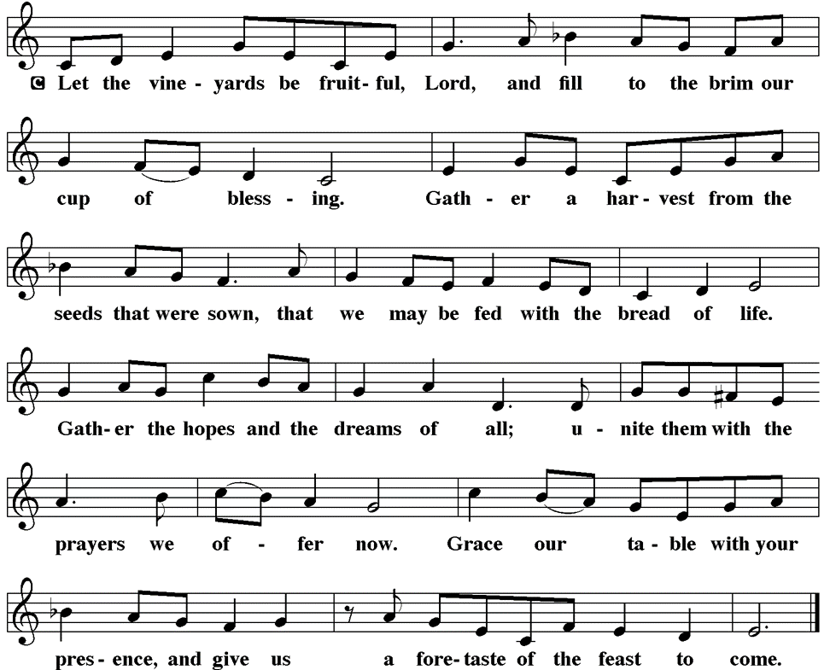
OFFERTORY “Let the Vineyards”
Notes:
Image: Five Loaves by Caroline Coolidge Brown. Copyright © Caroline Coolidge Brown. All rights reserved. Used by permission of the artist.

Slide 78
OFFERING PRAYER
P: God, we can think of no greater gift to us than Jesus. In awe and gratitude, we respond with our offerings out of the abundance you have provided in our lives. Use them for the good of the world.
C: Amen.
Notes:
Image: Five Loaves by Caroline Coolidge Brown. Copyright © Caroline Coolidge Brown. All rights reserved. Used by permission of the artist.

Slide 79
THE GREAT THANKSGIVING
All the Baptized are welcome to celebrate this Holy Meal.

Slide 80
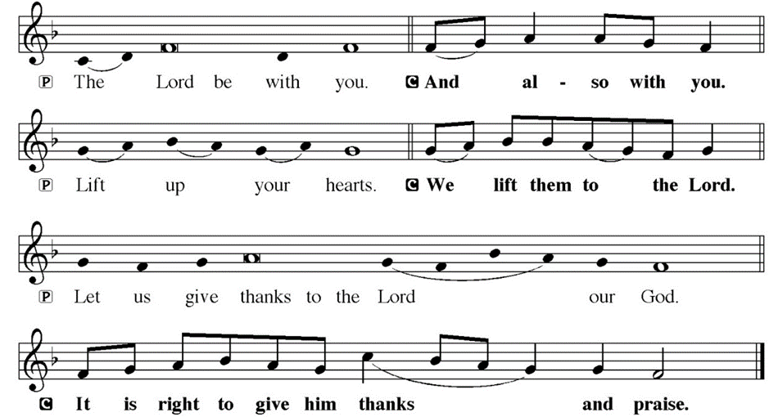
DIALOGUE

Slide 81
THE PREFACE
P: It is indeed right and salutary…
… we praise your name and join their unending hymn.

Slide 82
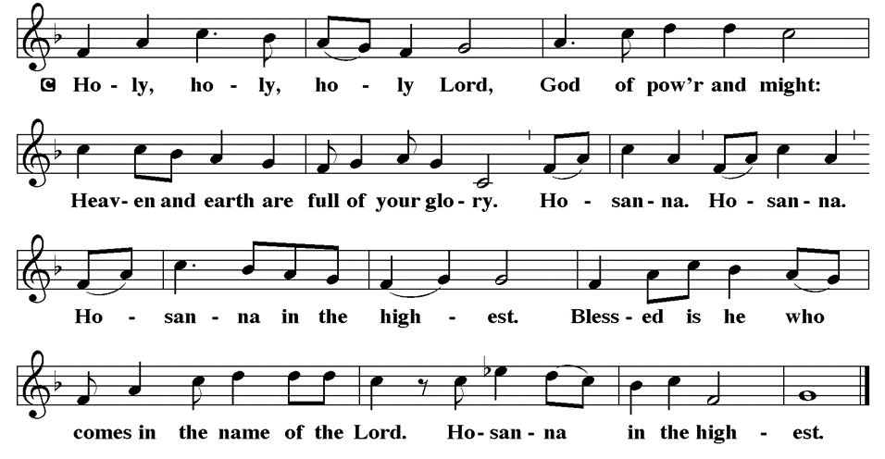
THE SANCTUS

Slide 83
EUCHARISTIC PRAYER
P: Holy God, Creator of all…
…both now and forever,
C: Amen.

Slide 84
THE LORD’S PRAYER
C: Our Father, who art in heaven, hallowed be thy name, thy kingdom come, thy will be done, on earth as it is in heaven. Give us this day our daily bread; and forgive us our trespasses, as we forgive those who trespass against us; and lead us not into temptation, but deliver us from evil.

Slide 85
THE LORD’S PRAYER
C: For thine is the kingdom, and the power, and the glory, forever and ever. Amen.

Slide 86
INVITATION TO COMMUNION
P: The infant in the manger became our leader and teacher, and gave his life for the sake of all creation. He invites you now to this table, to share in the bread and wine that makes us one. Come to the feast.

Slide 87
COMMUNION DISTRIBUTION
All will commune “At the Rail”.
The bread may be broken for distribution. As the ministers give the bread and wine, they say these words :
The body of Christ, given for you.
The blood of Christ, shed for you.
The communicant may say: Amen.

Slide 88
POST COMMUNION CANTACLE

Slide 89
POST COMMUNION CANTACLE

Slide 90
POST COMMUNION BLESSING
P: May this body and blood of our Lord and Savior, Jesus Christ, strengthen, keep, and unity us, ☩ now and forever,
C: Amen.

Slide 91
POST COMMUNION PRAYER
P: Let us pray… On this day, O God, you gave us Christ the Son to save us. As you sent the one foretold, send us now with good news for all people. Let the gladness of this feast have no end as we share with others the joy that fills us; through Jesus Christ, our Savior and Lord.
C: Amen.

Slide 92
LIGHTING OF THE CANDLES
The Pastor and Acolyte will distribute the flame from the Christ Candle down the center aisle and the congregation will pass the flame from the center aisle outward.
Unlit candles lean to lighted candles so as not to drip hot wax.
When all candles are lit and the only light in the sanctuary, the congregation will sing Silent Night.

Slide 93
Silent Night
Silent night, holy night!
All is calm, all is bright
round yon virgin
mother and child.
Holy Infant, so tender and mild,
sleep in heavenly peace,
sleep in heavenly peace.

Slide 94
Silent Night
Silent night, holy night!
Shepherds quake at the sight;
glories stream from heaven afar,
heav'nly hosts sing, alleluia!
Christ, the Savior, is born!
Christ, the Savior, is born!

Slide 95
Silent Night
Silent night, holy night!
Son of God, love's pure light
radiant beams from your holy face, with the dawn of redeeming grace,
Jesus, Lord, at your birth,
Jesus, Lord, at your birth.
The candles are extinguished and the lights are restored in the sanctuary once again.

Slide 96
ANNOUNCEMENTS
Notes:
Image: Five Loaves by Caroline Coolidge Brown. Copyright © Caroline Coolidge Brown. All rights reserved. Used by permission of the artist.

Slide 97
BLESSING
P: May Christ, who by his incarnation has filled us with grace and truth, give you peace this Christmas and always. Almighty God, Father, ☩ Son, and Holy Spirit, bless you now and forever.
C: Amen

Slide 98
SENDING BLESSING
P: The God of peace bless you, the love of Christ sustain you in hope, and the anointing of the Spirit ☩ remain upon you now and forever.
C: Amen.

Slide 99
Sending Song
“Go Tell It On The Mountain”
LBW 70
Notes:
Image: Five Loaves by Caroline Coolidge Brown. Copyright © Caroline Coolidge Brown. All rights reserved. Used by permission of the artist.

Slide 100
“Go Tell It On The Mountain” LBW 70
Refrain
Go tell it on the mountain,
over the hills and ev'rywhere;
go tell it on the mountain
that Jesus Christ is born!
Notes:
Image: Preparing yeast dough. Copyright © tomasworks/iStock/Thinkstock. Used by permission.

Slide 101
“Go Tell It On The Mountain” LBW 70
1 While shepherds kept their watching
o'er silent flocks by night,
behold, throughout the heavens
there shone a holy light.
Notes:
Image: Preparing yeast dough. Copyright © tomasworks/iStock/Thinkstock. Used by permission.

Slide 102
“Go Tell It On The Mountain” LBW 70
Refrain
Go tell it on the mountain,
over the hills and ev'rywhere;
go tell it on the mountain
that Jesus Christ is born!
Notes:
Image: Preparing yeast dough. Copyright © tomasworks/iStock/Thinkstock. Used by permission.

Slide 103
“Go Tell It On The Mountain” LBW 70
2 The shepherds feared and trembled
when, lo, above the earth
rang out the angel chorus
that hailed our Savior's birth.
Notes:
Image: Preparing yeast dough. Copyright © tomasworks/iStock/Thinkstock. Used by permission.

Slide 104
“Go Tell It On The Mountain” LBW 70
Refrain
Go tell it on the mountain,
over the hills and ev'rywhere;
go tell it on the mountain
that Jesus Christ is born!
Notes:
Image: Preparing yeast dough. Copyright © tomasworks/iStock/Thinkstock. Used by permission.

Slide 105
“Go Tell It On The Mountain” LBW 70
3 Down in a lonely manger
the humble Christ was born;
and God sent us salvation
that blessed Christmas morn.
Notes:
Image: Preparing yeast dough. Copyright © tomasworks/iStock/Thinkstock. Used by permission.

Slide 106
“Go Tell It On The Mountain” LBW 70
Refrain
Go tell it on the mountain,
over the hills and ev'rywhere;
go tell it on the mountain
that Jesus Christ is born!
Notes:
Image: Preparing yeast dough. Copyright © tomasworks/iStock/Thinkstock. Used by permission.

Slide 107
DISMISSAL
P: … Depart in Christ’s Love.
C: Seeking, welcoming, and serving all. Amen!
POSTLUDE
Pre-Recorded By
Roxanne Groff
From sundaysandseasons.com. Copyright © 2023 Augsburg Fortress. All rights reserved. Reprinted by permission under Augsburg Fortress Liturgies Annual License #SAS023830. New Revised Standard Version Bible, Copyright © 1989, Division of Christian Education of the National Council of the Churches of Christ in the United States of America. Used by permission. All rights reserved. Revised Common Lectionary, Copyright © 1992 Consultation on Common Texts, admin Augsburg Fortress. Used by permission.

