Slide 1
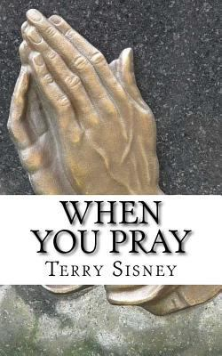
Trinity Evangelical Lutheran Church May 26, 2024
WELCOME!
Notes:
Image: Five Loaves by Caroline Coolidge Brown. Copyright © Caroline Coolidge Brown. All rights reserved. Used by permission of the artist.

Slide 2
Prelude By Pam Sherman
= Please stand if able
= Please be seated
Office of the Acolyte and Ringing of the Bell
Welcome Dean Thompson
Notes:
Image: Five Loaves by Caroline Coolidge Brown. Copyright © Caroline Coolidge Brown. All rights reserved. Used by permission of the artist.

Slide 3
THANKSGIVING FOR BAPTISM
All may make the sign of the cross, the sign marked at baptism…
P: Blessed be the holy Trinity, ☩ one God, the fountain of living water, the rock who gave us birth, our light and our salvation.
C: Amen.
Notes:
Image: Five Loaves by Caroline Coolidge Brown. Copyright © Caroline Coolidge Brown. All rights reserved. Used by permission of the artist.

Slide 4
THANKSGIVING FOR BAPTISM
The presiding minister addresses the assembly.
P: Joined to Christ in the waters of baptism, we are clothed with God’s mercy and forgiveness. Let us give thanks for the gift of baptism.
Water may be poured into the font as the presiding minister gives thanks.
Notes:
Image: Five Loaves by Caroline Coolidge Brown. Copyright © Caroline Coolidge Brown. All rights reserved. Used by permission of the artist.

Slide 5
THANKSGIVING FOR BAPTISM
P: We give you thanks, O God, for in the beginning your Spirit moved over the waters and by your Word you created the world, calling forth life in which you took delight. Through the waters of the flood you delivered Noah and his family. Through the sea you led your people Israel from slavery into freedom. At the river your Son was baptized by John and anointed with the Holy Spirit. By water and your Word you claim us as
Notes:
Image: Five Loaves by Caroline Coolidge Brown. Copyright © Caroline Coolidge Brown. All rights reserved. Used by permission of the artist.

Slide 6
THANKSGIVING FOR BAPTISM
P: daughters and sons, making us heirs of your promise and servants of all. We praise you for the gift of water that sustains life, and above all we praise you for the gift of new life in Jesus Christ. Shower us with your Spirit, and renew our lives with your forgiveness, grace, and love. To you be given honor and praise through Jesus Christ our Lord in the unity of the Holy Spirit, now and forever.
C: Amen.
Notes:
Image: Five Loaves by Caroline Coolidge Brown. Copyright © Caroline Coolidge Brown. All rights reserved. Used by permission of the artist.

Slide 7
Gathering Song
“Children of the Heavenly Father”
LBW 474
Notes:
Image: Five Loaves by Caroline Coolidge Brown. Copyright © Caroline Coolidge Brown. All rights reserved. Used by permission of the artist.

Slide 8
“Children of the Heavenly Father” LBW 474
1 Children of the heav'nly Father
safely in his bosom gather;
nestling bird nor star in heaven
such a refuge e'er was given.
2 God his own doth tend and nourish,
in his holy courts they flourish.
From all evil things he spares them,
in his mighty arms he bears them.
Notes:
Image: Five Loaves by Caroline Coolidge Brown. Copyright © Caroline Coolidge Brown. All rights reserved. Used by permission of the artist.

Slide 9
“Children of the Heavenly Father” LBW 474
3 Neither life nor death shall ever
from the Lord his children sever;
unto them his grace he showeth,
and their sorrows all he knoweth.
4 Though he giveth or he taketh,
God his children ne'er forsaketh;
his the loving purpose solely
to preserve them pure and holy.
Notes:
Image: Five Loaves by Caroline Coolidge Brown. Copyright © Caroline Coolidge Brown. All rights reserved. Used by permission of the artist.

Slide 10
APOSTOLIC GREETING
P: The grace of our Lord Jesus Christ, the love of God, and the communion of the Holy Spirit be with you all.
C: And also with you.
Notes:
Image: Five Loaves by Caroline Coolidge Brown. Copyright © Caroline Coolidge Brown. All rights reserved. Used by permission of the artist.

Slide 11
KYRIE
Notes:
Image: Five Loaves by Caroline Coolidge Brown. Copyright © Caroline Coolidge Brown. All rights reserved. Used by permission of the artist.

Slide 12
KYRIE
Notes:
Image: Five Loaves by Caroline Coolidge Brown. Copyright © Caroline Coolidge Brown. All rights reserved. Used by permission of the artist.

Slide 13
KYRIE
Notes:
Image: Five Loaves by Caroline Coolidge Brown. Copyright © Caroline Coolidge Brown. All rights reserved. Used by permission of the artist.

Slide 14
HYMN OF PRAISE
Glory be to God in heaven;
peace, goodwill to all the earth.
Mighty God of all creation,
Father of surpassing worth:
we exalt you, we adore you,
we lift high our thanks and praise.
Saints and angels bow before you; here on earth our songs we raise.
Notes:
Image: Five Loaves by Caroline Coolidge Brown. Copyright © Caroline Coolidge Brown. All rights reserved. Used by permission of the artist.

Slide 15
HYMN OF PRAISE
Glory be to Christ forever,
Lamb of God and Lord of love.
Son of God and gracious Savior, you have come from heav’n above;
on the cross you died to save us; now you reign at God’s right hand.
Hear our prayer; restore, forgive us; in your promise firm we stand.
Notes:
Image: Five Loaves by Caroline Coolidge Brown. Copyright © Caroline Coolidge Brown. All rights reserved. Used by permission of the artist.

Slide 16
HYMN OF PRAISE
Holy One we now acclaim you;
Lord alone, to you we call;
Holy One in faith we name you,
God most high, yet near to all:
Jesus Christ, with God the Spirit,
in the Father’s splendor bright.
For the peace that we inherit,
glory be to God on high!
Notes:
Image: Five Loaves by Caroline Coolidge Brown. Copyright © Caroline Coolidge Brown. All rights reserved. Used by permission of the artist.

Slide 17
PRAYER OF THE DAY
P: Let us pray… Holy God, you have claimed us as your own, as your beloved children, in and through Jesus Christ, our savior and brother. Help us always to remember you love us more deeply and more unconditionally than any human parent. Call us into conversation with you each day, so we might stay connected to you, and be open to your guidance in our daily lives. In Jesus’ name we pray.
C: Amen
Notes:
Image: Five Loaves by Caroline Coolidge Brown. Copyright © Caroline Coolidge Brown. All rights reserved. Used by permission of the artist.

Slide 18
Notes:
Image: Preparing yeast dough. Copyright © tomasworks/iStock/Thinkstock. Used by permission.

Slide 19
Scripture Reading
R: Our scripture reading is from the Holy Gospel according to Saint Luke, the 11th chapter.
C: Glory to you O’ Lord! (Spoken)
Notes:
Image: Five Loaves by Caroline Coolidge Brown. Copyright © Caroline Coolidge Brown. All rights reserved. Used by permission of the artist.

Slide 20
Luke 11:2-4
²He said to them, “When you pray, say: Father, hallowed be your name. Your kingdom come. ³Give us each day our daily bread. ⁴And forgive us our sins, for we ourselves forgive everyone indebted to us. And do not bring us to the time of trial.”
Notes:
Image: Five Loaves by Caroline Coolidge Brown. Copyright © Caroline Coolidge Brown. All rights reserved. Used by permission of the artist.

Slide 21
Luke 11:2-4
R: This is the Word of the Lord.
C: Praise to You, O Christ (Spoken)
Notes:
Image: Five Loaves by Caroline Coolidge Brown. Copyright © Caroline Coolidge Brown. All rights reserved. Used by permission of the artist.

Slide 22
Sermon
Notes:
Image: Five Loaves by Caroline Coolidge Brown. Copyright © Caroline Coolidge Brown. All rights reserved. Used by permission of the artist.

Slide 23
Hymn
of the
Day
“Our Father, by Whose Name”
ELW 640

Slide 24
“Our Father, by Whose Name” ELW 640
1 Our Father, by whose name
all parenthood is known,
in love divine you claim
each fam'ly as your own.
Bless mothers, fathers, guarding well,
with constant love as sentinel,
the homes in which your people dwell.

Slide 25
“Our Father, by Whose Name” ELW 640
2 O Christ, yourself a child
within an earthly home,
with heart still undefiled
to full adulthood come:
our children bless in ev'ry place
that they may all behold your face
and, knowing you, may grow in grace.

Slide 26
“Our Father, by Whose Name” ELW 640
3 O Holy Spirit, bind
our hearts in unity
and teach us how to find
the love from self set free;
in all our hearts such love increase
that ev'ry home, by this release,
may be the dwelling place of peace.

Slide 27
NICENE CREED
C: We believe in one God, the Father, the Almighty, maker of heaven and earth, of all that is, seen and unseen.

Slide 28
NICENE CREED
C: We believe in one Lord, Jesus Christ, the only Son of God, eternally begotten of the Father, God from God, Light from Light, true God from true God, begotten, not made, of one Being with the Father.

Slide 29
NICENE CREED
C: Through him all things were made. For us and for our salvation he came down from heaven; by the power of the Holy Spirit he became incarnate from the virgin Mary, and was made man. For our sake he was crucified under Pontius Pilate;

Slide 30
NICENE CREED
C: he suffered death and was buried. On the third day he rose again in accordance with the Scriptures; he ascended into heaven and is seated at the right hand of the Father. He will come again in glory to judge the living and the dead, and his kingdom will have no end.

Slide 31
NICENE CREED
C: We believe in the Holy Spirit, the Lord, the giver of life, who proceeds from the Father and the Son. With the Father and the Son he is worshiped and glorified. He has spoken through the prophets. We believe in one holy catholic and apostolic Church.

Slide 32
NICENE CREED
C: We acknowledge one Baptism for the forgiveness of sins. We look for the resurrection of the dead, and the life of the world to come. Amen.

Slide 33
PRAYERS OF INTERCESSION
Each petition will end with the words,
A: God, our shepherd,
The congregation will respond with:
C: Hear our prayer.

Slide 34
PRAYERS OF INTERCESSION
The prayer concludes…
P: Confident that you care for all our needs, we lift these prayers, spoken and unspoken, into your loving hands.
C: Amen.

Slide 35
OFFERING
Notes:
Image: Five Loaves by Caroline Coolidge Brown. Copyright © Caroline Coolidge Brown. All rights reserved. Used by permission of the artist.

Slide 36
OFFERING PRAYER
Notes:
Image: Five Loaves by Caroline Coolidge Brown. Copyright © Caroline Coolidge Brown. All rights reserved. Used by permission of the artist.

Slide 37
THE GREAT THANKSGIVING
All the Baptized are welcome to celebrate this Holy Meal.

Slide 38
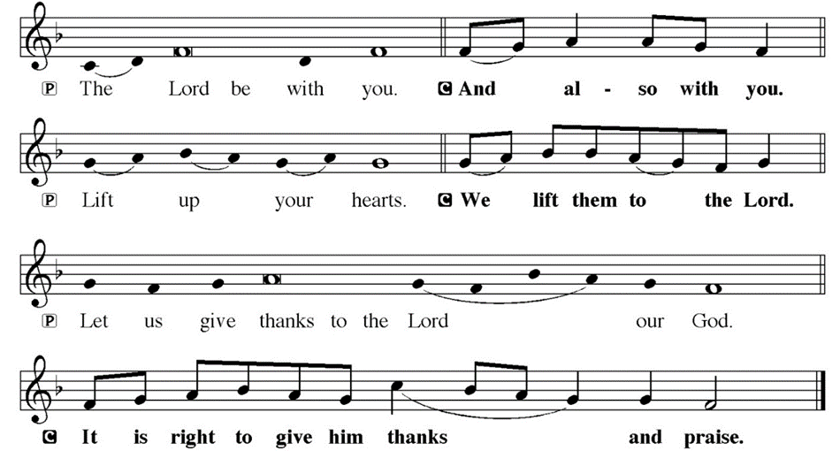
DIALOGUE

Slide 39
THE PREFACE
P: It is indeed right and salutary…
… we praise your name and join their unending hymn.

Slide 40
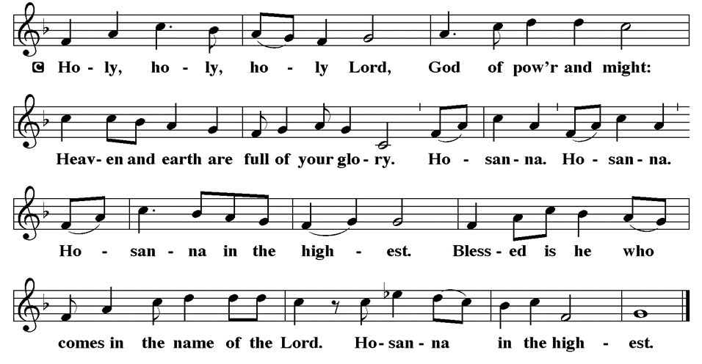
THE SANCTUS

Slide 41
EUCHARISTIC PRAYER
P: Holy, God, breath of life…
…both now and forever.
C: Amen.

Slide 42
THE LORD’S PRAYER
C: Our Father, who art in heaven, hallowed be thy name, thy kingdom come, thy will be done, on earth as it is in heaven. Give us this day our daily bread; and forgive us our trespasses, as we forgive those who trespass against us; and lead us not into temptation, but deliver us from evil.

Slide 43
THE LORD’S PRAYER
C: For thine is the kingdom, and the power, and the glory, forever and ever. Amen.

Slide 44
INVITATION TO COMMUNION
P: Christ whose body is the whole church united invites you now to this table to share with one another the bread and wine that is his presence in our midst. Come and be fed, for all is prepared.

Slide 45
COMMUNION DISTRIBUTION
All will commune “By Station”.
The bread may be broken for distribution. As the ministers give the bread and wine, they say these words :
The body of Christ, given for you.
The blood of Christ, shed for you.
The communicant may say: Amen.

Slide 46
POST COMMUNION BLESSING
P: May this body and blood of our Lord and Savior, Jesus Christ, strengthen, keep and unite us, ☩ now and forever, amen.
C: Amen.

Slide 47
POST COMMUNION CANTACLE

Slide 48
POST COMMUNION CANTACLE

Slide 49
POST COMMUNION PRAYER
P: Let us pray… Shepherding God, you have prepared a table before us and nourished us with your love. Send us forth from this banquet to proclaim your goodness and share the abundant mercy of Jesus, our redeemer and friend.
C: Amen

Slide 50
ANNOUNCEMENTS
Notes:
Image: Five Loaves by Caroline Coolidge Brown. Copyright © Caroline Coolidge Brown. All rights reserved. Used by permission of the artist.

Slide 51
SENDING BLESSING
P: The blessing of God, who provides for us, feeds us, and journeys with us, ☩ be upon you now and forever.
C: Amen.

Slide 52
Sending Song
“Great Is Thy Faithfulness”
ELW 733
Notes:
Image: Five Loaves by Caroline Coolidge Brown. Copyright © Caroline Coolidge Brown. All rights reserved. Used by permission of the artist.

Slide 53
“Great Is Thy Faithfulness” ELW 733
1 Great is thy faithfulness, O God my Father;
there is no shadow of turning with thee;
thou changest not, thy compassions they fail not;
as thou hast been, thou forever wilt be.
Notes:
Image: Preparing yeast dough. Copyright © tomasworks/iStock/Thinkstock. Used by permission.

Slide 54
“Great Is Thy Faithfulness” ELW 733
Refrain
Great is thy faithfulness! Great is thy faithfulness!
Morning by morning new mercies I see;
all I have needed thy hand hath provided;
great is thy faithfulness, Lord, unto me!
Notes:
Image: Preparing yeast dough. Copyright © tomasworks/iStock/Thinkstock. Used by permission.

Slide 55
“Great Is Thy Faithfulness” ELW 733
2 Summer and winter and springtime and harvest,
sun, moon, and stars in their courses above
join with all nature in manifold witness
to thy great faithfulness, mercy, and love.
Notes:
Image: Preparing yeast dough. Copyright © tomasworks/iStock/Thinkstock. Used by permission.

Slide 56
“Great Is Thy Faithfulness” ELW 733
Refrain
Great is thy faithfulness! Great is thy faithfulness!
Morning by morning new mercies I see;
all I have needed thy hand hath provided;
great is thy faithfulness, Lord, unto me!
Notes:
Image: Preparing yeast dough. Copyright © tomasworks/iStock/Thinkstock. Used by permission.

Slide 57
“Great Is Thy Faithfulness” ELW 733
3 Pardon for sin and a peace that endureth,
thine own dear presence to cheer and to guide;
strength for today and bright hope for tomorrow,
blessings all mine, with ten thousand beside!
Notes:
Image: Preparing yeast dough. Copyright © tomasworks/iStock/Thinkstock. Used by permission.

Slide 58
“Great Is Thy Faithfulness” ELW 733
Refrain
Great is thy faithfulness! Great is thy faithfulness!
Morning by morning new mercies I see;
all I have needed thy hand hath provided;
great is thy faithfulness, Lord, unto me!
Notes:
Image: Preparing yeast dough. Copyright © tomasworks/iStock/Thinkstock. Used by permission.

Slide 59
DISMISSAL
P: … Depart in Christ’s Love.
C: Seeking, welcoming, and serving all. Amen!
POSTLUDE
By Pam Sherman
From sundaysandseasons.com. Copyright © 2024 Augsburg Fortress. All rights reserved. Reprinted by permission under Augsburg Fortress Liturgies Annual License #SAS023830. New Revised Standard Version Bible, Copyright © 1989, Division of Christian Education of the National Council of the Churches of Christ in the United States of America. Used by permission. All rights reserved. Revised Common Lectionary, Copyright © 1992 Consultation on Common Texts, admin Augsburg Fortress. Used by permission.

