Slide 1
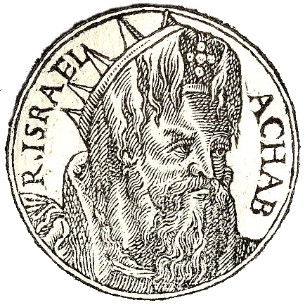
November 5, 2023
WELCOME!
Trinity Lutheran Church
All Saints Sunday
Notes:
Image: Five Loaves by Caroline Coolidge Brown. Copyright © Caroline Coolidge Brown. All rights reserved. Used by permission of the artist.

Slide 2
= Please stand if able
= Please be seated
Prelude - By Roxanne Groff
Office of the Acolyte
Ringing of the Bell
Welcome

Slide 3
Remembering Our Saints
We will read the names of our dearly departed saints in groups of 3. After each group of names is read the bell will toll.
Please respond in faith that they are “Here with Us.”
Notes:
Image: Preparing yeast dough. Copyright © tomasworks/iStock/Thinkstock. Used by permission.

Slide 4
THANKSGIVING FOR BAPTISM
All may make the sign of the cross, the sign marked at baptism, as the presiding minister begins.
P: Blessed be the holy Trinity, ☩ one God, the fountain of living water, the rock who gave us birth, our light and our salvation.
C: Amen.
Notes:
Image: Preparing yeast dough. Copyright © tomasworks/iStock/Thinkstock. Used by permission.

Slide 5
P: Joined to Christ in the waters of baptism, we are clothed with God's mercy and forgiveness. Let us give thanks for the gift of baptism. Water may be poured into the font as the presiding minister gives thanks.
THANKSGIVING FOR BAPTISM
Notes:
Image: Preparing yeast dough. Copyright © tomasworks/iStock/Thinkstock. Used by permission.

Slide 6
P: We give you thanks, O God, for in the beginning your Spirit moved over the waters and by your Word you created the world, calling forth life in which you took delight. Through the waters of the flood you delivered Noah and his family. Through the sea you led your people Israel from slavery into freedom.
THANKSGIVING FOR BAPTISM
Notes:
Image: Preparing yeast dough. Copyright © tomasworks/iStock/Thinkstock. Used by permission.

Slide 7
P: At the river your Son was baptized by John and anointed with the Holy Spirit. By water and your Word you claim us as daughters and sons, making us heirs of your promise and servants of all. We praise you for the gift of water that sustains life, and above all we praise you for the gift of new life in Jesus Christ.
THANKSGIVING FOR BAPTISM
Notes:
Image: Preparing yeast dough. Copyright © tomasworks/iStock/Thinkstock. Used by permission.

Slide 8
P: Shower us with your Spirit, and renew our lives with your forgiveness, grace, and love. To you be given honor and praise through Jesus Christ our Lord in the unity of the Holy Spirit, now and forever.
THANKSGIVING FOR BAPTISM
C: Amen.
Notes:
Image: Preparing yeast dough. Copyright © tomasworks/iStock/Thinkstock. Used by permission.

Slide 9
CONFESSION AND FORGIVENESS
All may make the sign of the cross, the sign marked at baptism…
L: We confess our sins before God and one another.
Pause for silence and reflection.
L: God whose reign is just,
Notes:
Image: Five Loaves by Caroline Coolidge Brown. Copyright © Caroline Coolidge Brown. All rights reserved. Used by permission of the artist.

Slide 10
CONFESSION AND FORGIVENESS
C: We acknowledge that our actions and inactions have led to the oppression of our neighbors. We have willingly benefitted from privileges that cause harm to others. We have failed to heed your call to lead from a place of humility, and to care for our communities in a way that makes is possible for all to flourish.
Notes:
Image: Five Loaves by Caroline Coolidge Brown. Copyright © Caroline Coolidge Brown. All rights reserved. Used by permission of the artist.

Slide 11
CONFESSION AND FORGIVENESS
C: Forgive us our fear of scarcity and love of power, and keep us ever mindful of the needs of others.
Notes:
Image: Five Loaves by Caroline Coolidge Brown. Copyright © Caroline Coolidge Brown. All rights reserved. Used by permission of the artist.

Slide 12
CONFESSION AND FORGIVENESS
P: The reign of God has come near to you! In Christ Jesus, we are reconciled to God, and therefore God forgives us all our sins. ☩ Let God guide us to work for God’s justice.
C: Amen.
Notes:
Image: Five Loaves by Caroline Coolidge Brown. Copyright © Caroline Coolidge Brown. All rights reserved. Used by permission of the artist.

Slide 13
Gathering Song/Hymn of Praise
“For All Your Saints, Oh Lord”
LBW 176

Slide 14
“For All Your Saints, Oh Lord” LBW 176
1 For all your saints, O Lord,
who strove in you to live,
who followed you, obeyed, adored,
our grateful hymn receive.
2 For all your saints, O Lord,
who strove in you to die,
who counted you their great reward,
accept our thankful cry.
Notes:
Image: Five Loaves by Caroline Coolidge Brown. Copyright © Caroline Coolidge Brown. All rights reserved. Used by permission of the artist.

Slide 15
“For All Your Saints, Oh Lord” LBW 176
3 They all in life and death,
with you, their Lord, in view,
learned from your Holy Spirit’s breath
to suffer and to do.
4 For this, your name we bless
and humbly pray anew
that we like them in holiness
may live and die in you.
Notes:
Image: Five Loaves by Caroline Coolidge Brown. Copyright © Caroline Coolidge Brown. All rights reserved. Used by permission of the artist.

Slide 16
“For All Your Saints, Oh Lord” LBW 176
5 To God, the Father, Son,
and Spirit, ever blest,
the One in Three, the Three in One,
be endless praise addressed.
Notes:
Image: Five Loaves by Caroline Coolidge Brown. Copyright © Caroline Coolidge Brown. All rights reserved. Used by permission of the artist.

Slide 17
APOSTOLIC GREETING
P: The grace of our Lord Jesus Christ, the love of God, and the communion of the Holy Spirit be with you all.
C: And also with you.
Notes:
Image: Five Loaves by Caroline Coolidge Brown. Copyright © Caroline Coolidge Brown. All rights reserved. Used by permission of the artist.

Slide 18
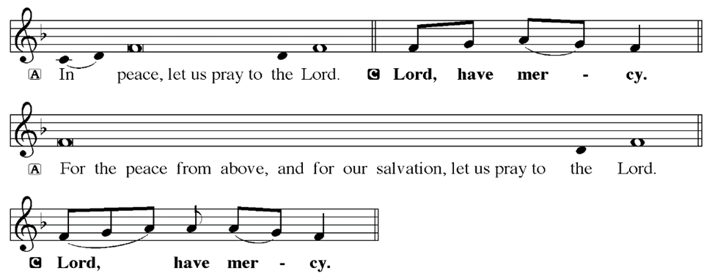
KYRIE
Notes:
Image: Five Loaves by Caroline Coolidge Brown. Copyright © Caroline Coolidge Brown. All rights reserved. Used by permission of the artist.

Slide 19
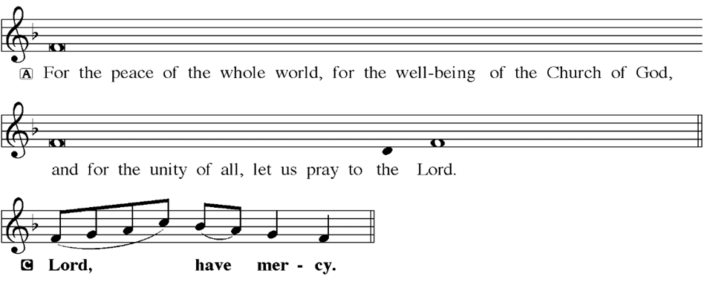
KYRIE
Notes:
Image: Five Loaves by Caroline Coolidge Brown. Copyright © Caroline Coolidge Brown. All rights reserved. Used by permission of the artist.

Slide 20
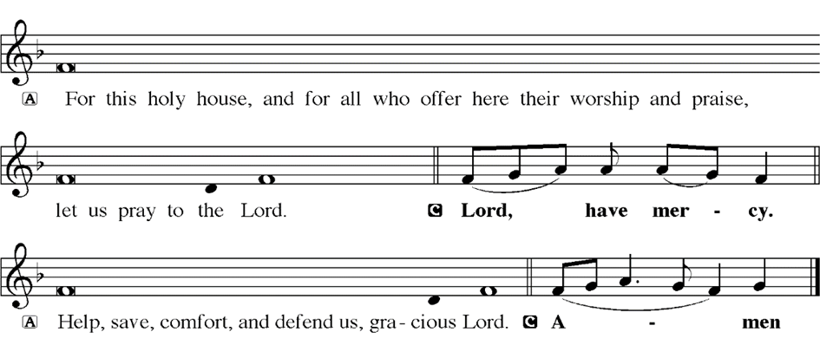
KYRIE
Notes:
Image: Five Loaves by Caroline Coolidge Brown. Copyright © Caroline Coolidge Brown. All rights reserved. Used by permission of the artist.

Slide 21
HYMN OF PRAISE
Glory be to God in heaven;
peace, goodwill to all the earth.
Mighty God of all creation,
Father of surpassing worth:
we exalt you, we adore you,
we lift high our thanks and praise.
Saints and angels bow before you; here on earth our songs we raise.
Notes:
Image: Five Loaves by Caroline Coolidge Brown. Copyright © Caroline Coolidge Brown. All rights reserved. Used by permission of the artist.

Slide 22
HYMN OF PRAISE
Glory be to Christ forever,
Lamb of God and Lord of love.
Son of God and gracious Savior, you have come from heav’n above;
on the cross you died to save us; now you reign at God’s right hand.
Hear our prayer; restore, forgive us; in your promise firm we stand.
Notes:
Image: Five Loaves by Caroline Coolidge Brown. Copyright © Caroline Coolidge Brown. All rights reserved. Used by permission of the artist.

Slide 23
HYMN OF PRAISE
Holy One we now acclaim you;
Lord alone, to you we call;
Holy One in faith we name you,
God most high, yet near to all:
Jesus Christ, with God the Spirit,
in the Father’s splendor bright.
For the peace that we inherit,
glory be to God on high!
Notes:
Image: Five Loaves by Caroline Coolidge Brown. Copyright © Caroline Coolidge Brown. All rights reserved. Used by permission of the artist.

Slide 24
PRAYER OF THE DAY
P: Let us pray… Mighty God, day by day we are witnesses to your miracles, big and small, whether we are even aware of them. Draw our attention to your action in the world, that we might proclaim your goodness. In Jesus name we pray.
C: Amen
Notes:
Image: Five Loaves by Caroline Coolidge Brown. Copyright © Caroline Coolidge Brown. All rights reserved. Used by permission of the artist.

Slide 25
Notes:
Image: Five Loaves by Caroline Coolidge Brown. Copyright © Caroline Coolidge Brown. All rights reserved. Used by permission of the artist.

Slide 26
Scripture Reading
L: Our scripture reading for this day is from 1st Kings the 18th Chapter.
C: Glory to you O’ Lord! (Spoken)
Notes:
Image: Five Loaves by Caroline Coolidge Brown. Copyright © Caroline Coolidge Brown. All rights reserved. Used by permission of the artist.

Slide 27
1 Kings 18:17-39
¹⁷ When Ahab saw Elijah, Ahab said to him, “Is it you, you troubler of Israel?” ¹⁸ He answered, “I have not troubled Israel; but you have, and your father’s house, because you have forsaken the commandments of the Lord and followed the Baals. ¹⁹Now therefore have all Israel assemble for me at Mount Carmel, with the four hundred fifty prophets of Baal and the four
Notes:
Image: Five Loaves by Caroline Coolidge Brown. Copyright © Caroline Coolidge Brown. All rights reserved. Used by permission of the artist.

Slide 28
1 Kings 18:17-39
hundred prophets of Asherah, who eat at Jezebel’s table.”
²⁰ So Ahab sent to all the Israelites, and assembled the prophets at Mount Carmel. ²¹ Elijah then came near to all the people, and said, “How long will you go limping with two different opinions? If the Lord is God, follow him; but if Baal, then follow him.” The people did not answer him a word.
Notes:
Image: Five Loaves by Caroline Coolidge Brown. Copyright © Caroline Coolidge Brown. All rights reserved. Used by permission of the artist.

Slide 29
1 Kings 18:17-39
²² Then Elijah said to the people, “I, even I only, am left a prophet of the Lord; but Baal’s prophets number four hundred fifty. ²³ Let two bulls be given to us; let them choose one bull for themselves, cut it in pieces, and lay it on the wood, but put no fire to it; I will prepare the other bull and lay it on the wood, but put no fire to it. ²⁴Then you call on the name of your god and I will
Notes:
Image: Five Loaves by Caroline Coolidge Brown. Copyright © Caroline Coolidge Brown. All rights reserved. Used by permission of the artist.

Slide 30
1 Kings 18:17-39
call on the name of the Lord; the god who answers by fire is indeed God.” All the people answered, “Well spoken!” ²⁵ Then Elijah said to the prophets of Baal, “Choose for yourselves one bull and prepare it first, for you are many; then call on the name of your god, but put no fire to it.” ²⁶ So they took the bull that was given them, prepared it, and called on the name of Baal from
Notes:
Image: Five Loaves by Caroline Coolidge Brown. Copyright © Caroline Coolidge Brown. All rights reserved. Used by permission of the artist.

Slide 31
1 Kings 18:17-39
morning until noon, crying, “O Baal, answer us!” But there was no voice, and no answer. They limped about the altar that they had made. ²⁷ At noon Elijah mocked them, saying, “Cry aloud! Surely he is a god; either he is meditating, or he has wandered away, or he is on a journey, or perhaps he is asleep and must be awakened.” ²⁸ Then they cried aloud and, as was their
Notes:
Image: Five Loaves by Caroline Coolidge Brown. Copyright © Caroline Coolidge Brown. All rights reserved. Used by permission of the artist.

Slide 32
1 Kings 18:17-39
custom, they cut themselves with swords and lances until the blood gushed out over them. ²⁹ As midday passed, they raved on until the time of the offering of the oblation, but there was no voice, no answer, and no response.
³⁰ Then Elijah said to all the people, “Come closer to me”; and all the people came closer to him. First he
Notes:
Image: Five Loaves by Caroline Coolidge Brown. Copyright © Caroline Coolidge Brown. All rights reserved. Used by permission of the artist.

Slide 33
1 Kings 18:17-39
repaired the altar of the Lord that had been thrown down; ³¹ Elijah took twelve stones, according to the number of the tribes of the sons of Jacob, to whom the word of the Lord came, saying, “Israel shall be your name”; ³² with the stones he built an altar in the name of the Lord. Then he made a trench around the altar, large enough to contain two measures of seed. ³³Next
Notes:
Image: Five Loaves by Caroline Coolidge Brown. Copyright © Caroline Coolidge Brown. All rights reserved. Used by permission of the artist.

Slide 34
1 Kings 18:17-39
he put the wood in order, cut the bull in pieces, and laid it on the wood. He said, “Fill four jars with water and pour it on the burnt offering and on the wood.” ³⁴ Then he said, “Do it a second time”; and they did it a second time. Again he said, “Do it a third time”; and they did it a third time, ³⁵ so that the water ran all around the altar, and filled the trench also with water.
Notes:
Image: Five Loaves by Caroline Coolidge Brown. Copyright © Caroline Coolidge Brown. All rights reserved. Used by permission of the artist.

Slide 35
1 Kings 18:17-39
³⁶ At the time of the offering of the oblation, the prophet Elijah came near and said, “O Lord, God of Abraham, Isaac, and Israel, let it be known this day that you are God in Israel, that I am your servant, and that I have done all these things at your bidding. ³⁷Answer me, O Lord, answer me, so that this people may know that you, O Lord, are God, and that you have turned their
Notes:
Image: Five Loaves by Caroline Coolidge Brown. Copyright © Caroline Coolidge Brown. All rights reserved. Used by permission of the artist.

Slide 36
1 Kings 18:17-39
hearts back.” ³⁸ Then the fire of the Lord fell and consumed the burnt offering, the wood, the stones, and the dust, and even licked up the water that was in the trench. ³⁹ When all the people saw it, they fell on their faces and said, “The Lord indeed is God; the Lord indeed is God.”
Notes:
Image: Five Loaves by Caroline Coolidge Brown. Copyright © Caroline Coolidge Brown. All rights reserved. Used by permission of the artist.

Slide 37
1 Kings 18:17-39
R: This is the Word of the Lord.
C: Praise to You, O Christ (Spoken)
Notes:
Image: Five Loaves by Caroline Coolidge Brown. Copyright © Caroline Coolidge Brown. All rights reserved. Used by permission of the artist.

Slide 38
Sermon

Slide 39
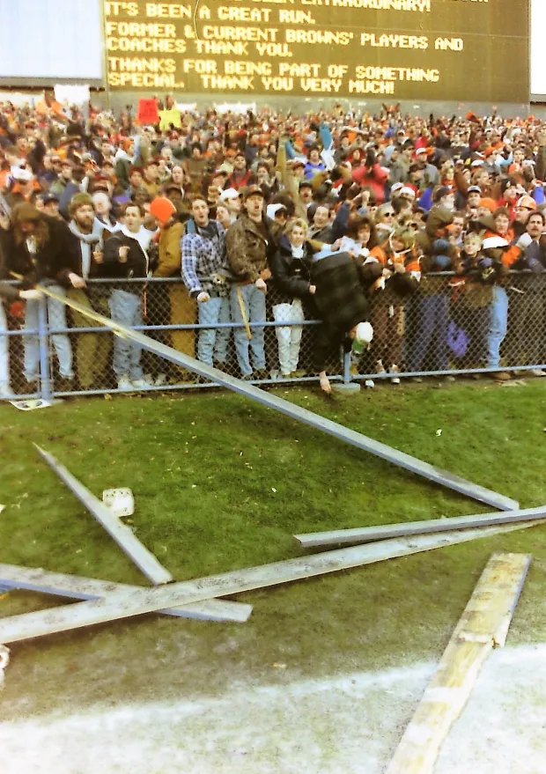
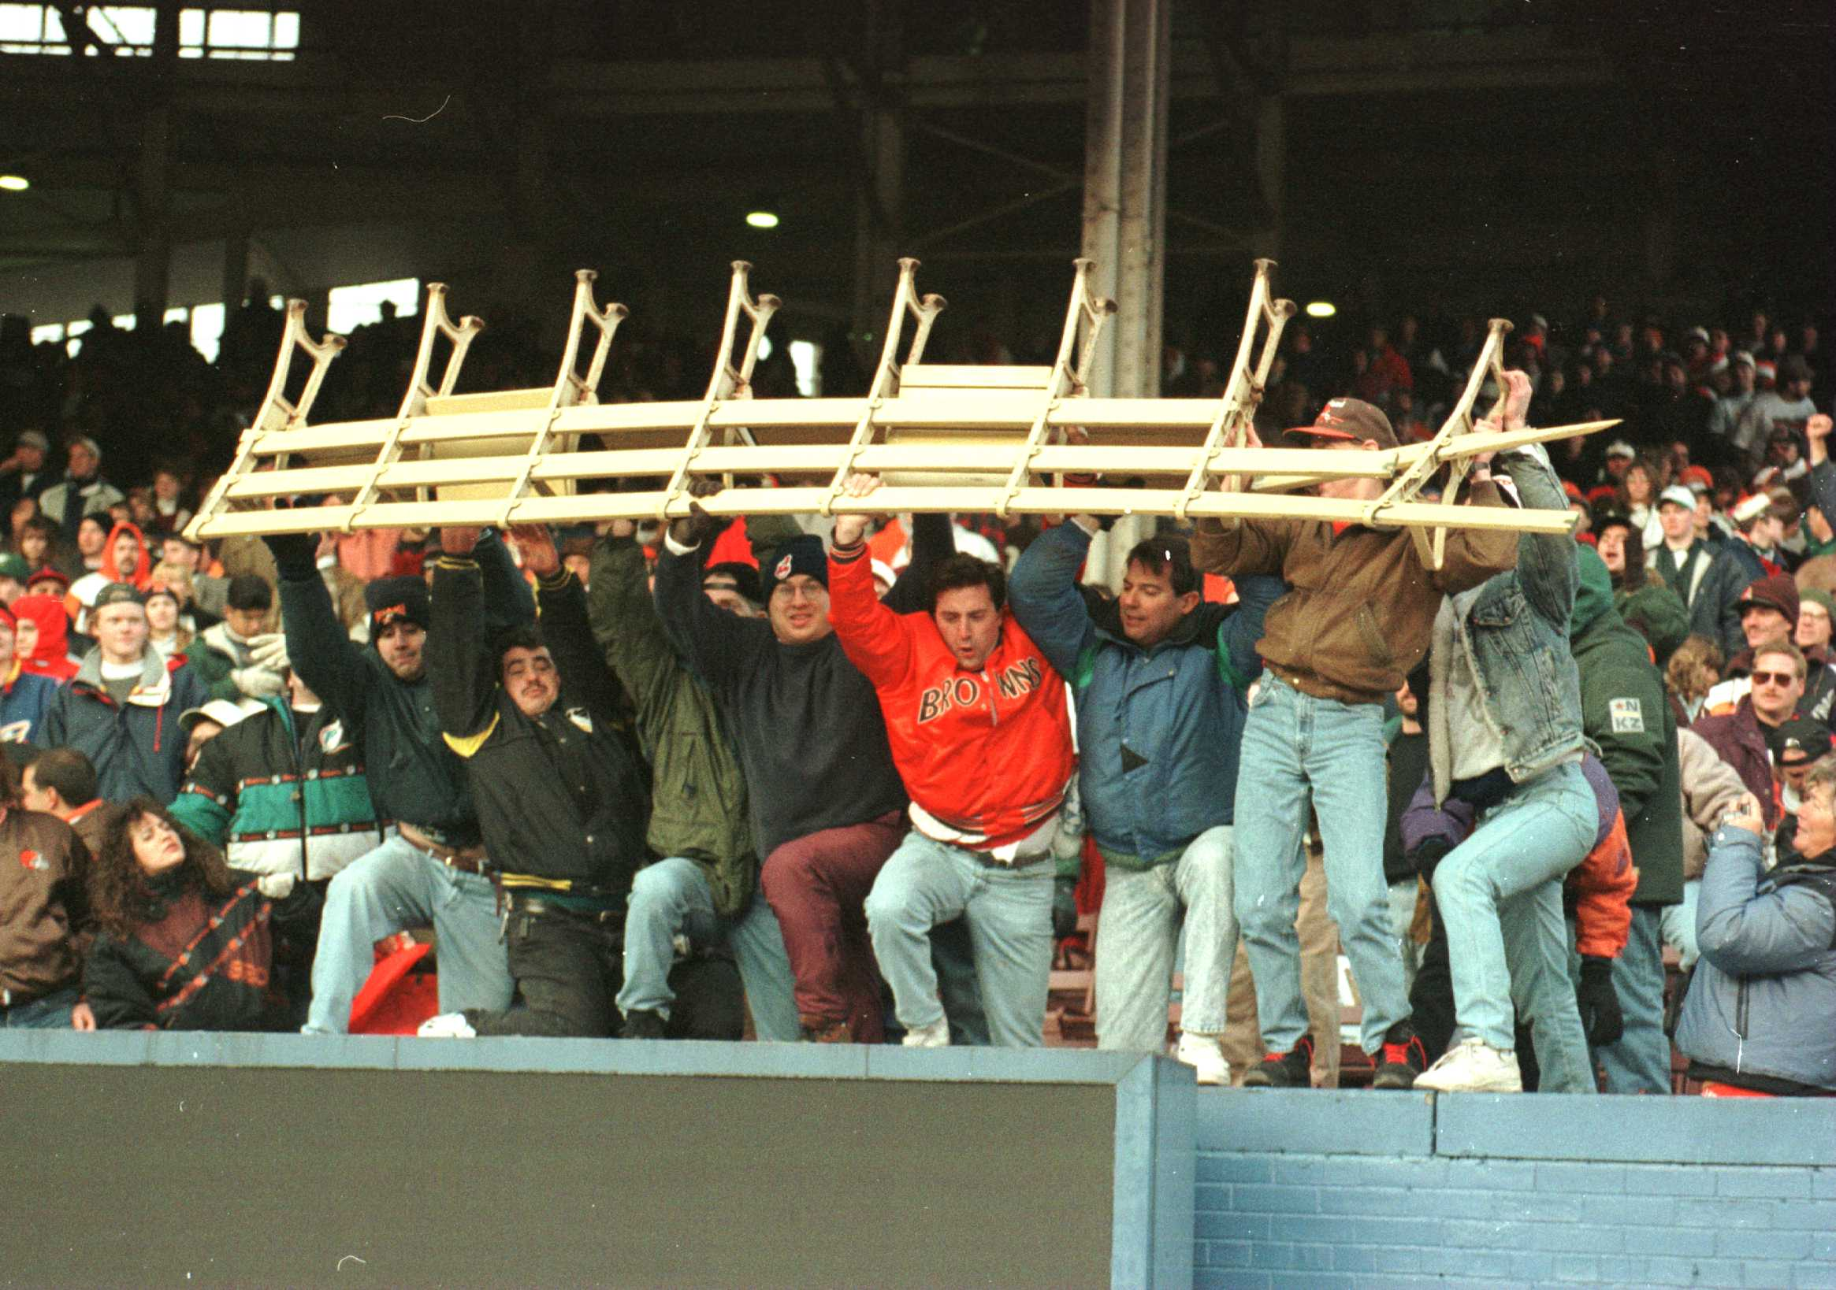
Sermon
December 17, 1995
Final Game – Cleveland Municipal Stadium
Final Score:
Cleveland 26 Cincinnati 10

Slide 40
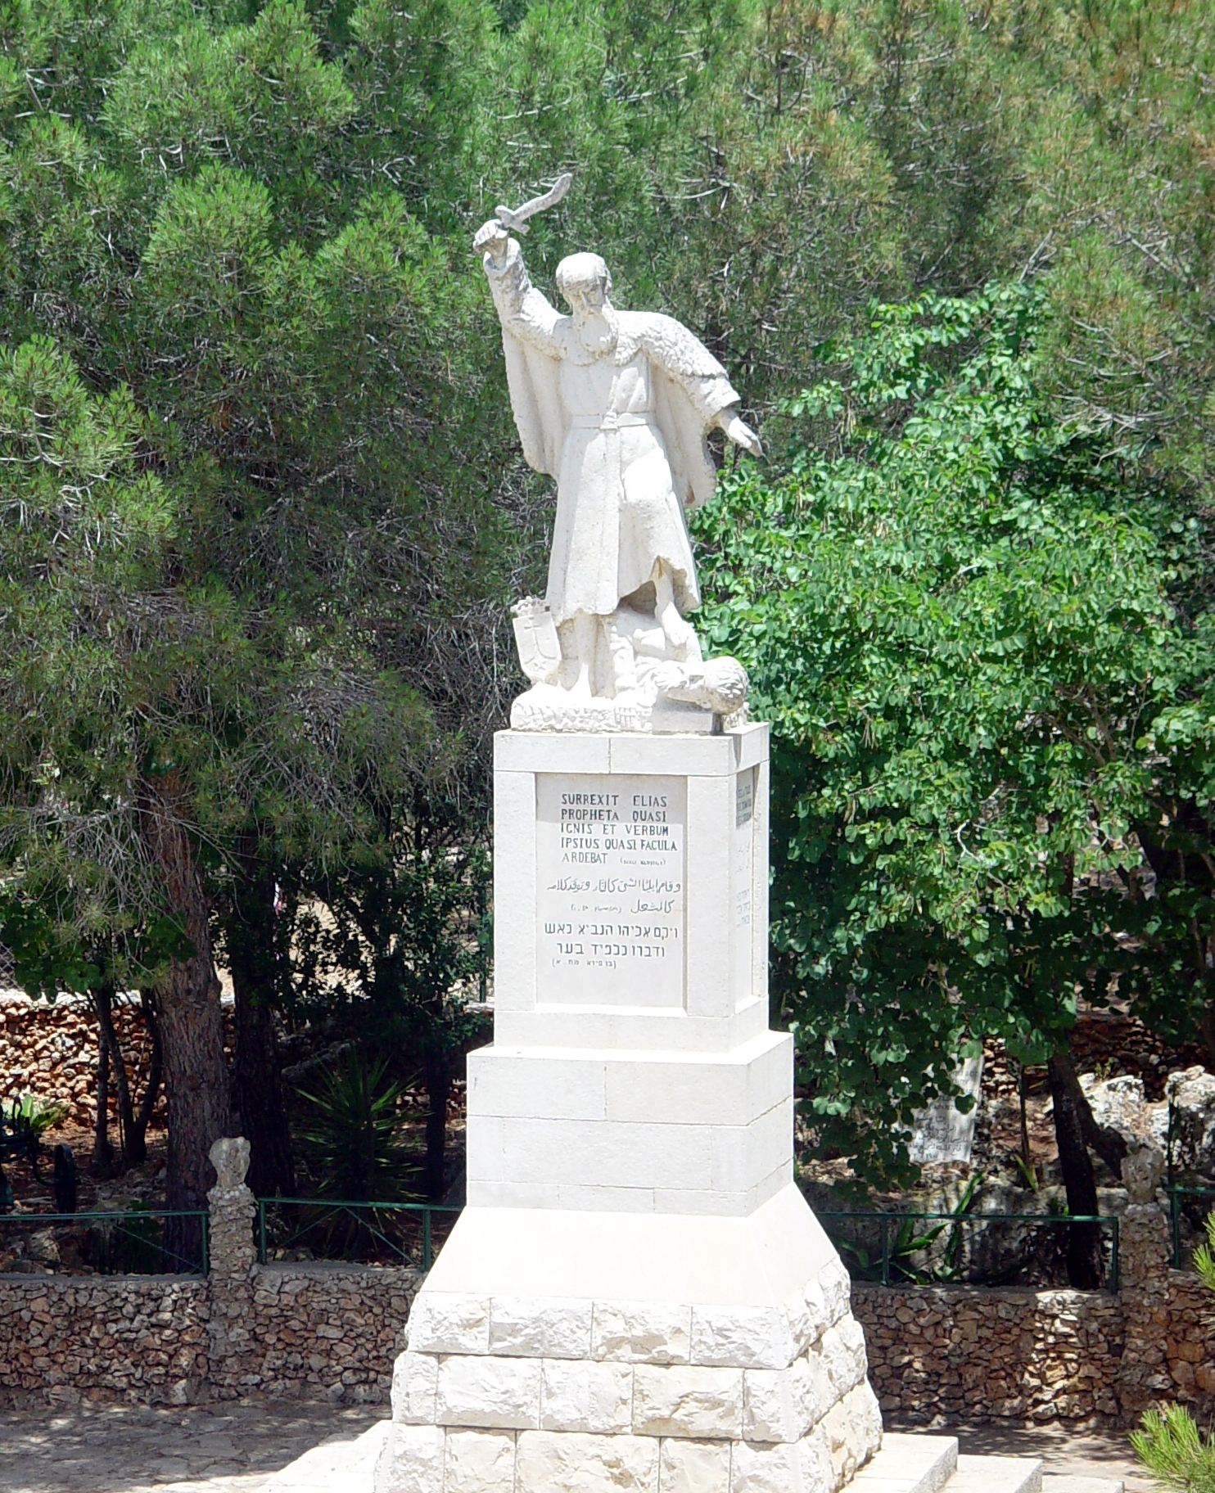
Sermon

Slide 41
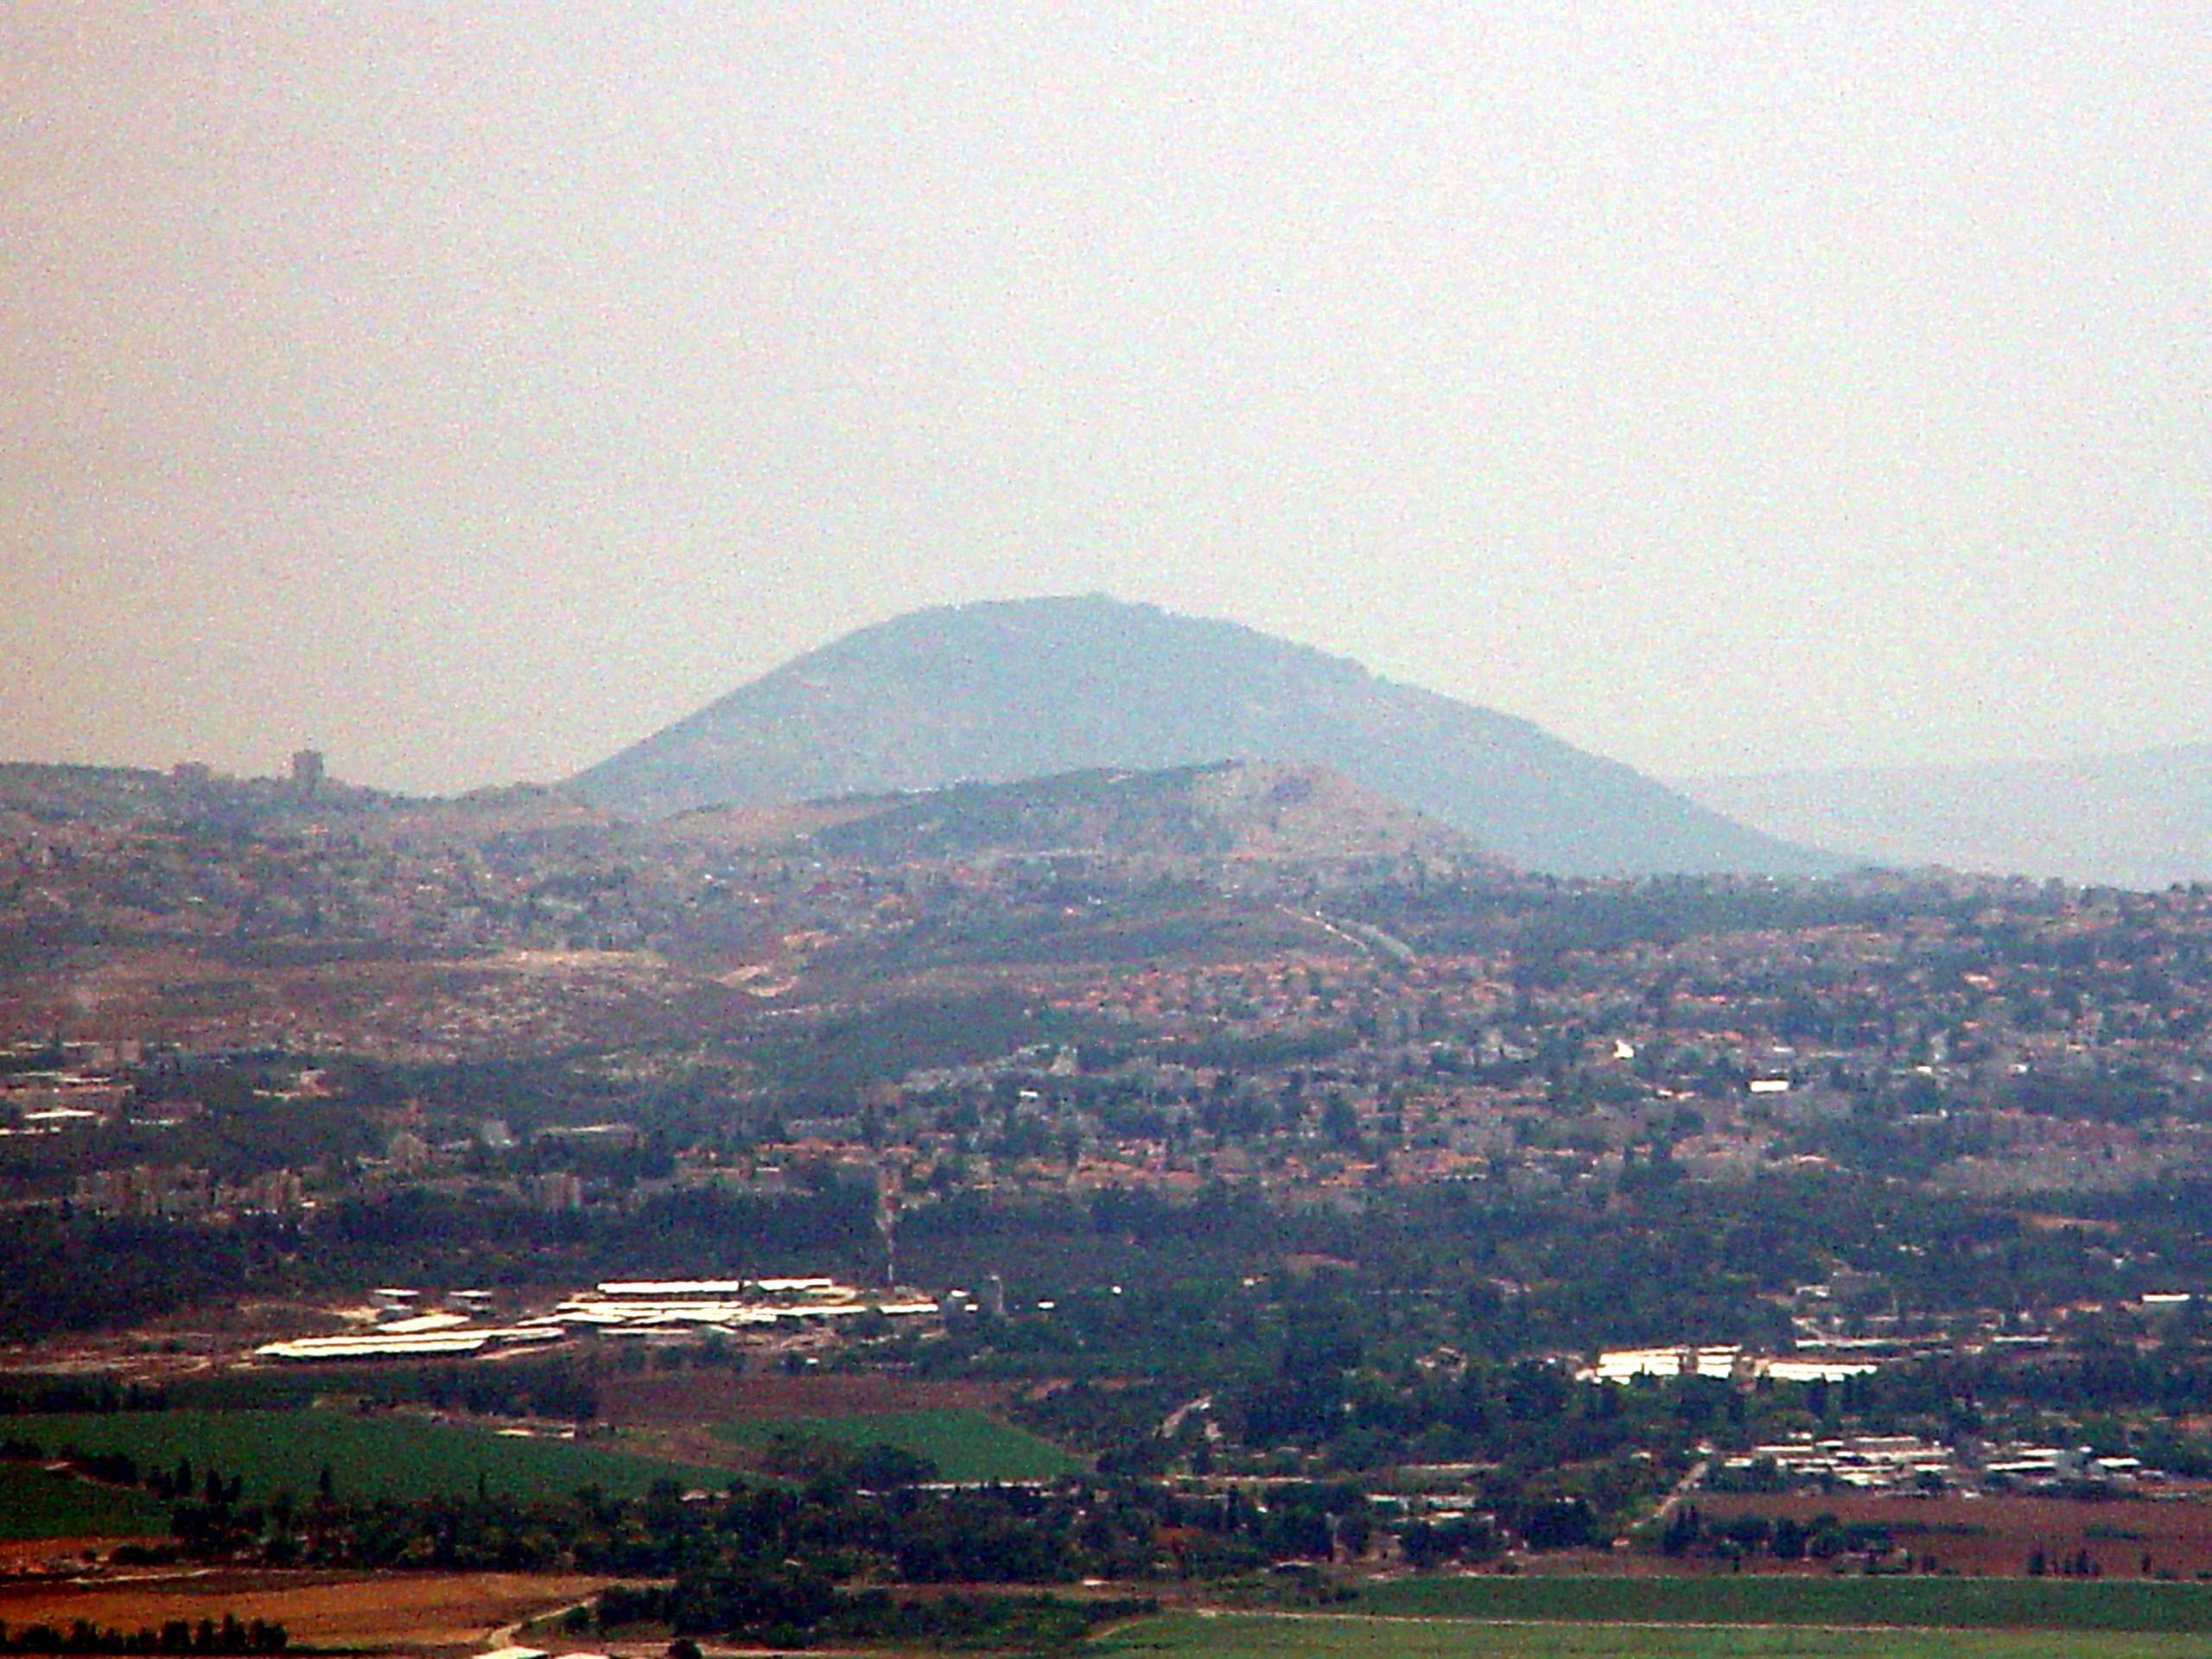
Sermon

Slide 42
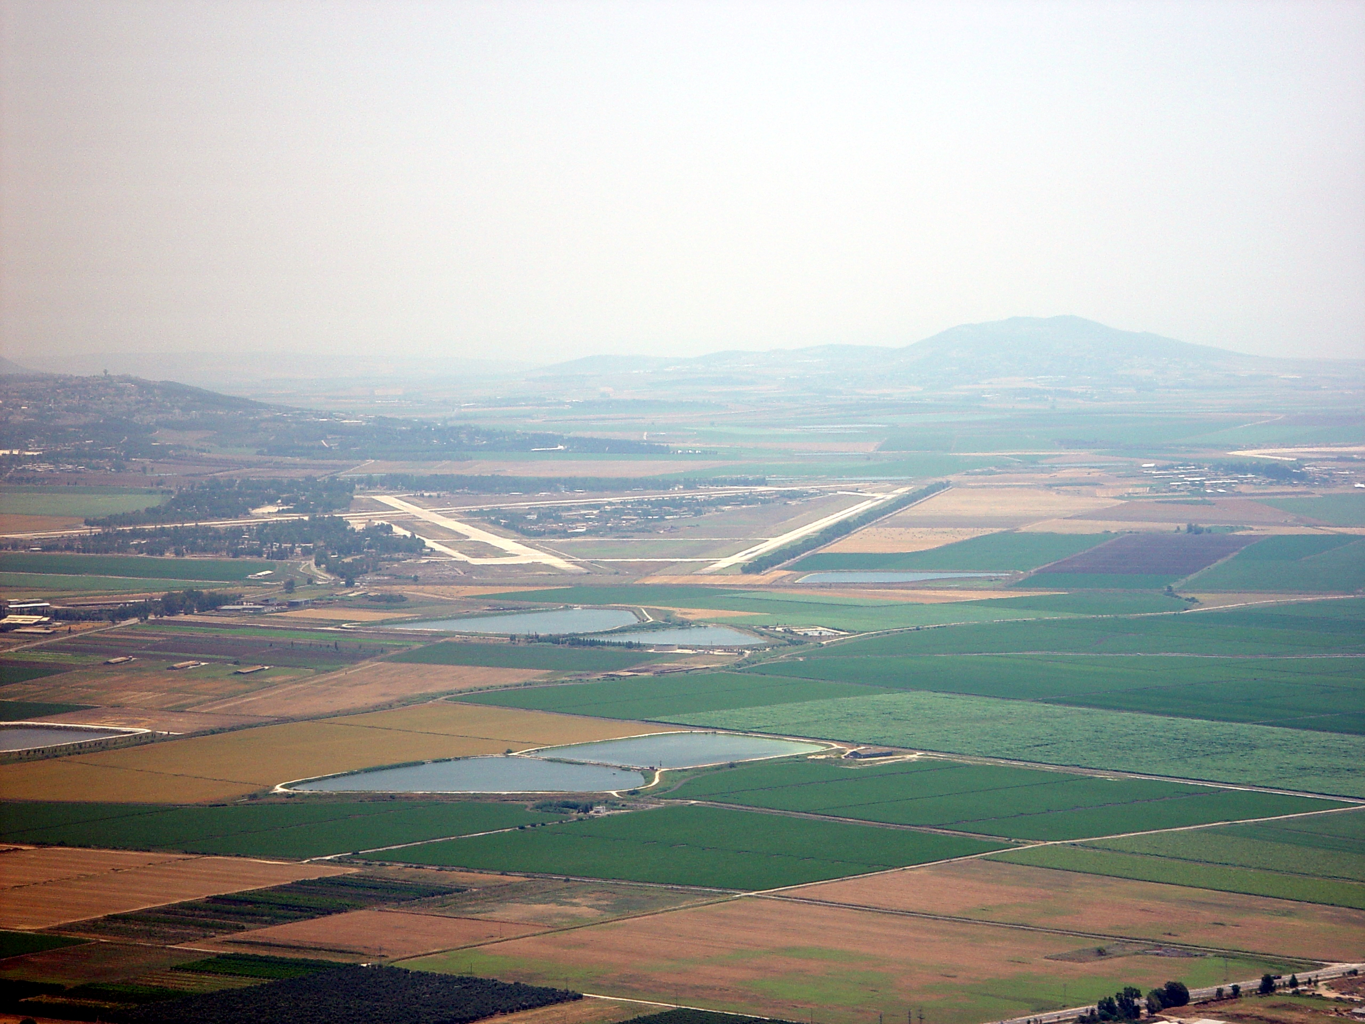
Sermon

Slide 43
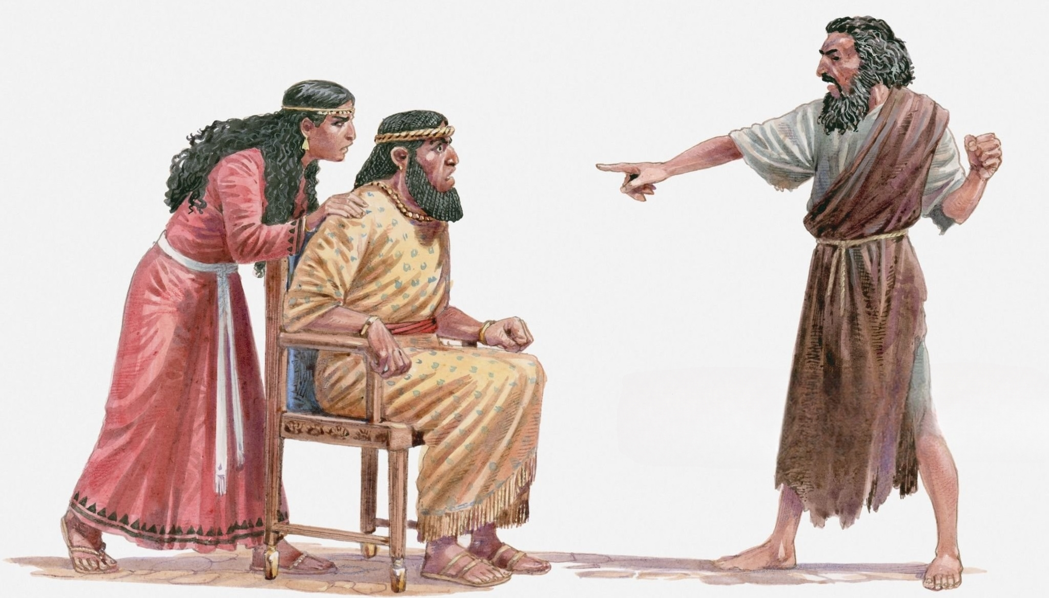
Sermon

Slide 44
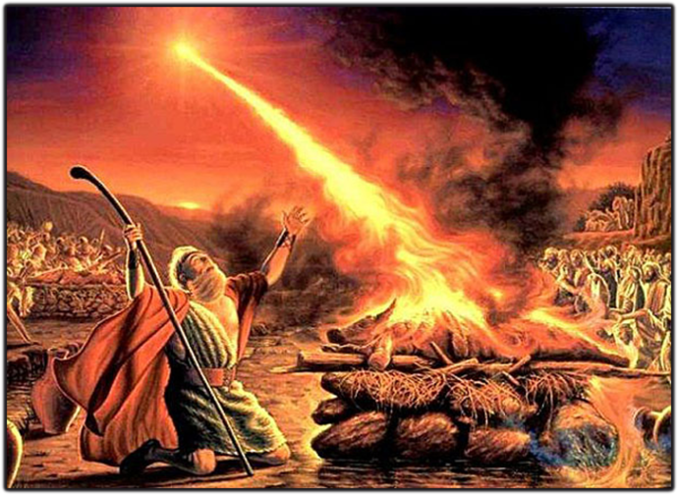
Sermon

Slide 45
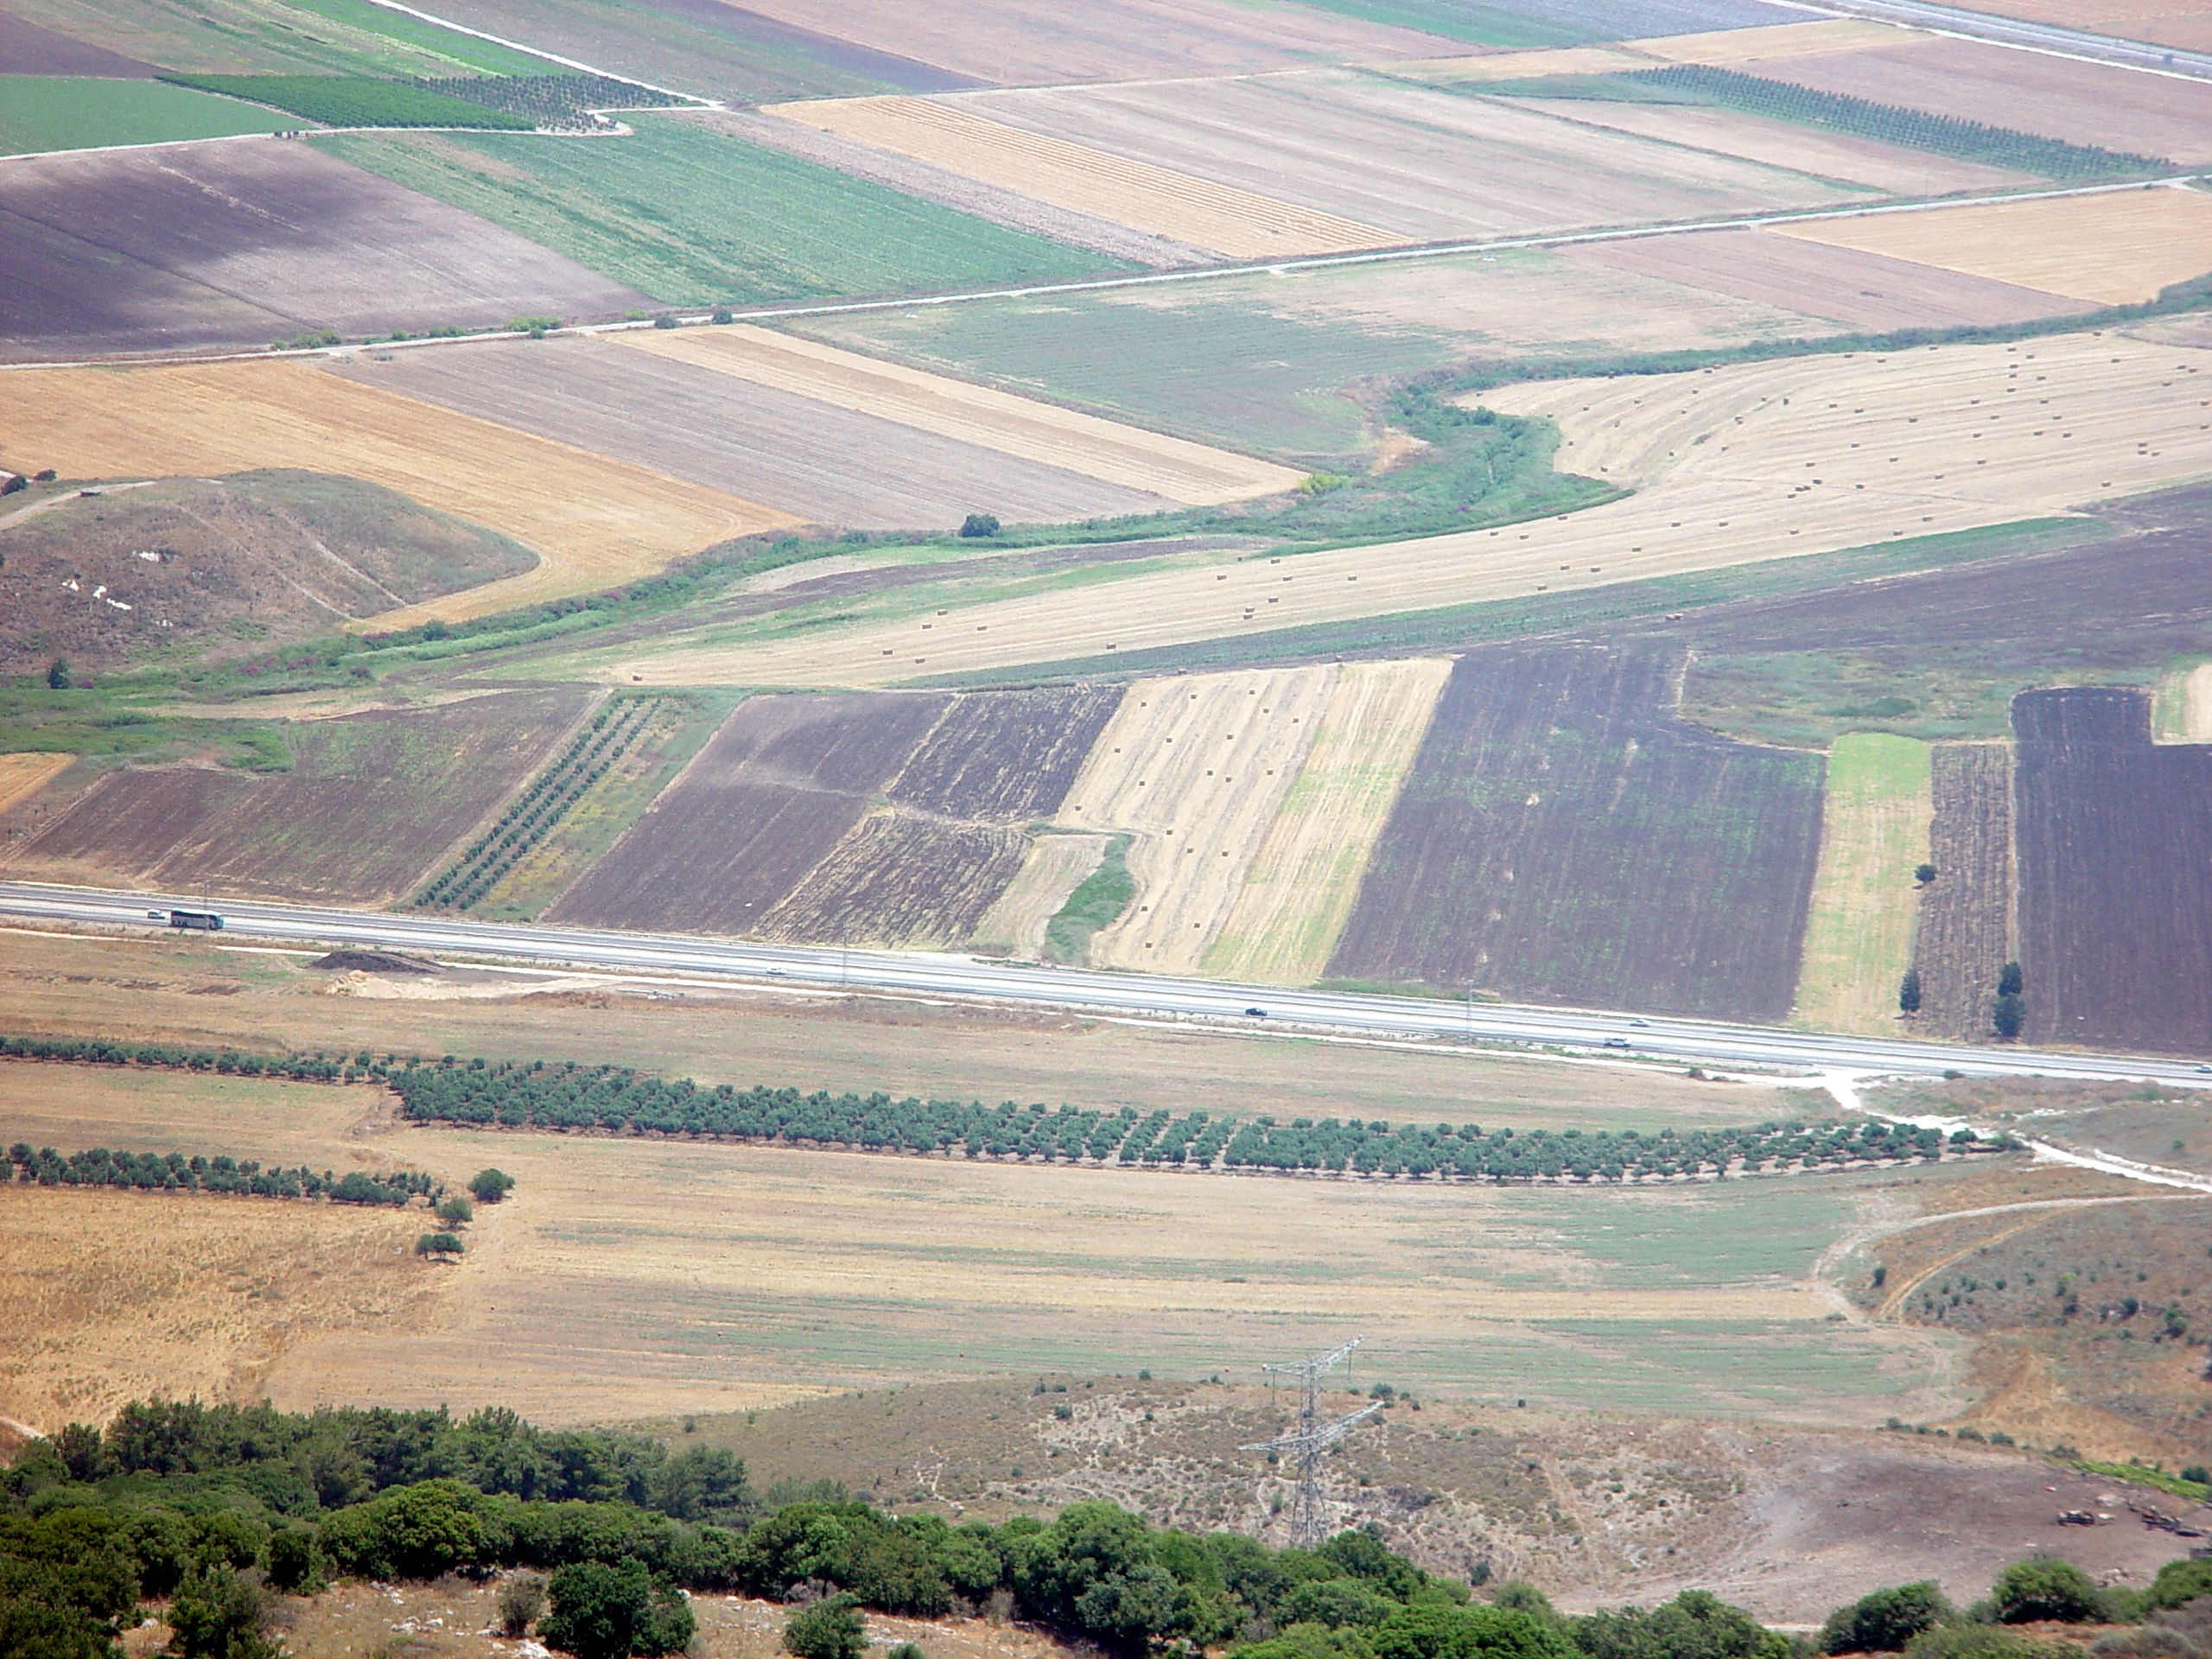
Sermon
Wadi Kishon

Slide 46
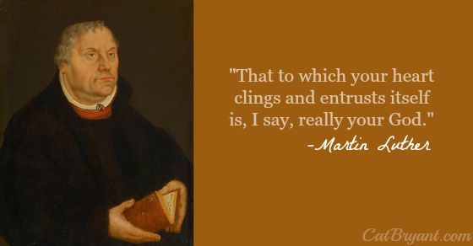
Sermon

Slide 47
AFFIRMATION OF BAPTISM
PRESENTATION OF CONFIRMANDS
Mercedes Angles
Claire Hien
Devyn Thobe
RENUNCIATION OF EVIL

Slide 48
PROFESSION OF FAITH
P: Do you believe in God the Father?
C: I believe in God, the Father almighty, creator of heaven and earth.

Slide 49
PROFESSION OF FAITH
P: Do you believe in Jesus Christ, the Son of God?
C: I believe in Jesus Christ, his only Son, our Lord. He was conceived by the power of the Holy Spirit and born of the virgin Mary. He suffered under Pontius Pilate, was crucified, died, and was buried. He descended into hell.*

Slide 50
PROFESSION OF FAITH
C: On the third day he rose again. He ascended into heaven, and is seated at the right hand of the Father. He will come again to judge the living and the dead.

Slide 51
PROFESSION OF FAITH
P: Do you believe in God the Holy Spirit?
C: I believe in the Holy Spirit, the holy catholic Church, the communion of saints, the forgiveness of sins, the resurrection of the body, and the life everlasting. Amen

Slide 52
PRAYERS
Each petition will end with the words,
A: God of Justice,
C: In mercy, hear our prayer.

Slide 53
PRAYERS OF INTERCESSION
The prayer concludes…
P: Merciful God, we turn all these things over to your tender care, trusting that you hear and answer all our prayers, spoken and unspoken, through Jesus Christ our Savior.
C: Amen.

Slide 54
AFFIRMATION OF BAPTISM
COMMITMENT
PRAYER OF BLESSING
LAYING ON OF HANDS
MENTOR COMMENTS
QUILT SQUARE PRESENTATION

Slide 55
SHARING OF THE Peace
The Sharing of the Peace that began when the congregation arrived is now shared with the Pastor at this time...
P: The peace of the Lord be with you always.
C: And also with you.

Slide 56
Hymn of the Day
XXX

Slide 57
XXX
XXX

Slide 58
APOSTLE’S CREED
C: I believe in God, the Father almighty, creator of heaven and earth.

Slide 59
APOSTLE’S CREED
C: I believe in Jesus Christ, his only Son, our Lord. He was conceived by the power of the Holy Spirit and born of the virgin Mary. He suffered under Pontius Pilate, was crucified, died, and was buried.

Slide 60
APOSTLE’S CREED
C: He descended into hell. On the third day he rose again. He ascended into heaven, and is seated at the right hand of the Father. He will come again to judge the living and the dead.

Slide 61
APOSTLE’S CREED
C: I believe in the Holy Spirit, the holy catholic Church, the communion of saints, the forgiveness of sins, the resurrection of the body, and the life everlasting. Amen.

Slide 62
NICENE CREED
C: We believe in one God, the Father, the Almighty, maker of heaven and earth, of all that is, seen and unseen.

Slide 63
NICENE CREED
C: We believe in one Lord, Jesus Christ, the only Son of God, eternally begotten of the Father, God from God, Light from Light, true God from true God, begotten, not made, of one Being with the Father.

Slide 64
NICENE CREED
C: Through him all things were made. For us and for our salvation he came down from heaven; by the power of the Holy Spirit he became incarnate from the virgin Mary, and was made man. For our sake he was crucified under Pontius Pilate;

Slide 65
NICENE CREED
C: he suffered death and was buried. On the third day he rose again in accordance with the Scriptures; he ascended into heaven and is seated at the right hand of the Father. He will come again in glory to judge the living and the dead, and his kingdom will have no end.

Slide 66
NICENE CREED
C: We believe in the Holy Spirit, the Lord, the giver of life, who proceeds from the Father and the Son. With the Father and the Son he is worshiped and glorified. He has spoken through the prophets. We believe in one holy catholic and apostolic Church.

Slide 67
NICENE CREED
C: We acknowledge one Baptism for the forgiveness of sins. We look for the resurrection of the dead, and the life of the world to come. Amen.

Slide 68
QUILT TYING AND PRESENTATION
This Quilt was lovingly crafted for recovery and healing especially for XXX.
Let us pray…

Slide 69
PRAYERS OF INTERCESSION
Each petition will end with the words,
A: God of Justice,
The congregation will respond with:
C: In mercy, hear our prayer.

Slide 70
PRAYERS OF INTERCESSION
The prayer concludes…
P: Merciful God, we turn all these things over to your tender care, trusting that you hear and answer all our prayers, spoken and unspoken, through Jesus Christ our Savior.
C: Amen.

Slide 71
SHARING OF THE Peace
The Sharing of the Peace that began when the congregation arrived is now shared with the Pastor at this time...
P: The peace of the Lord be with you always.
C: And also with you.

Slide 72
OFFERING
Notes:
Image: Five Loaves by Caroline Coolidge Brown. Copyright © Caroline Coolidge Brown. All rights reserved. Used by permission of the artist.

Slide 73
OFFERING PRAYER
Notes:
Image: Five Loaves by Caroline Coolidge Brown. Copyright © Caroline Coolidge Brown. All rights reserved. Used by permission of the artist.

Slide 74
THE GREAT THANKSGIVING
All the Baptized are welcome to celebrate this Holy Meal.

Slide 75
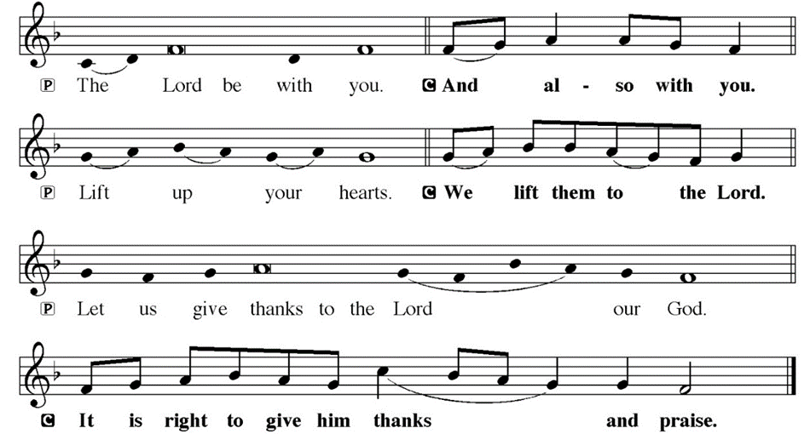
DIALOGUE

Slide 76
THE PREFACE
P: It is indeed right and salutary…
… we praise your name and join their unending hymn.

Slide 77
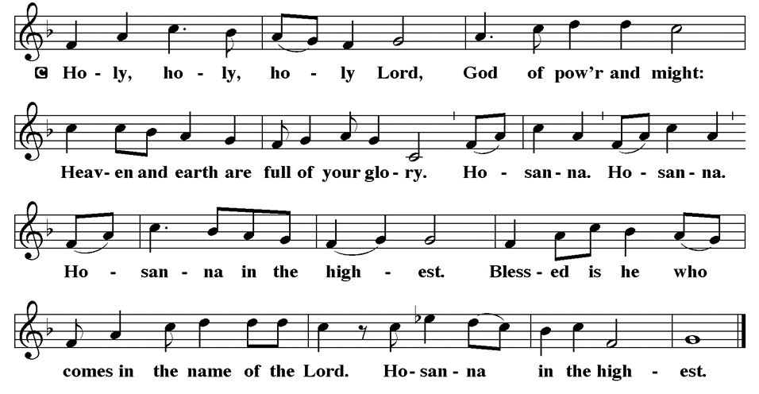
THE SANCTUS

Slide 78
EUCHARISTIC PRAYER
P: We praise you, all Holy God…
…today, tomorrow and forever.
C: Amen.

Slide 79
THE LORD’S PRAYER
C: Our Father, who art in heaven, hallowed be thy name, thy kingdom come, thy will be done, on earth as it is in heaven. Give us this day our daily bread; and forgive us our trespasses, as we forgive those who trespass against us; and lead us not into temptation, but deliver us from evil.

Slide 80
THE LORD’S PRAYER
C: For thine is the kingdom, and the power, and the glory, forever and ever. Amen.

Slide 81
INVITATION TO COMMUNION
P: The God whose power consumed Elijah’s offering also raised Christ Jesus from the dead, destroying death forever. God, in Jesus, invites you now to feast on bread and wine in remembrance of the resurrected one. Come, for all is prepared.

Slide 82
COMMUNION DISTRIBUTION
All will commune “By Station”.
The bread may be broken for distribution. As the ministers give the bread and wine, they say these words :
The body of Christ, given for you.
The blood of Christ, shed for you.
The communicant may say: Amen.

Slide 83
POST COMMUNION BLESSING
P: May this body and blood of our Lord and Savior, Jesus Christ, strengthen, keep, and unity us, ☩ now and forever,
C: Amen.

Slide 84
POST COMMUNION CANTACLE

Slide 85
POST COMMUNION CANTACLE

Slide 86
POST COMMUNION PRAYER
P: Let us pray together…
C: We give you thanks, gracious God, that you have once again fed us with food beyond compare, the body and blood of Christ. Lead us from this place, nourished and forgiven, into your beloved vineyard to wipe away the tears of all who hunger and thirst, guided by the example of the same Jesus Christ and led by the Holy Spirit, now and forever. Amen.

Slide 87
ANNOUNCEMENTS
Notes:
Image: Five Loaves by Caroline Coolidge Brown. Copyright © Caroline Coolidge Brown. All rights reserved. Used by permission of the artist.

Slide 88
SENDING BLESSING
P: May the God of all creation, in whose image we are made, who claims us and calls us beloved, who strengthens us for service, give you reason to rejoice and be glad! The blessing of God, Sovereign, Savior, and Spirit, be with you today and always.
C: Amen.

Slide 89
Sending Song
“Oh, Happy Day When We Shall Stand”
LBW 351
Notes:
Image: Five Loaves by Caroline Coolidge Brown. Copyright © Caroline Coolidge Brown. All rights reserved. Used by permission of the artist.

Slide 90
Oh, Happy Day When We Shall Stand--LBW 351
1 Oh, happy day when we shall stand
in heaven with the saved;
all peoples at the Lord’s right hand
shall find their names engraved,
shall find their names engraved.
Notes:
Image: Preparing yeast dough. Copyright © tomasworks/iStock/Thinkstock. Used by permission.

Slide 91
Oh, Happy Day When We Shall Stand--LBW 351
2 Oh, blessed day when Christ shall come
and show himself as Lord,
and thousands meet in their new home
which Jesus has prepared,
which Jesus has prepared.
Notes:
Image: Preparing yeast dough. Copyright © tomasworks/iStock/Thinkstock. Used by permission.

Slide 92
Oh, Happy Day When We Shall Stand--LBW 351
3 Oh, what a mighty rushing flood
of joy and love and peace
will roll down over us with good
and blessedness and grace,
and blessedness and grace.
Notes:
Image: Preparing yeast dough. Copyright © tomasworks/iStock/Thinkstock. Used by permission.

Slide 93
Oh, Happy Day When We Shall Stand--LBW 351
4 O Lord, your grace is ev’rything;
your love has made us free
to stand among the saints and sing
the glory that we see,
the glory that we see.
Notes:
Image: Preparing yeast dough. Copyright © tomasworks/iStock/Thinkstock. Used by permission.

Slide 94
DISMISSAL
P: … Depart in Christ’s Love.
C: Seeking, welcoming, and serving all. Amen!
POSTLUDE
By
Roxanne Groff
From sundaysandseasons.com. Copyright © 2023 Augsburg Fortress. All rights reserved. Reprinted by permission under Augsburg Fortress Liturgies Annual License #SAS023830. New Revised Standard Version Bible, Copyright © 1989, Division of Christian Education of the National Council of the Churches of Christ in the United States of America. Used by permission. All rights reserved. Revised Common Lectionary, Copyright © 1992 Consultation on Common Texts, admin Augsburg Fortress. Used by permission.

