Slide 1


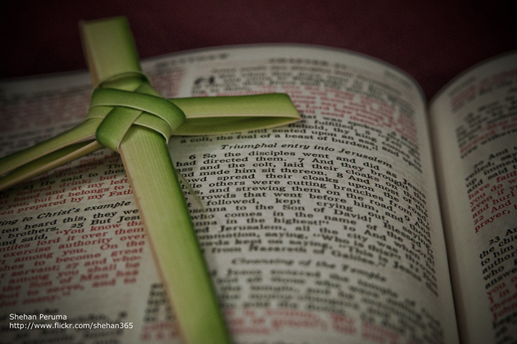
Welcome in the Name of
The Triune God
March 24, 2024
Palm/Passion Sunday
Prelude by Pam Sherman
Office of the Acolyte
Ringing of the Bell
Notes:
Image: Preparing yeast dough. Copyright © tomasworks/iStock/Thinkstock. Used by permission.

Slide 2
PROCESSION WITH PALMS
The congregation gathers under the portico (weather permitting) or in the Fellowship room. Palm branches are distributed before the service begins.
P: Blessed is he who comes in the name of the Lord.
C: Hosanna to the Son of David.
P: The Lord Be with You.
C: And also with you.
Notes:
Image: Five Loaves by Caroline Coolidge Brown. Copyright © Caroline Coolidge Brown. All rights reserved. Used by permission of the artist.

Slide 3
PROCESSION WITH PALMS
P: Let us pray… Mercifully assist us, O Lord God of our salvation, that we may enter with joy upon the contemplation of those mighty acts whereby you have given us life everlasting; through your Son, Jesus Christ our Lord.
C: Amen
Notes:
Image: Five Loaves by Caroline Coolidge Brown. Copyright © Caroline Coolidge Brown. All rights reserved. Used by permission of the artist.

Slide 4
PROCESSION GOSPEL Mark 11:1-11
P: A reading from the Gospel according to Saint Mark, the 11th chapter…
When they were approaching Jerusalem, at Bethphage and Bethany, near the Mount of Olives, he sent two of his disciples ² and said to them, “Go into the village ahead of you, and immediately as you enter it, you will find tied there a colt that has never
Notes:
Image: Five Loaves by Caroline Coolidge Brown. Copyright © Caroline Coolidge Brown. All rights reserved. Used by permission of the artist.

Slide 5
PROCESSION GOSPEL Mark 11:1-11
been ridden; untie it and bring it. ³ If anyone says to you, ‘Why are you doing this?’ just say this, ‘The Lord needs it and will send it back here immediately.’” ⁴ They went away and found a colt tied near a door, outside in the street. As they were untying it, ⁵ some of the bystanders said to them, “What are you doing, untying the colt?”
Notes:
Image: Five Loaves by Caroline Coolidge Brown. Copyright © Caroline Coolidge Brown. All rights reserved. Used by permission of the artist.

Slide 6
PROCESSION GOSPEL Mark 11:1-11
⁶ They told them what Jesus had said; and they allowed them to take it. ⁷ Then they brought the colt to Jesus and threw their cloaks on it; and he sat on it. ⁸ Many people spread their cloaks on the road, and others spread leafy branches that they had cut in the fields. ⁹Then those who went ahead and those who followed were shouting,
Notes:
Image: Five Loaves by Caroline Coolidge Brown. Copyright © Caroline Coolidge Brown. All rights reserved. Used by permission of the artist.

Slide 7
PROCESSION GOSPEL Mark 11:1-11
“Hosanna!
Blessed is the one who comes in the name of the Lord!
¹⁰ Blessed is the coming kingdom of our ancestor David!
Hosanna in the highest heaven!”
Notes:
Image: Five Loaves by Caroline Coolidge Brown. Copyright © Caroline Coolidge Brown. All rights reserved. Used by permission of the artist.

Slide 8
PROCESSION GOSPEL Mark 11:1-11
¹¹ Then he entered Jerusalem and went into the temple; and when he had looked around at everything, as it was already late, he went out to Bethany with the twelve.
Notes:
Image: Five Loaves by Caroline Coolidge Brown. Copyright © Caroline Coolidge Brown. All rights reserved. Used by permission of the artist.

Slide 9
PALM SUNDAY PROCESSION
P: The Lord be with you.
C: And also with you.
P: Let us give thanks to the Lord our God.
C: It is right to give him thanks and praise
P: We praise and thank you, O God, for the great acts of love by which you have redeemed us through your Son, Jesus Christ our Lord.
Notes:
Image: Five Loaves by Caroline Coolidge Brown. Copyright © Caroline Coolidge Brown. All rights reserved. Used by permission of the artist.

Slide 10
PALM SUNDAY PROCESSION
P: On this day he entered the holy city of Jerusalem in triumph and was acclaimed Son of David and King of Kings by those who scattered their garments and branches of palm in his path. We ask that you bless these branches and those who bear them.
Notes:
Image: Five Loaves by Caroline Coolidge Brown. Copyright © Caroline Coolidge Brown. All rights reserved. Used by permission of the artist.

Slide 11
PALM SUNDAY PROCESSION
P: Grant that we may ever hail him as our Lord and King and follow him with perfect confidence; through the same Jesus Christ, our Lord, who lives and reigns with you and the Holy Spirit, one God, now and forever.
C: Amen
P: Let us go forth in peace,
C: in the name of the Lord.
Please raise your palm branches for the thanksgiving and the processional hymn.
Notes:
Image: Five Loaves by Caroline Coolidge Brown. Copyright © Caroline Coolidge Brown. All rights reserved. Used by permission of the artist.

Slide 12
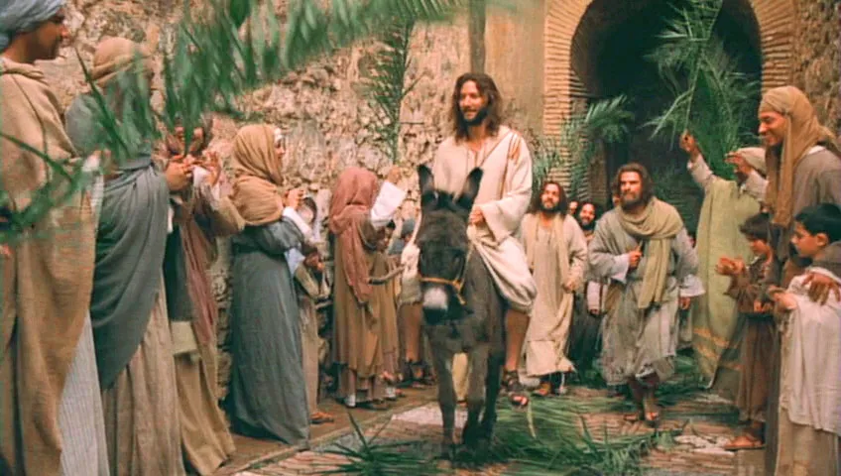
PROCESSIONAL HYMN
All Glory Laud and Honor
LBW 108
Notes:
Image: Five Loaves by Caroline Coolidge Brown. Copyright © Caroline Coolidge Brown. All rights reserved. Used by permission of the artist.

Slide 13
All Glory, Laud, and Honor LBW 108
Refrain
All glory, laud, and honor
to you, redeemer, king,
to whom the lips of children
made sweet hosannas ring.
Notes:
Image: Five Loaves by Caroline Coolidge Brown. Copyright © Caroline Coolidge Brown. All rights reserved. Used by permission of the artist.

Slide 14
All Glory, Laud, and Honor LBW 108
1 You are the king of Israel
and David’s royal Son,
now in the Lord’s name coming,
our King and Blessed One.
Notes:
Image: Five Loaves by Caroline Coolidge Brown. Copyright © Caroline Coolidge Brown. All rights reserved. Used by permission of the artist.

Slide 15
All Glory, Laud, and Honor LBW 108
Refrain
All glory, laud, and honor
to you, redeemer, king,
to whom the lips of children
made sweet hosannas ring.
Notes:
Image: Five Loaves by Caroline Coolidge Brown. Copyright © Caroline Coolidge Brown. All rights reserved. Used by permission of the artist.

Slide 16
All Glory, Laud, and Honor LBW 108
2 The company of angels
is praising you on high;
creation and all mortals
in chorus make reply.
Notes:
Image: Five Loaves by Caroline Coolidge Brown. Copyright © Caroline Coolidge Brown. All rights reserved. Used by permission of the artist.

Slide 17
All Glory, Laud, and Honor LBW 108
Refrain
All glory, laud, and honor
to you, redeemer, king,
to whom the lips of children
made sweet hosannas ring.
Notes:
Image: Five Loaves by Caroline Coolidge Brown. Copyright © Caroline Coolidge Brown. All rights reserved. Used by permission of the artist.

Slide 18
All Glory, Laud, and Honor LBW 108
3 The multitude of pilgrims
with palms before you went.
Our praise and prayer and anthems
before you we present.
Notes:
Image: Five Loaves by Caroline Coolidge Brown. Copyright © Caroline Coolidge Brown. All rights reserved. Used by permission of the artist.

Slide 19
All Glory, Laud, and Honor LBW 108
Refrain
All glory, laud, and honor
to you, redeemer, king,
to whom the lips of children
made sweet hosannas ring.
Notes:
Image: Five Loaves by Caroline Coolidge Brown. Copyright © Caroline Coolidge Brown. All rights reserved. Used by permission of the artist.

Slide 20
All Glory, Laud, and Honor LBW 108
4 To you, before your passion,
they sang their hymns of praise.
To you, now high exalted,
our melody we raise.
Notes:
Image: Five Loaves by Caroline Coolidge Brown. Copyright © Caroline Coolidge Brown. All rights reserved. Used by permission of the artist.

Slide 21
All Glory, Laud, and Honor LBW 108
Refrain
All glory, laud, and honor
to you, redeemer, king,
to whom the lips of children
made sweet hosannas ring.
Notes:
Image: Five Loaves by Caroline Coolidge Brown. Copyright © Caroline Coolidge Brown. All rights reserved. Used by permission of the artist.

Slide 22
All Glory, Laud, and Honor LBW 108
5 Their praises you accepted;
accept the prayers we bring,
great author of all goodness,
O good and gracious King.
Notes:
Image: Five Loaves by Caroline Coolidge Brown. Copyright © Caroline Coolidge Brown. All rights reserved. Used by permission of the artist.

Slide 23
All Glory, Laud, and Honor LBW 108
Refrain
All glory, laud, and honor
to you, redeemer, king,
to whom the lips of children
made sweet hosannas ring.
Notes:
Image: Five Loaves by Caroline Coolidge Brown. Copyright © Caroline Coolidge Brown. All rights reserved. Used by permission of the artist.

Slide 24
PRAYER OF THE DAY
P: Let us pray… God, our blessed sovereign, we gather with shouts of ‘hosanna’, knowing full well that we will soon be shouting ‘crucify.’ Remind us that, come what may, you are still our God, and your love for us cannot be shaken, that we might go into this holy week with our eyes and ears open to what you would teach us. In Jesus’ name we pray.
C: Amen.
Notes:
Image: Five Loaves by Caroline Coolidge Brown. Copyright © Caroline Coolidge Brown. All rights reserved. Used by permission of the artist.

Slide 25
The Passion of Jesus According to Saint Mark
Thank you!
Cast of Readers
Character | Reader
Narrator | Jennifer Arling
Chief Priests | Rob Arling
Disciples | Mark Oswalt
Jesus | Pr Mel
Peter | Chris Cassel
Judas | Kathy Kathman
Accusers | Teresa Neitzelt
Servant Girl | Lexie Angles
Bystanders | Linda Baker
Pilate | Robby Arling
Crowd | Congregation
Soldiers | Peggy Didier
Centurion | Eldon Erdmann
Notes:
Image: Five Loaves by Caroline Coolidge Brown. Copyright © Caroline Coolidge Brown. All rights reserved. Used by permission of the artist.

Slide 26
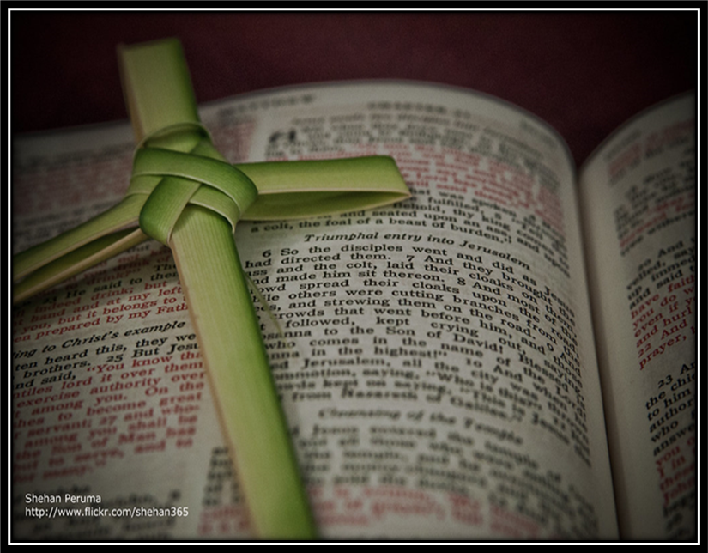
SPECIAL MUSIC
“He Is Here”
Larry Harter
Notes:
Image: Five Loaves by Caroline Coolidge Brown. Copyright © Caroline Coolidge Brown. All rights reserved. Used by permission of the artist.

Slide 27
APOSTLE’S CREED
C: I believe in God, the Father almighty, creator of heaven and earth.

Slide 28
APOSTLE’S CREED
C: I believe in Jesus Christ, his only Son, our Lord. He was conceived by the power of the Holy Spirit and born of the virgin Mary. He suffered under Pontius Pilate, was crucified, died, and was buried.

Slide 29
APOSTLE’S CREED
C: He descended into hell. On the third day he rose again. He ascended into heaven, and is seated at the right hand of the Father. He will come again to judge the living and the dead.

Slide 30
APOSTLE’S CREED
C: I believe in the Holy Spirit, the holy catholic Church, the communion of saints, the forgiveness of sins, the resurrection of the body, and the life everlasting. Amen.

Slide 31
NICENE CREED
C: We believe in one God, the Father, the Almighty, maker of heaven and earth, of all that is, seen and unseen.

Slide 32
NICENE CREED
C: We believe in one Lord, Jesus Christ, the only Son of God, eternally begotten of the Father, God from God, Light from Light, true God from true God, begotten, not made, of one Being with the Father.

Slide 33
NICENE CREED
C: Through him all things were made. For us and for our salvation he came down from heaven; by the power of the Holy Spirit he became incarnate from the virgin Mary, and was made man. For our sake he was crucified under Pontius Pilate;

Slide 34
NICENE CREED
C: he suffered death and was buried. On the third day he rose again in accordance with the Scriptures; he ascended into heaven and is seated at the right hand of the Father. He will come again in glory to judge the living and the dead, and his kingdom will have no end.

Slide 35
NICENE CREED
C: We believe in the Holy Spirit, the Lord, the giver of life, who proceeds from the Father and the Son. With the Father and the Son he is worshiped and glorified. He has spoken through the prophets. We believe in one holy catholic and apostolic Church.

Slide 36
NICENE CREED
C: We acknowledge one Baptism for the forgiveness of sins. We look for the resurrection of the dead, and the life of the world to come. Amen.

Slide 37
PRAYERS OF INTERCESSION
Each petition will end with the words,
A: God of the journey,
The congregation will respond with:
C: In mercy hear our prayer.

Slide 38
PRAYERS OF INTERCESSION
The prayer concludes…
P: Confident that you walk alongside us in our need, we lift to you all our prayers, spoken and unspoken, through Jesus Christ our savior.
C: Amen.

Slide 39
SHARING OF THE Peace
The Sharing of the Peace that began when the congregation arrived is now shared with the Pastor at this time...
P: The peace of the Lord be with you always.
C: And also with you.

Slide 40
OFFERING/OFFERING PRAYER
Notes:
Image: Five Loaves by Caroline Coolidge Brown. Copyright © Caroline Coolidge Brown. All rights reserved. Used by permission of the artist.

Slide 41
THE GREAT THANKSGIVING
All the Baptized are welcome to celebrate this Holy Meal.

Slide 42
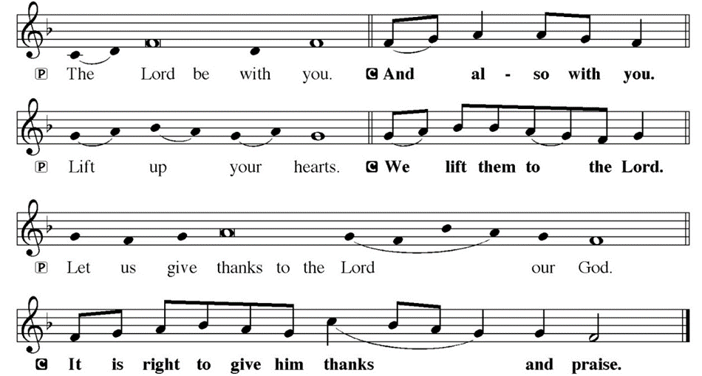
DIALOGUE

Slide 43
THE PREFACE
P: It is indeed right and salutary…
… we praise your name and join their unending hymn.

Slide 44
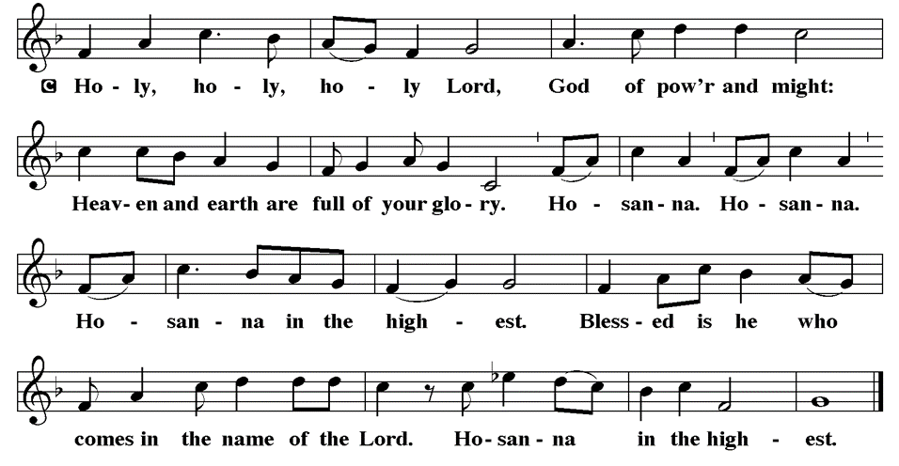
THE SANCTUS

Slide 45
EUCHARISTIC PRAYER
P: Holy God, our living Water…
…both now and forever.
C: Amen.

Slide 46
THE LORD’S PRAYER
C: Our Father, who art in heaven, hallowed be thy name, thy kingdom come, thy will be done, on earth as it is in heaven. Give us this day our daily bread; and forgive us our trespasses, as we forgive those who trespass against us; and lead us not into temptation, but deliver us from evil.

Slide 47
THE LORD’S PRAYER
C: For thine is the kingdom, and the power, and the glory, forever and ever. Amen.

Slide 48
INVITATION TO COMMUNION
P: Jesus invites you to the banquet, and pours out his holy presence upon you like costly ointment. Come share in the bread and wine and be strengthened for this journey of Holy Week. All is prepared.

Slide 49
COMMUNION DISTRIBUTION
All will commune “By Station”.
The bread may be broken for distribution. As the ministers give the bread and wine, they say these words :
The body of Christ, given for you.
The blood of Christ, shed for you.
The communicant may say: Amen.

Slide 50
POST COMMUNION BLESSING
P: May this body and blood of our Lord and Savior, Jesus Christ, strengthen, keep, and unity us, ☩ now and forever,
C: Amen.

Slide 51
POST COMMUNION CANTACLE

Slide 52
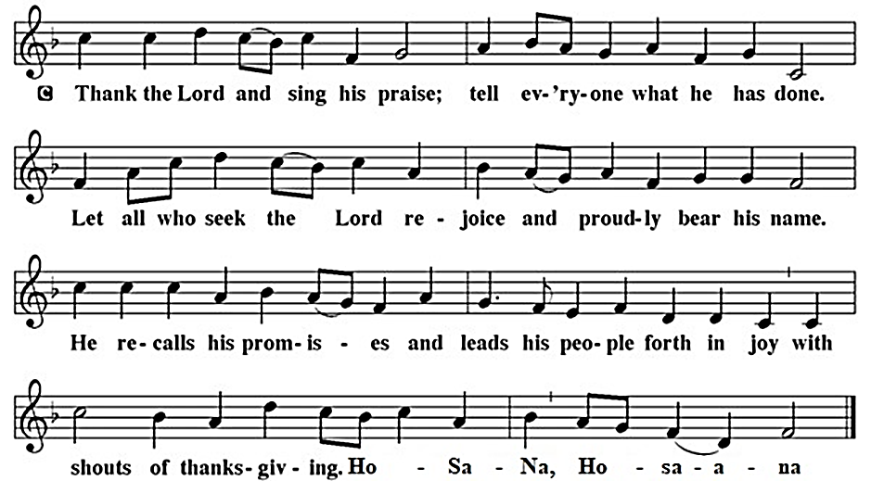
POST COMMUNION CANTACLE

Slide 53
POST COMMUNION PRAYER
P: Let us pray… Giver of every gift, Christ’s body is our food, and we are Christ’s body. Raise us to life by your power for the benefit of all and to your glory, now and forever.
C: Amen

Slide 54

ANNOUNCEMENTS
Notes:
Image: Five Loaves by Caroline Coolidge Brown. Copyright © Caroline Coolidge Brown. All rights reserved. Used by permission of the artist.

Slide 55
SENDING BLESSING
P: God who names you, Christ who claims you, and the Holy Spirit who dwells in you, bless you and remain with you always.
C: Amen.

Slide 56
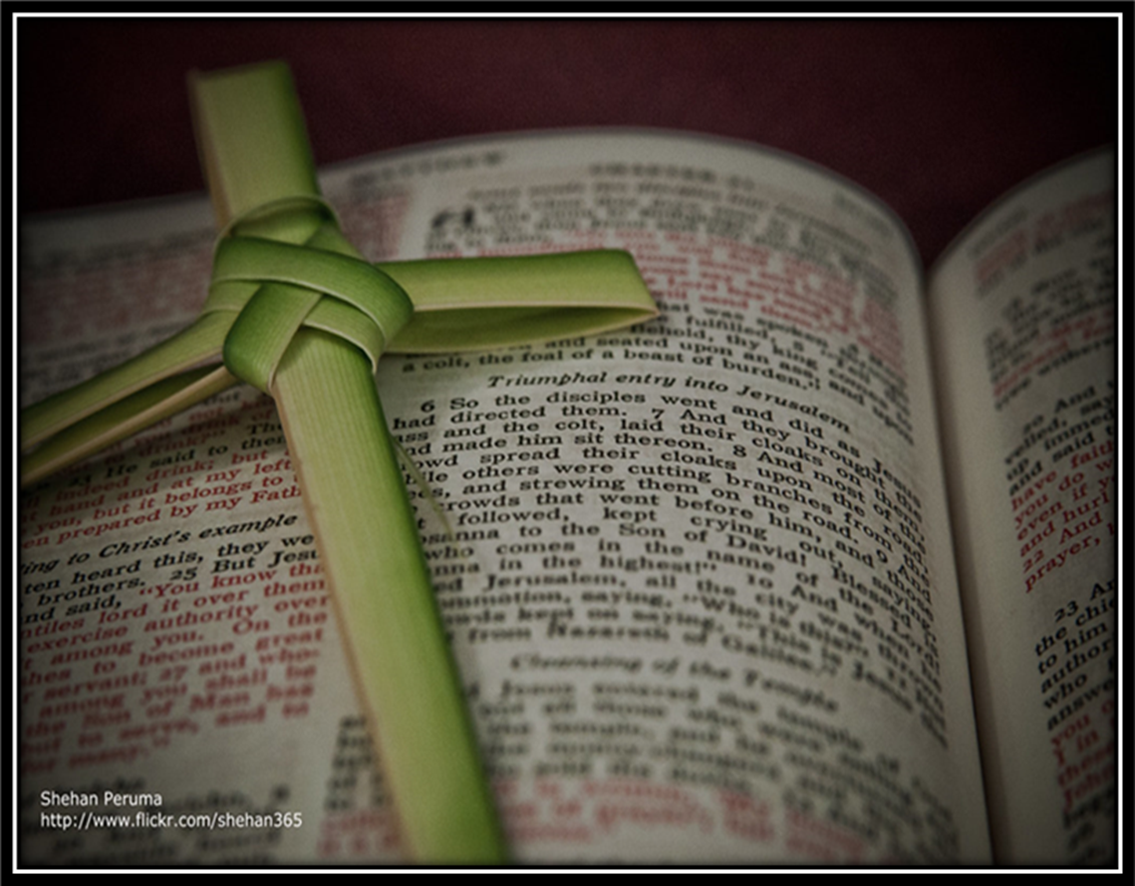
SENDING SONG
“In The Cross of Christ I Glory”
LBW 104
Notes:
Image: Five Loaves by Caroline Coolidge Brown. Copyright © Caroline Coolidge Brown. All rights reserved. Used by permission of the artist.

Slide 57
In The Cross LBW 104
1 In the cross of Christ I glory,
tow'ring o'er the wrecks of time.
All the light of sacred story
gathers round its head sublime.
2 When the woes of life o'ertake me,
hopes deceive, and fears annoy,
never shall the cross forsake me;
lo, it glows with peace and joy.

Slide 58
In The Cross LBW 104
3 When the sun of bliss is beaming
light and love upon my way,
from the cross the radiance streaming
adds more luster to the day.
4 Bane and blessing, pain and pleasure,
by the cross are sanctified;
peace is there that knows no measure,
joys that through all time abide.

Slide 59
In The Cross LBW 104
3 When the sun of bliss is beaming
light and love upon my way,
from the cross the radiance streaming
adds more luster to the day.
4 Bane and blessing, pain and pleasure,
by the cross are sanctified;
peace is there that knows no measure,
joys that through all time abide.

Slide 60
DISMISSAL
P: Until we gather again as God’s people to offer our worship and praise, depart in Christ’s Love,
C: Seeking, welcoming, and serving all. Amen!
Postlude by Pam Sherman
Copyright © 2024 Augsburg Fortress. All rights reserved. Reprinted by permission under Augsburg Fortress Liturgies Annual License #SAS023830. New Revised Standard Version Bible, Copyright © 1989, Division of Christian Education of the National Council of the Churches of Christ in the United States of America. Used by permission. All rights reserved. Revised Common Lectionary, Copyright © 1992 Consultation on Common Texts, admin Augsburg Fortress. Used by permission.

