Slide 1

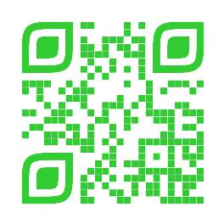
Announcements
Trinity Lutheran Church
February 2, 2025
Scan Me!

Slide 2

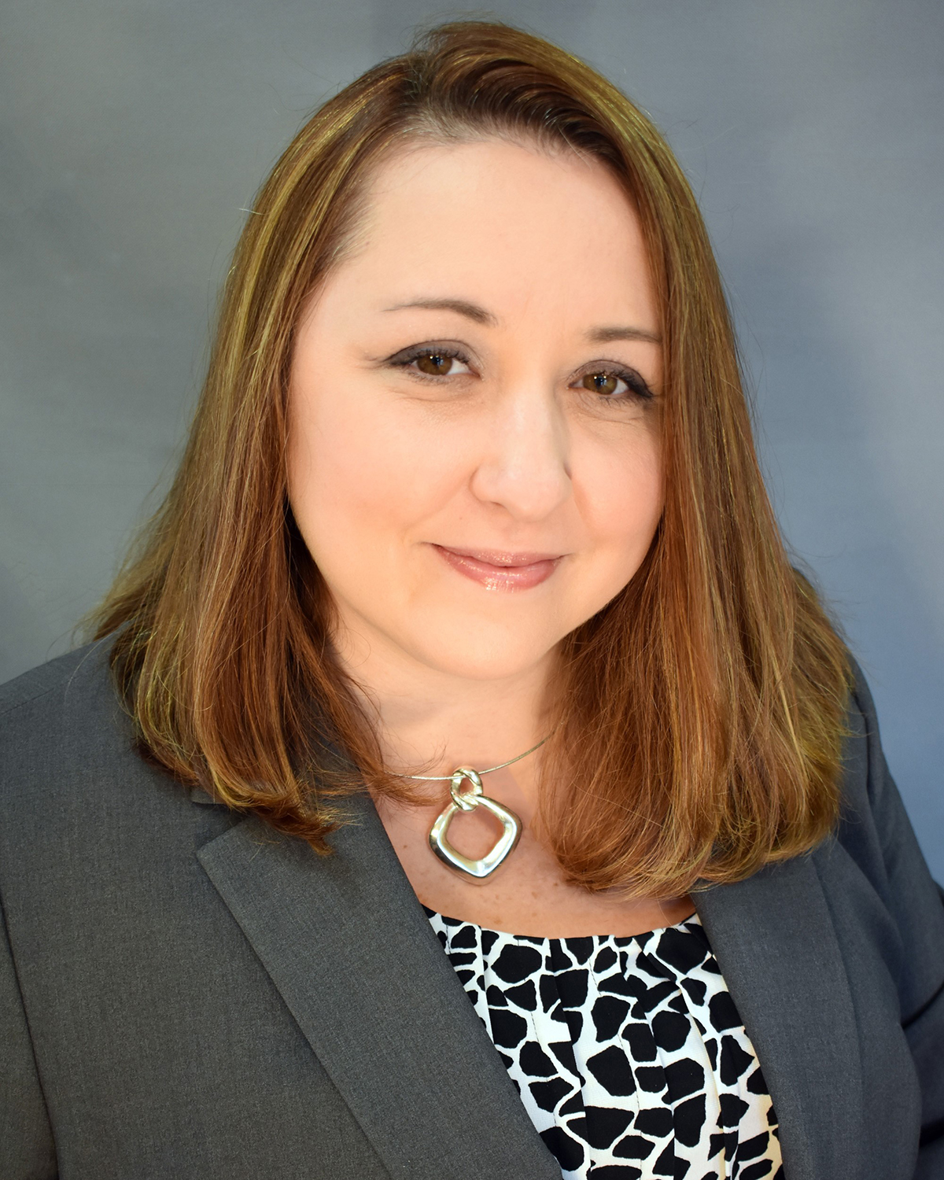


Andria Haworth, FIC
Financial Advisor

Slide 3

Body, Mind, Spirit
MIND: Watch a movie based on true events.
BODY: Try to balance on one foot- hold onto a chair for added support.
SPIRIT: Write 5 things you are thankful for in your gratitude journal.

Slide 4


Our Office Secretary Is Sharon Fourman
Church Office Schedule
Tues, Wed, Thurs – 8-11:30 am
Office Phone: (937) 692-5670
Pastor’s Phone: (937) 626-7100
Email: secretary@pitsburgtlc.org

Slide 5

The Trinity Trumpet
A Monthly Newsletter
Published by Trinity Lutheran Church,
Pitsburg, OH
We’re looking for stories and pictures of Trinity people in action!
Submit to Secretary, Sharon Fourman at secretary@pitsburgtlc.org
Articles and Info due on or about the 15th of each month

Slide 6

Trinity Trumpet
    Your Trinity Trumpet Newsletter for February is available!
    Please take your copy before you leave today!

Slide 7
Trinity Trumpet
    Newsletter Deadline is Tuesday, February 18, 2024
    Please turn in all your newsworthy items to Sharon Fourman at:
    secretary@pitsburgtlc.org

Slide 8

We’re Online!
www.pitsburgtlc.org
Sermons and announcements are posted weekly
Trinity Trumpet is Posted here too!
The ‘Official’ Trinity Calendar is available for you to see!
Pictures, Videos and more!
Also, like us on FaceBook at
facebook.com/pitsburgtrinitylutheran.church

Slide 9
We’re Online!
www.pitsburgtlc.org
We now have our own QR Code!
Scan this code with your Smartphone and you will connect to all our Online media (Facebook, YouTube, and our own Church Website)

Slide 10

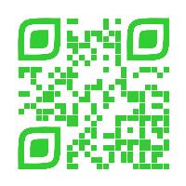
Online Giving
www.pitsburgtlc.org
Click the “Give to Trinity” Button
Stay current in your giving even when you can’t make it to Worship!
Separate Giving Categories for:
    General Treasury
    Benevolence/Mission Support
    Building Fund
    Annual Christmas Auction
    Memorial Funds
    Thrive Capital Campaign

Slide 11


Church
Council
Trinity Church Council
Next Regular Meeting
February 19, 2025
@ 7:00 pm

Slide 12


Trinity’s Team Meetings
Next Meeting
TBD
@ 6:00 pm
On the Agenda – Preparing the proposed 2023 budget

Slide 13
Please Pass the Pew Pads
(We now track Communion on the Pads)

Slide 14

Worship Team
Next Meeting:
  TBD

Slide 15

Mutual Ministry Team
  Julie Kossler
  VACANT
  Peggy Didier
  Please see one of them with your comments and suggestions
  Next Meeting - TBD

Slide 16


Choice FISH Pantry
Please join us every Friday @ 3:30 pm
400 Markwith Dr, Greenville OH
Most Needed Items
Kidney Beans
Canned Peas
Hamburger Helper
Pork & Beans
Canned Mixed Veggies
Large Cans of Soups
Applesauce
Boxed Meals
(i.e. Rice a Roni)

Slide 17
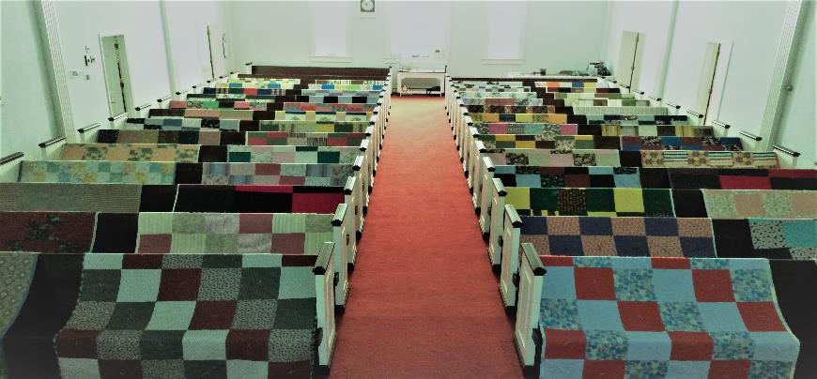
Prayers and Squares
Quilting Ministry
February 13 @ 10:00 am
February 25 @ 10:00 am

Slide 18

Next Meeting:
March 5, 2024
@ 11:30 am
Notes:
This Photo by Unknown Author is licensed under CC BY-NC

Slide 19

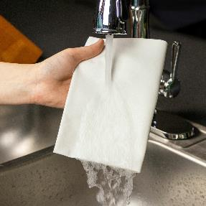
ULTIMATE CLEANING CLOTH SALE
1 for $7.00
2 for $10.00
5 for $20.00
See
  Portia Boord or Diane Warner

Slide 20


Ladies and Gents Luncheon
Date: February 20, 2025
Where: JT's Brew & Grill, 1475 Wagner Ave, Greenville,
For Reservations/Questions:
        See Linda Baker or call her @ 937 545-8410

Slide 21

Confirmation Program
    Sunday Class @ 9:00 am each week
    Weekly Worship attendance is required (In person or via FaceBook)
    Worship Notes may be emailed to pastor@pitsburgtlc.org or placed in Pr Mel’s mailbox outside the Church Office
    Confirmands are HIGHLY encouraged to take turns as Acolyte

Slide 22

    Who can be an Acolyte? YOU CAN!!!
    Ask Pr Mel about training opportunities
    Please sign up for Acolyte Duty on the chart by the Church Office!
    Confirmation Students are Highly Encouraged to perform Acolyte duty…
    Please sign up today!

Slide 23
New Member Class
We are forming a “New Member” Class for anyone who wants to learn more about Being Lutheran and what Being a member of Trinity entails
    Classes will begin January 8th
    Classes start at 12:00 Noon or as soon after Worship as possible
    Please see Pastor Mel if Interested in attending

Slide 24

    If you would like to sponsor the Altar Flowers, see PJ to Sign Up!

Slide 25

Next Meeting
March 13, 2025 @ 9:00 am
Purpose – Plan Spring Events!
Please come if you can!

Slide 26

Blood Pressure Screening
BP Screening
By Appointment
In The Nursery
Notes:
Cover: Sermon on the Mount by Laura James. Copyright © Laura James. All rights reserved. Used by permission of the artist.

Slide 27

Calling all Adults!
Join Us For “Christian Conversations”
Not Your Ordinary Adult Sunday School
Sharing – Discussion - Prayer
Every Sunday @
9:30 am
Notes:
Cover: Sermon on the Mount by Laura James. Copyright © Laura James. All rights reserved. Used by permission of the artist.

Slide 28

The Chosen
Video Discussion Group
February 9th Cancelled due to Super Bowl
Next Meeting: February 23
Notes:
Cover: Sermon on the Mount by Laura James. Copyright © Laura James. All rights reserved. Used by permission of the artist.

Slide 29

Trinity Troops
Date: February 16, 2025 -- After Worship
Where: Trinity Fellowship Hall
Who: Youth 4th – 6th Grades
What: Fun and Snacks!
Trinity Troops!

Slide 30

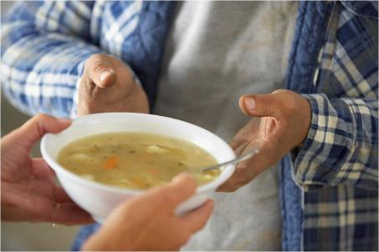
Grace Resurrection Community Center
Soup Kitchen Meal
When: Wednesday, March 19, 2025
10:00 am to 1:00 pm.
Where: 433 Water Street in Greenville

Slide 31
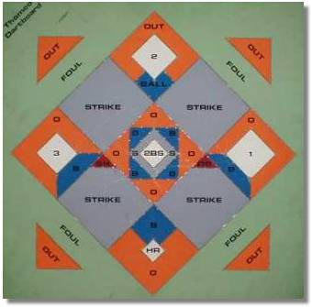


Thank you to all who participated this year!!!

Slide 32

Shrove or “Fat” Tuesday – Mar 4 @ 6 pm
Ash Wednesday Worship – Mar 5 @ 7 pm
Lenten Soup Suppers:
  March 12, 19, 26
  April 2, & 9
Maundy Thursday Worship – 7 pm, April 17
Good Friday Worship – 7 pm, April 18
Easter Services – 8 & 10:30 am, April 20
Notes:
Cover: Sermon on the Mount by Laura James. Copyright © Laura James. All rights reserved. Used by permission of the artist.

Slide 33

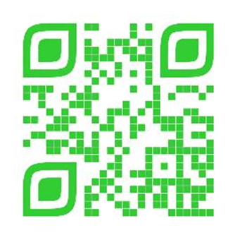
SOUPER BOWL SUNDAY!!!
Today!!!
Special Offering for Local Food Pantries
No Cash?
SCAN ME!
Donate through our Secure Website

Slide 34

February 9, 2025
Show your team colors!
Wear your favorite sports team jersey/tee-shirt, or other merch (as long as it’s orange and brown)

Slide 35
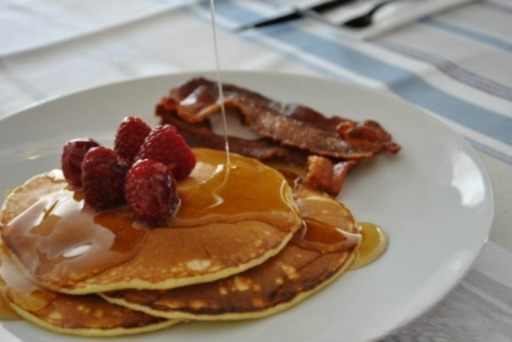


Shrove (Fat) Tuesday
                Wednesday, March 4th
                6:00 pm – 8:30 pm
                Pancake Supper!
                Make your own Mardi Gras Mask
                Join the Trivia Challenge!

Slide 36
Lenten Season Begins With Ash Wednesday
March 4th, 2025
At 7:00 pm

Slide 37
Lenten Soup Supper
Devotion
Wednesdays @ 6:30 pm
  March 12, 19, & 26
  April 2 & 9
Sign-Up for Soup, Bread, Salad, and desert on communications table
Video
and
Discussion

Slide 38

Maundy Thursday – April 17, 2025
  7 pm – Stripping of the Altar
Good Friday – April 18, 2025
  Worship Service @ 7 pm “A Service of Tenebrae” (Shadows)
Easter Morning – April 20, 2025
  8:00 am – Early Service
  9:15 am Easter Breakfast
  10:00 am Easter Egg Hunt
  10:30 am Late Service

Slide 39
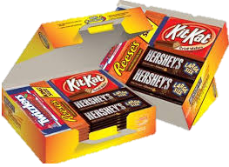
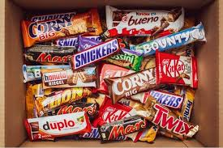
Trinity Youth
Fun (d) Raiser!
Candy Bar Sales!
Large Selection
$2 Each
Supports Our Youth
Notes:
Cover: Sermon on the Mount by Laura James. Copyright © Laura James. All rights reserved. Used by permission of the artist.

